Slide 1
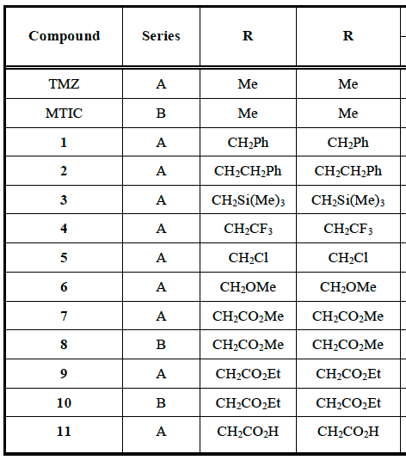
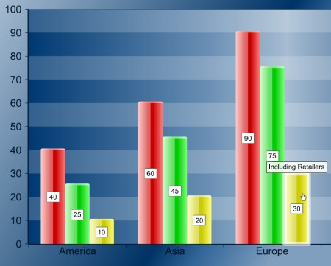
POSTER TITLE HERE
Student Name, (Titles), University of Arizona College of Medicine, Phoenix Authors names, titles, institutions
Abstract
Methods
The abstract should be one paragraph which summarizes the project. Limit to 500 words. Abstract should include: a) Research question; b) Background, significance, and rationale for the question; c) Methods; d) Results; and, e) Conclusions and Impact. Someone should be able to quickly read your abstract and understand what you did (Methods below), why you did it (Introduction below), what you found (Results below), and what it means (Conclusions and Impact below).
This section describes in detail what you did to address your research question. The methodological approach should be brief but provide enough information for someone to understand what you did to address the research question. It also provides a description of the study design and analytic methods. This section should include the number of subjects in the design, the rationale for using this number of subjects, the variables that were analyzed, and the statistical approach. This section should also include other methodology (e.g., recruiting/enrolling subjects; specific methods, manipulations, or procedures).
The length of each section and the number of figures and tables will vary for each project. Be brief with the text. Take figures, charts and tables directly from the thesis. Each poster should have clear and succinct abstract, introduction, results, and conclusions sections. All figures, charts, and tables need a titled caption that summarizes the information.
You should consult heavily with your mentor on poster construction. Kristen Wagner (krwagner@email.arizona.edu or Sunny Belous in Media Services (602) 827-2042 - belous@u.arizona.edu) can help with formatting. Please remember - presenting your SP project in poster format at the March research symposium is a course requirement.
Figure 3: All figures, charts, and tables should include a caption which summarizes the information. We recommend italics for the captions.
Introduction
This section should be brief. It should clearly state the research question and the significance and rationale for asking the question. This section should provide enough information to let a faculty member in a clinical or basic science department easily understand and review the project. The introduction is based on the background literature which identifies knowledge gaps. Your research question should target one or more of these gaps. After reading this short introduction section, the project’s stated question, impact, significance, and rationale should be crystal clear to the reader.
Results: Experiment 2
In the poster, Tables and Figures are much more prominent than text, since you will be at the poster to discuss findings with visitors. Include both negative and positive results. Results are often clearer if you subdivide results into logical segments with clear headings.
Discussion and Conclusions
Results: Experiment 1
This section provides a summary of the major findings of your project. It makes clear the originality, impact, strengths and weaknesses of the work.
Please feel free to contact the SP office for any advice or questions. We are happy to help.
The results section describes research observations using narrative, tables, graphs and statistics in enough detail that readers can interpret them independently.
Acknowledgements
I wish to thank my mentor Dr. Sally Smith and her collaborator Dr. Mary Jones. I would also like to thank Dr. Mike Sommers for contributing the antibodies.
Figure 1: All figures, charts, and tables should include a caption which summarizes the information. We recommend italics for the captions.
Figure 2: All figures, charts, and tables should include a titled caption which summarizes the information. We recommend italics for the captions.
Table 1: All figures, charts, and tables should include a caption which summarizes the information. We recommend italics for the captions.
Notes:
Please use font size 28 pt or higher for text in your poster. The text boxes can be resized, but are 8.8” wide and have a 0.25” margin on all sides. Table and figure captions are 7.5” wide. Section headings are 1” tall and 9” wide and center justified.

