Slide 1
University of Arizona College of Medicine phoenix Med Peds Program

Slide 2
Med Peds Program Director Overview

Slide 3
Leadership team

Slide 4
Associate program directors
Heather bartz, do
Jennifer nelson, do

Slide 5
Med Peds faculty

Slide 6
Program Directors for Categorical programs
Donna Holland, md
Internal medicine
Jon mcgreevy, md
pediatrics

Slide 7
Program Highlights

Slide 8
Banner University Medical Center of Phoenix
712 beds
Quaternary care center
Highly specialized care of patients from all over Arizona

Slide 9
Phoenix Children’s HOspital
6th largest Children’s Hospital in the US
433 beds

Slide 10
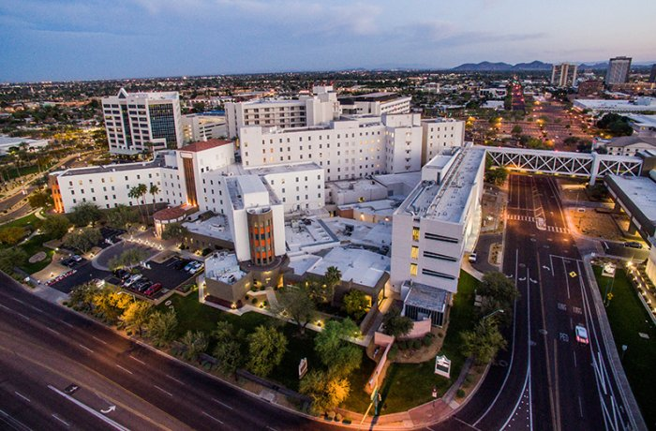
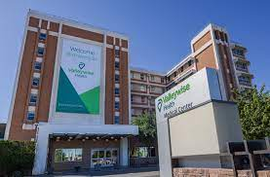
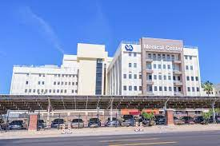
Additional sites
St. Joseph’s Hospital
Valleywise Medical Center
VA Medical Center

Slide 11
Our Program
University based with strong community roots
24 residents
Switch every 4 months between Internal Medicine & Pediatrics
Internship is 16 months (8 months Peds, 8 months IM)
Continuity Clinic Experiences
Community based (local, rural)
Hospital based – ½ day per week alternating between IM and Peds clinics

Slide 12
Diversity & inclusion
We strive to recruit a diverse class of residents and foster a culture of inclusive excellence.
Initiatives in place:
Social Injustice Awareness Book & Movie Club
Implicit Bias/Social Determinants of Health Curriculum
Conversations on race
Justice Equity Diversity & Inclusion (JEDI) IM Elective – focus on advocacy
URM mentorship with faculty
Pediatric funded rotation for 4th year URM students

Slide 13
Internal medicine
GME PIE Programs
Leadership, Personal Best Coaching, Resident as Teacher, Health Disparities
POCUS Curriculum
Research mentorship and advanced rotations to promote scholarly activity
QI curriculum in ambulatory clinic
Fellowship mentoring panels
Awesome Board Review 6 day prep course with protected time to attend during 4th year
Quality & Safety monthly conferences
High Value Care Contests
Social justice curriculum & advocacy
Retreats for interns, PGY-2 & PGY-3/4 years

Slide 14
Pediatrics
Global Health & Advocacy Tracks
Homeless Youth Outreach program/mobile health clinics
QI curriculum built into continuity clinic
Rural community rotations
Fellowship mentoring program
Dedicated board review for PGY-3/PGY-4 residents
X+Y Schedule (3+1)

Slide 15
New additions to our program
CLINICAL REASONING CURRICULUM FOR INTERNS
MONTHLY MED PEDS CURRICULUM
WEEKLY AMBULATORY CURRICULUM
EXPANDED RURAL HEALTH ROTATIONS

Slide 16
didactics
IM
Peds
Protected learning time Tuesday mornings
Educational Scholars
Monthly themes
Articles/objective available online
Incorporates board questions/audience response
Harvard PEAK ambulatory modules
Protected learning on Thursday mornings
Follows a curriculum over 18 months
Maintenance of education questions
Board review incorporated separately at the end of 3rd/4th years
Yale Ambulatory Curriculum

Slide 17
fellowships
IM
Peds
Cardiology – Interventional, Advanced Heart Failure & EP
GI/Advanced Endoscopy
Neurology
Sleep Medicine
Endocrinology
Clinical informatics
Geriatrics and Geriatrics Psychiatry
Sports Medicine
Toxicology
Pulmonary Critical Care
Palliative Medicine
Transplant Hepatology
Hospital Medicine
Cardiology
Emergency Medicine
Hematology/Oncology
Palliative Medicine
Neurology
Adolescent Gynecology
Pulmonary Critical Care/CVICU
Dermatology
Radiology
Neonatology
Hospitalist Medicine
Surgery

Slide 18
Salaries for 2022-2023
PGY-1 $60,302
PGY-2 $62,864
PGY-3 $66,143
PGY-4 $68,807

Slide 19
Personal wellness
IM
PEDS
Wellness center at BUMCP
On-site Psychologist at BUMCP for housestaff
Exercise equipment 24/7
Peleton bike/Treadmill
EAP individual counselling/Telehealth options
Wellness Coordinator
Wellness committee activities
Cultivating Happiness in Medicine activities
Wellness center at PCH
On-site Psychologist at PCH for housestaff
Exercise equipment 24/7
Wellness Coordinator
EAP individual counselling
Wellness committee activities

Slide 20
Living in arizona
Valley of the Sun
Hiking year round
Easy to bike to work
Great running paths/parks
Cost of living – very reasonable
Easy hub to fly in and out of Phoenix
Great public/private schools, universities

Slide 21
Professional sports

Slide 22
Things to do in arizona
Desert Botanical Gardens
Camelback Mountain

Slide 23
Exploring arizona
Zoo
Musical Instrument Museum

Slide 24
Outside of Phoenix
Havasu Falls
Grand Canyon

Slide 25
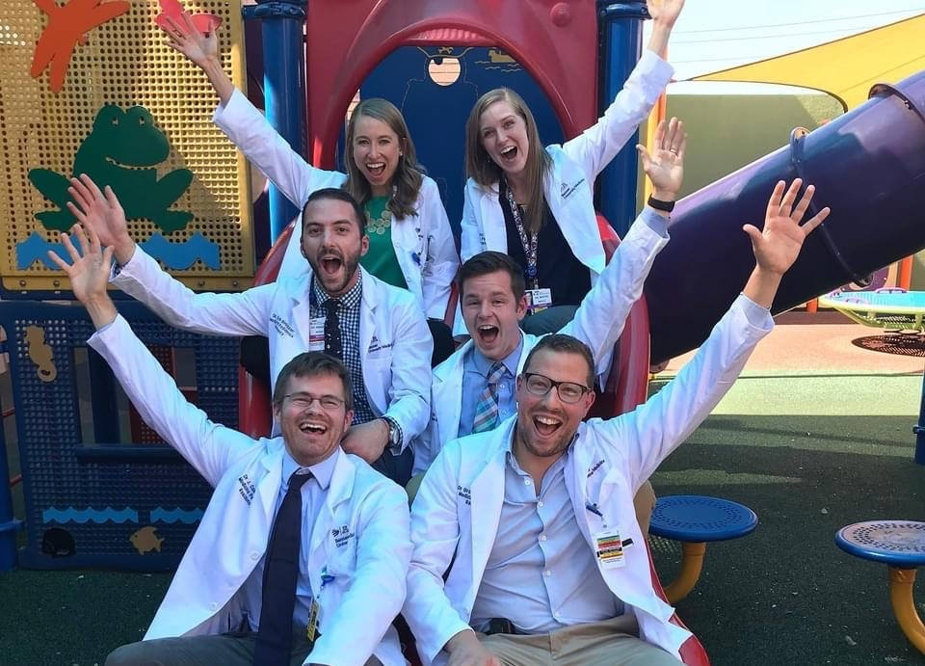
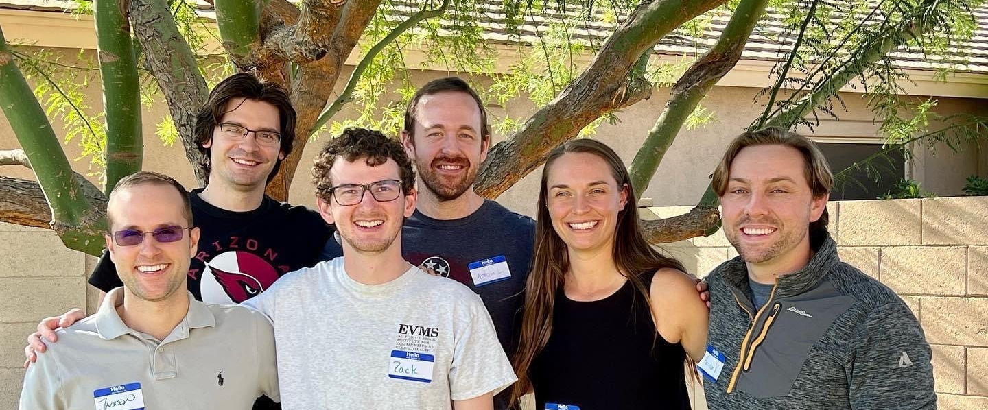
Fun times ahead

Slide 26
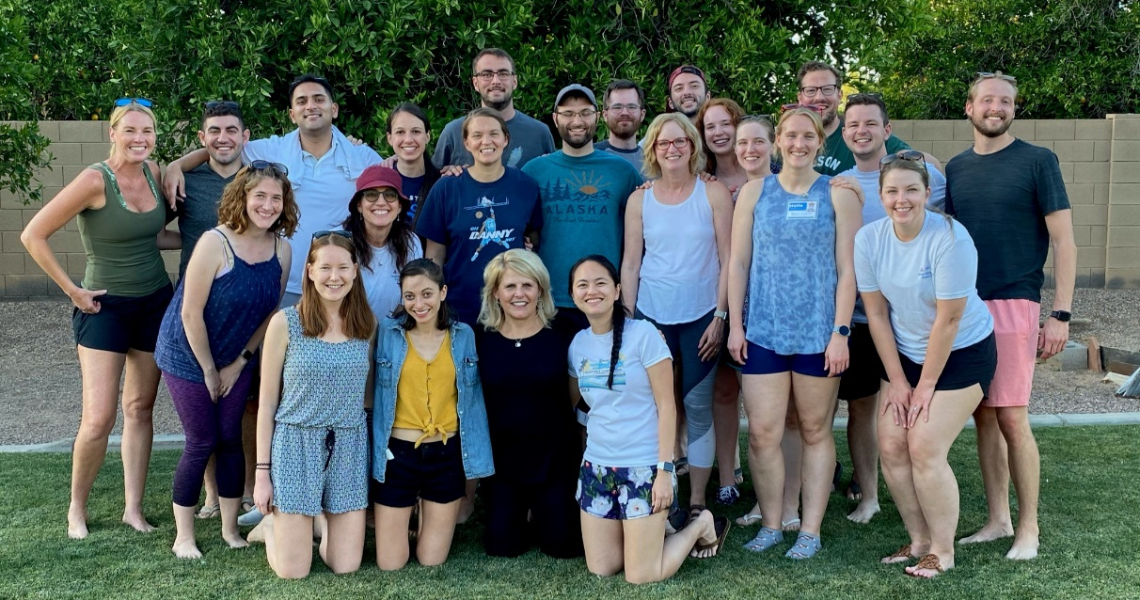
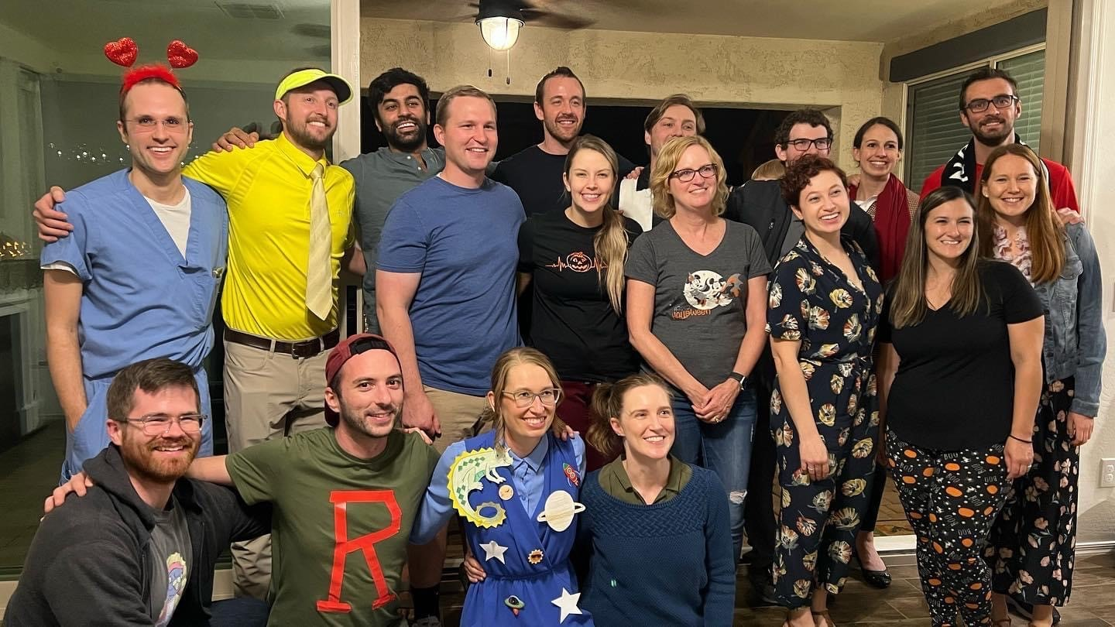
Fun times ahead

