Slide 1
Please turn on your speakers and follow along with Dr. Kaib as she presents this 5 minute presentation regarding the student policy and procedures to student exposure to potentially infectious agents and/or hazardous materials.
Press “Enter” on your keyboard to continue.
Thank you

Slide 2

Student Exposure to Potentially Infectious Agents and/or Hazardous Materials Policy and Procedures
FOR STUDENTS, FACULTY OF THE COLLEGE OF MEDICINE - PHOENIX

Slide 3
Contributing Faculty & Staff
Jonathan J. Snyder, MBA
Program Coordinator, Faculty Development
Susan Kaib, MD
Career and Professional Advisor, Student Affairs

Slide 4
The Student Exposure to Potentially Infectious Agents and/or Hazardous Materials Policy applies to:
  UA COM-P students currently enrolled
  Any non UA COM-P students on an approved clinical rotation as a visiting student at the college

Slide 5
The policy applies to students who are exposed while participating in a University-sponsored program including:
  Clinical rotations
  Community health initiative-Phoenix programs
  Any other official, curriculum-related programs as defined by the COM-P

Slide 6

What is an exposure?
  Needle stick, inhalation, mucus membrane or skin exposure or percutaneously to infectious agents and/or hazardous materials including blood/body fluids
  Exposure to secretions of a COVID patient, or any exposure to a potential COVID case without proper PPE
  All exposures require prompt medical attention
Notes:
(Note: insert various images or 1-3 second clips of various types of exposures – needle stick, blood splash, etc.)

Slide 7

Any student exposed should immediately report to the site’s Occupational Health, Urgent Care or Emergency Room for:
  Medical assessment and evaluation
  Baseline and follow-up laboratory values, and imaging (as needed)
  Prophylactic drug treatment (as needed)
  Counseling

Slide 8
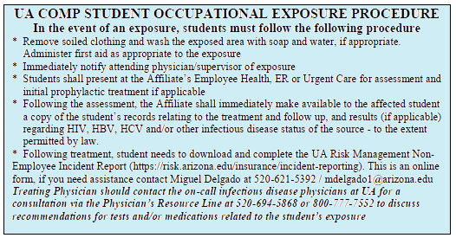
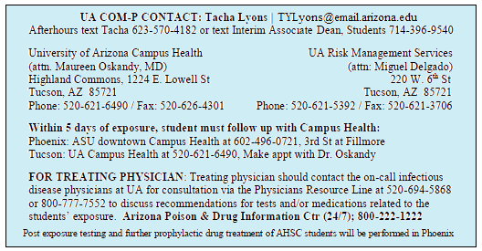
All UA COM-P students and officially approved visiting students should be in possession of a blue Student Occupational Exposure Procedure Card
Card should be carried at all times while participating in University-sponsored programs
Replacement cards can be obtained in Student Affairs in HSEB 5th floor- C wing.
Card outlines procedures which must be followed when an exposure occurs
Notes:
(Note: zoom in on image of blue card (front and back). Image of blue card within their clipon or lanyard ID badge pocket).

Slide 9
When ANY exposure occurs, no matter how seemingly insignificant, the following procedures MUST be followed by attending physicians and students who have been exposed

Slide 10

In the event of an exposure, students must follow the following procedures:
  When applicable, remove soiled clothing and wash the exposed area with soap and water. Administer first aid as appropriate to the exposure.
Notes:
(NOTE: brief clip of tossing blood soaked scrubs shirt, and hand/arm washing)

Slide 11

  2) Immediately notify the attending physician, resident, or site coordinator. Share with them the instructions on your double-sided blue Student Occupational Exposure Procedure Card.
Notes:
(NOTE: image or brief clip of student talking to attending physician)

Slide 12
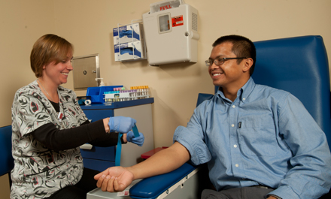
  3) Present at the affiliate’s employee health, ER, or Urgent care (per affiliate’s policy) to document the incident and to receive prompt medical attention including:
    Medical assessment and evaluation
    Baseline and follow-up laboratory values, and imaging (as needed)
    Prophylactic drug treatment (as needed)
    Counseling
Notes:
(NOTE: image of someone at desk, talking with student and documenting the incident)
(NOTE: image of someone preparing to draw blood from student)

Slide 13

4) Following the assessment, the Affiliate shall immediately make available to the affected student a copy of all records related to student’s exposure including:
Results (if applicable) regarding HIV, HBV, HCV and/or other infectious disease status of the source – to the extent permitted by the law.
Treatment
Follow-up
Notes:
(Note: image of nurse or doctor handing file to student)

Slide 14


5. Within 5 days of any exposure, student must also follow up with Campus Health in Tucson or Phoenix.
UA COM-P students should contact ASU Downtown Campus Health at 602-496-0721, located at 5th and Fillmore Streets near the Phoenix Biomedical Campus.
Notes:
(NOTE: Image of calendar with 5 days sequentially highlighted)

Slide 15

Treating physician/provider should contact the on-call infectious disease physicians at the University of Arizona for consultation to discuss recommendations for tests and/or medications related to the student’s exposure.
Physician’s Resource Line:
520-694-5868 or 800-777-7552
Notes:
(NOTE: Image of doctor on the phone)

Slide 16
UArizona Reporting Requirements
ALL occupational exposures:
Students must complete the UA Risk Management Non-Employee Incident Report at https://risk.arizona.edu/insurance/incident-reporting
This is an online form, if you need assistance contact Miguel Delgado at 520-621-5392 / mdelgado1@arizona.edu.
Instructions are also on the blue Student Occupational Exposure Procedure Card

Slide 17
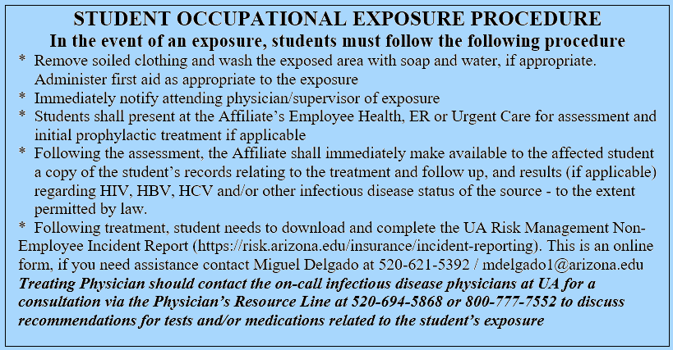
Notes:
(Note: Zoom in on printed copy of incident report form)
(Note: image of blue card with URL highlighted so students see where on the card the URL is located)

Slide 18


These procedures facilitate the required action of clinical affiliates based upon the most recent guidelines from the Centers for Disease Control and are consistent with the Occupational Safety and Health Administration standards.
Notes:
(NOTE: Images of CDC and OSHA logos)

Slide 19
After any exposure, affiliates and their staffs must ensure that any required assessment and treatment will occur within the appropriate timeline.
Affiliates must, to the extent permitted by law, make available to the student, a copy of all records such treatment and follow-up, including pertinent health status of the source (HIV, HBV and HCV status for blood-borne; pandemic flu, COVID-19, TB, SARS, Ebola, etc. if airborne).
Finally, the affiliate must provide copies of all incident reports documenting the circumstances of the exposure to the University of Arizona Risk Management Services in Tucson.

Slide 20
For more information or a full copy of the policy and procedures as well as related links and contact information, please visit
http://phoenixmed.arizona.edu/policy/student-exposure-blood-and-body-fluids-policy
Notes:
Screenshot of policy online

Slide 21
Questions about Process?
If there are any questions during this process, students, faculty or staff should call one of the below for immediate help:
Credentialing Coordinator, COMP: 602-827-2810
Director of Student Services, COMP 602-827-2342
Assoc. Dean, Student Affairs, COMP: 602-827-2308
Student Affairs, COMP: (front desk) 602- 827-2002

Slide 22
Thank you for completing the Student Occupational Exposure Policy and Procedure Training Module.
If you have any further questions, please contact Tacha Lyons, Credentialing Coordinator, at 602-827-2810 or tylyons@arizona.edu

