Slide 1




Let’s Talk Research
Basic Questions for Planning Great Projects
Janet Foote, PhD, Associate Professor,
Public Health Practice, Policy & Translational Research
Epidemiology & Biostatistics

Slide 2

Research: methodically asking & answering questions
Evaluation: systematic assessment / determination
Notes:
In general, Research is completed to further understanding, contribute to what is known about a disease or illness. Evaluation is more commonly used to make informed decisions, typically assisting those that have a stake in potential improvement. Evaluation can be considered performance or quality improvement. There is definite overlap in which Research can be an evaluative approach or quality assessment project.

Slide 3
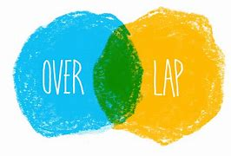
Research vs Evaluation
maybe
IRB /Human Subjects Review
Notes:
There is definite overlap in which Research can be an evaluative approach or quality assessment project.
Why am I pointing out a potential difference between Research and Evaluation? Research definitely needs IRB approval, although some studies may be considered exempt or receive accelerated approval because of use of publically-available or non-identifiable data.
Evaluation may or may not need IRB approval. If an examination is undertaken as a quality improvement project, improving quality or standard of care, or for educational objectives, it may not require IRB submission.

Slide 4
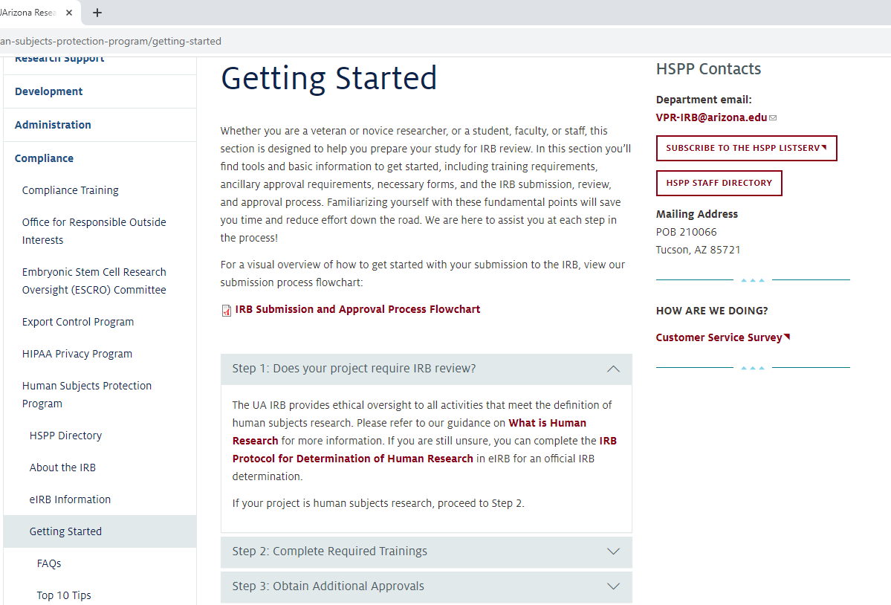
Research – UAHS Research Resource Contacts
regulatory@email.Arizona.edu
Notes:
The Human Subjects Protection Program provides materials to help you Determine if your study falls into the category of Research. Their staff, including the regulatory folks on our campus are there to help.

Slide 5
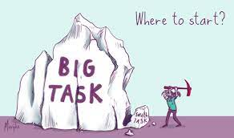
Research….
Notes:
Where do we start our discussion of research/

Slide 6

Question 1:
What is your overall question?
Notes:
Well, first we need an overall question…
Yes, this is a given, but also can lead to a lot of blank stares. How does one know what question to ask or what area to pursue?

Slide 7



Passion
See something of interest
Doubt the paradigm
Notes:
What areas really catch your interests? With what group do you like working? (i.e. kids, seniors, youth, pregnant women, post-partum new moms, 7th graders, specific types of health care providers – whatever. Identify who you like working with or helping as your target population. Identify your passion – who you like working with – what types of projects spark your interest? Is it general knowledge, specific procedures, adverse effects that should not happen?
See something of interest – it is often the everyday settings that lead to valuable projects. You learned that 20% of those with a specific occurrence have a certain outcome. For example, 20% that have a C-section develop a skin infection. You may want to take a step-by-step approach to figure out what is leading to that skin infection – or see if all the infections are the same type – or are some settings generating more infections than others, or some topical antibiotics associated with more of the skin infections or others, or does it make a difference if it is a schedule or unscheduled c-section – or maybe just determine if that rate of infection is consistent across all of the Banner Medical Centers..
Or – you may challenge the paradigm. You were told in your training that 20% of women who have a c-section get an infection, but it appears only 10% of the patients you see experience a skin infection. Standards change and frequency rates should be periodically assessed to determine if what is believed to be happening is still true. Standards of care change because there are new approaches, techniques, drugs, environments that can alter outcomes.
I have colleagues in Tucson that published findings that although there is a standard approach for assessing Helicobacter pylori, most gastroenterologists surveyed in the US did not use that approach, and also did not have a good understanding about the importance of assessing past anti-biotic use and prescribing appropriate anti-biotics as Helicobacter pylori has been shown to be quite resistant to specific types of anti-microbials.
Another group here has shown that although the method being used by nurses in the in-patient setting for assessing dementia is a validated method, how it is being used in the hospital setting is not identifying the cases of dementia that are documented during physician-based assessments. With this finding, the group has proposed a chart-based system that would identify those patients that should receive a more specific test to determine if dementia is present. These are all coming from everyday experiences in which someone noticed that what he/she/they are seeing does not appear to be consistent with what was learned.
One of our local physicians developed a study to determine if physicians knew the costs of general pieces of equipment used or considered alternatives to reduce health care costs.
Don’t be afraid to question; you may be able to show something different, new, or make something better…

Slide 8


Question 2:
What has been done in the field?
Complete background research.
Map it out
What gap can you fill?
What is the next step?
Notes:
Once you have your basic question or area of interest, learn all you can about it. This literature review step typically adds questions and will refine your primary question.

Slide 9
Question 3:
What is your Research Question?
Primary hypothesis needs to be test-able.
Notes:
Once you identified the area or need – and completed the background literature search – you can work on your primary research question, or hypothesis. This primary hypothesis needs to be “test-able.”
So what does “test-able” mean?

Slide 10
Hypothesis:
Assumption or ‘educated guess’ about the relationship between two or more variables. In other words, a tentative statement about the interaction between factors of interest.

Slide 11
A hypothesis is an ‘educated idea’ about how things will work.
There is a set way one to state the hypothesis.
Independent variable
If _________(I do this), then _________(this)________ will happen.
Dependent variable

Slide 12
Independent variable
If _________(I do this), then _________(this)________ will happen.
Dependent variable
Ex: If I test the blood sugar of 100 adults, more than 20% will be at risk* for diabetes.
If I add methyltrexate to HL1 cancer cells, the cells will stop multiplying, so the cancer cannot progress.
The hypothesis should be measureable, and do able.
* Risk is defined as…….

Slide 13

The hypothesis should be measureable, and do able.
Notes:
In other words, you want to be able to prove – or disprove – your hypothesis.

Slide 14
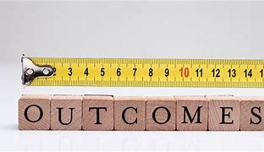
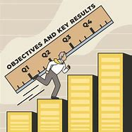

Slide 15

Not research questions!
What are the effects……..?
Does X lead to …….?
Is there an association…….?
But fishing expeditions…..

Slide 16

Once you have your primary question, you can start to build your project.

Slide 17

Question 4:
What are your specific aims?
Two or three specific, focused endpoints that will underpin / support your hypothesis.
What do you need to know / show to get you to your goal?

Slide 18
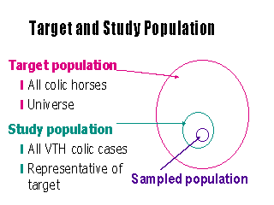
Question 5:
Who / what is your sample population?
How are you going to acquire that group?

Slide 19
Study Design
Question 6:
How do you think you will approach testing your Research Question?

Slide 20
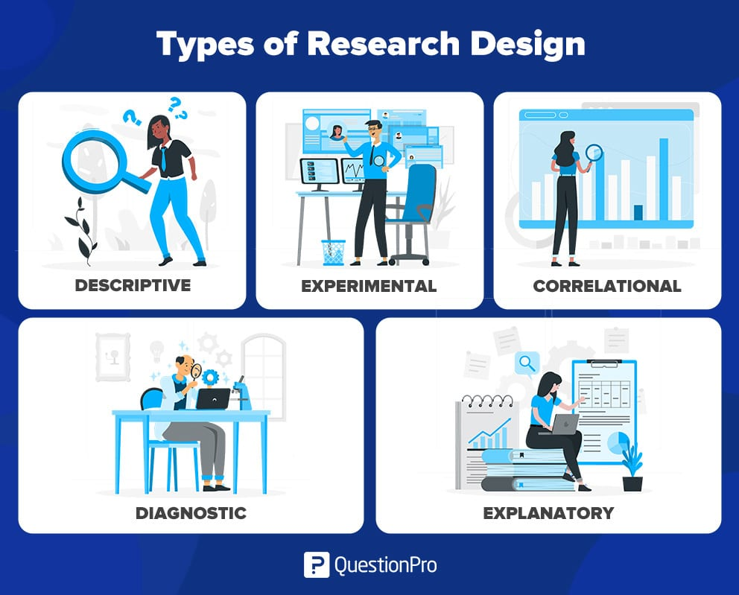
Study Designs

Slide 21
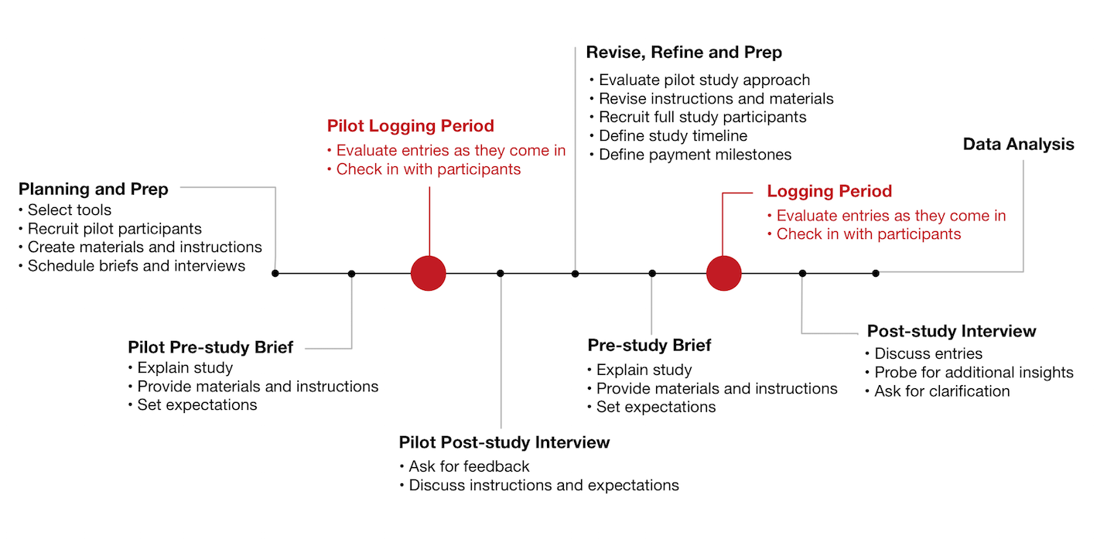
Study approach
Notes:
Draft out a figure of your study approach. Include a time line. What do you need; is it do-able?

Slide 22
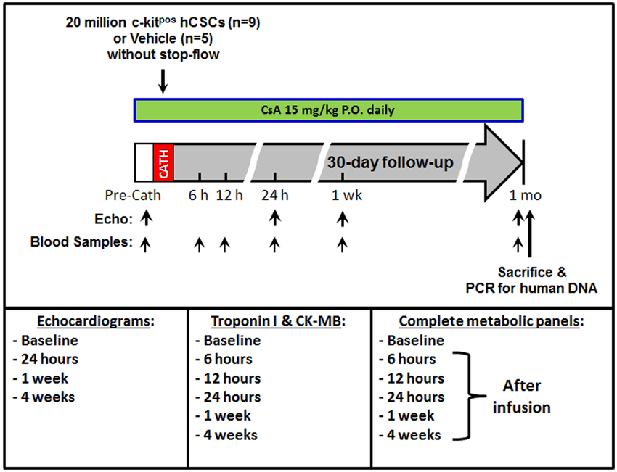
Study approach
Notes:
Draft out a figure of your study approach. Include a time line. What do you need; is it do-able?

Slide 23
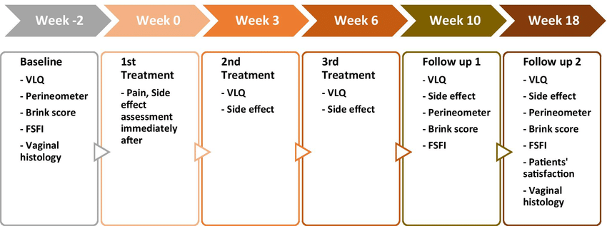
Study approach
Notes:
Draft out a figure of your study approach. Include a time line. What do you need; is it do-able?

Slide 24
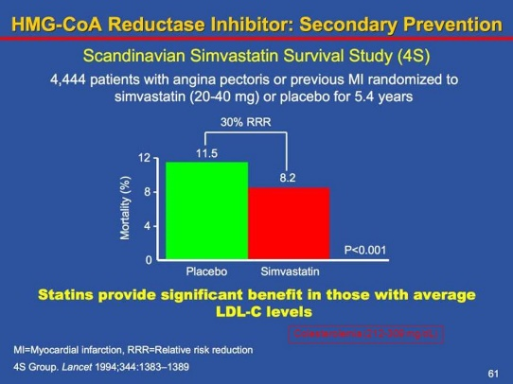
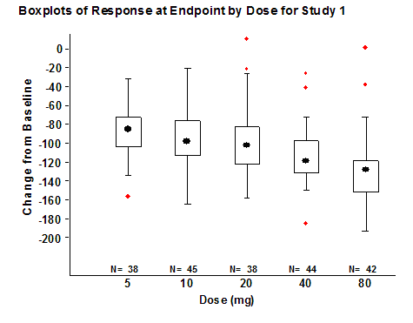
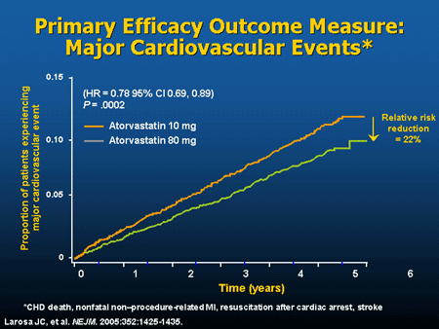
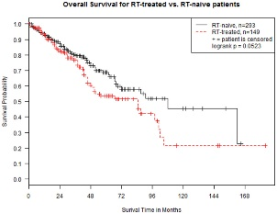
What is your primary outcome measure?
Notes:
Now we are starting to get to the point at which you need start consulting with others – including your biostatistician group.

Slide 25

What type of data is your primary outcome?
Notes:
…and this is where the eyes start to glaze over. What do you mean by “type” of data?

Slide 26
Data Types
Categorical
Quantity
Nominal
Ordinal
Binary
Discrete or continuous data.
Interval or ratio variables
Qualitative
Quantitative
Characteristics of data
Notes:
I will briefly review each of these types.

Slide 27
Categorical Data
The objects being studied are grouped into categories.
Categories are usually based on a qualitative trait.
These data are merely labels or categories.
May or may not have any underlying order.

Slide 28
Examples:
Nominal Data
Categorical data in which objects fall into unordered categories.
Type of Bicycle
  Mountain bike, road bike, chopper, folding, BMX.
Ethnicity
  Asian, Pacific Islander, African American, Caucasian, Latinx, Native American
  Smoking status
  smoker, non-smoker, former smoker

Slide 29
Ordinal Data
Categorical data in which order is important.
Highest Education level – elementary, high school, college graduate
Degree of illness- none, mild, moderate, acute, chronic.
Opinion of students about stats classes-
  Very unhappy, unhappy, neutral, happy, ecstatic!

Slide 30
Binary Data
Special type of categorical data in which there are only two categories.
Binary data can either be nominal or ordinal.
Answer: true, false
Current smoking status: smoker, non-smoker
Attendance: present, absent
Class mark: pass, fail.
Status of student: undergraduate, postgraduate.

Slide 31
Quantity or Quantitative Data
Whatever is under study is being ‘measured’ based on some quantitative trait.
Data are set of numbers.
Examples
Pulse rate
Height
Age
Exam marks
Size of bicycle frame
Time to complete a statistics test
Number of cigarettes smoked

Slide 32
Discrete Data
Quantity data can be classified as
Discrete or Continuous
Only certain values are possible (there are gaps between the possible values). Implies counting.
Continuous Data
Theoretically, with a fine enough measuring device, no gaps.

Slide 33
Discrete data -- Gaps between possible values- count
0 1 2 3 4 5 6 7
Continuous data -- Theoretically,
no gaps between possible values- measure
0 1000

Slide 34
Why is this Important?
The type of data collected in a study determines the type of statistical analysis used.

Slide 35
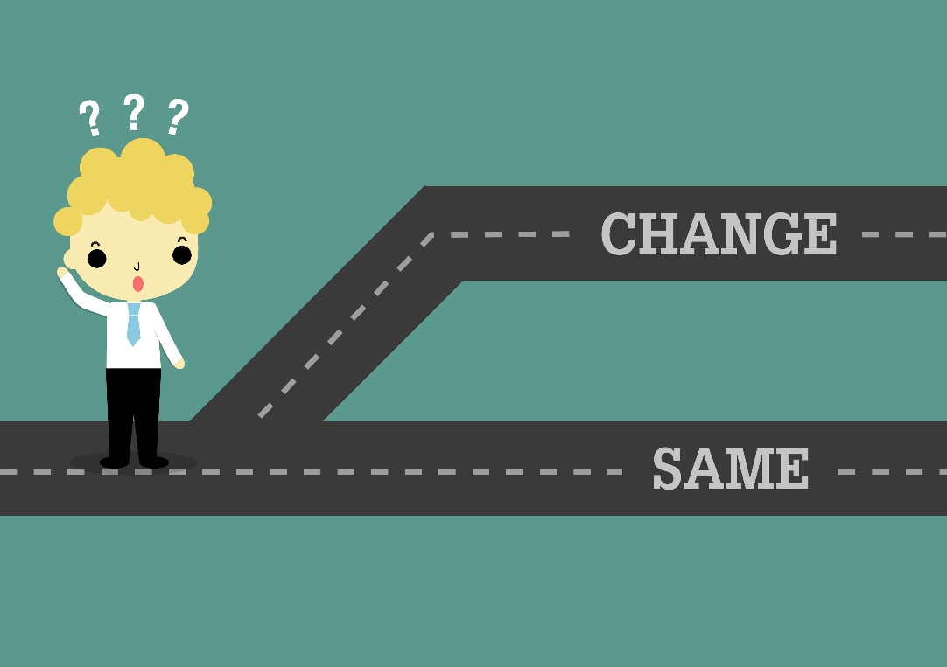
How much change is important?
Notes:
This is a big question. If you are seeking “improvement” - what interval of change is significant enough to be considered “improvement”? If the status quo has changed, how much “change” is needed to truly determine that it has changed.

Slide 36
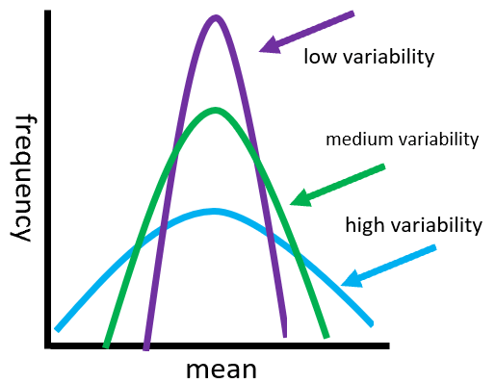
How much variability do you expect in your outcome measure?

Slide 37
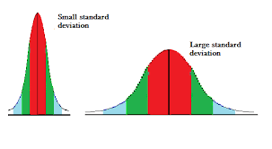
Ease of showing/seeing change is influenced by variability.

Slide 38
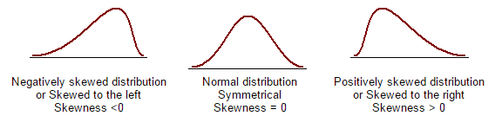
Is your outcome measure normally distributed?

Slide 39

What bio-statistician do I know that can help me…..?

Slide 40

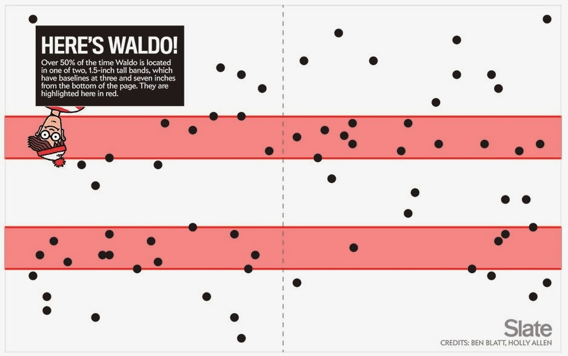
Finding your Biostatistician…..
Where’s Waldo?

Slide 41
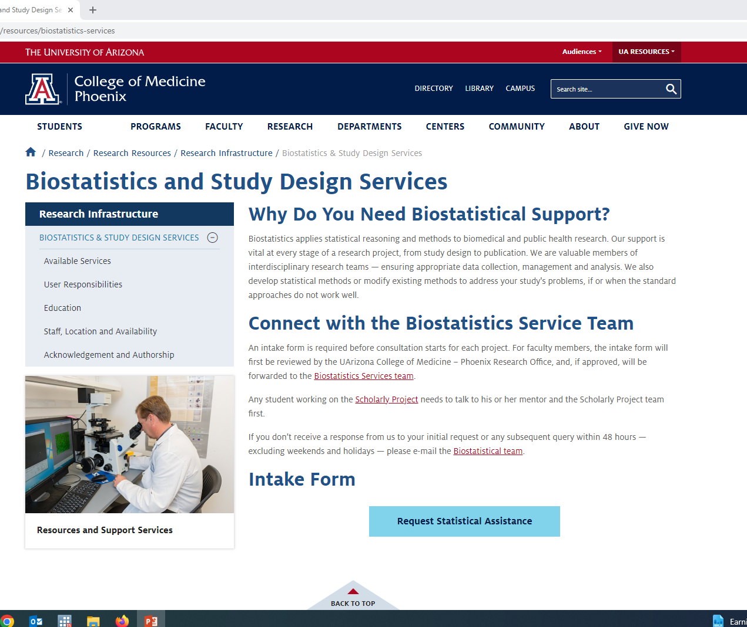

Here’s Waldo…

Slide 42
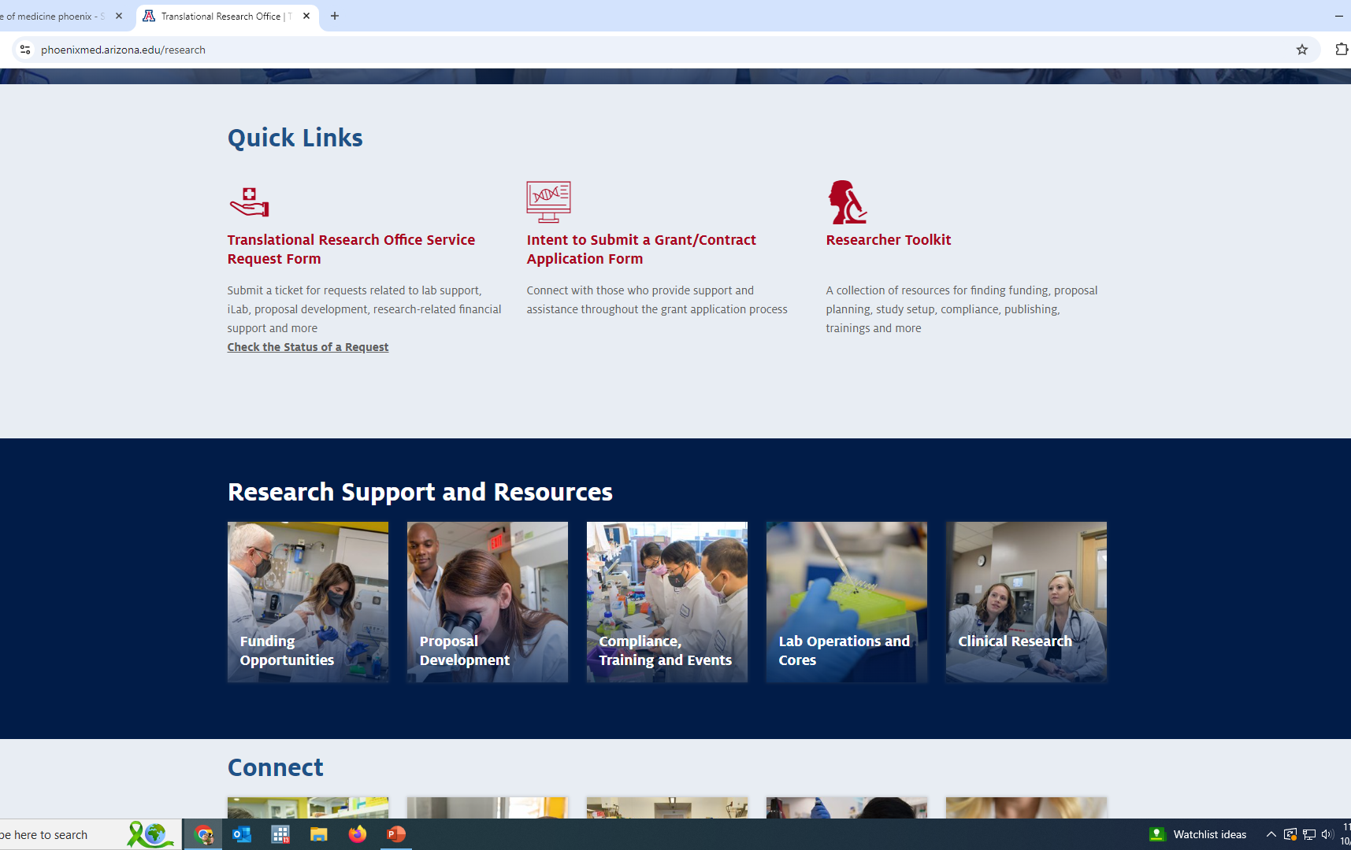

Slide 43
Where do I find help?

Slide 44


Ask the biostatistician, will you look over my study design?

Slide 45
Important Information:
What is your overall research question?
What are your specific aims to answer your question?
Who is you target population?
What approach do you think you’ll be using (i.e. measurements, surveys, observations/chart reviews, etc)?
How much difference / change / variation is important?
When do you need this?

Slide 46
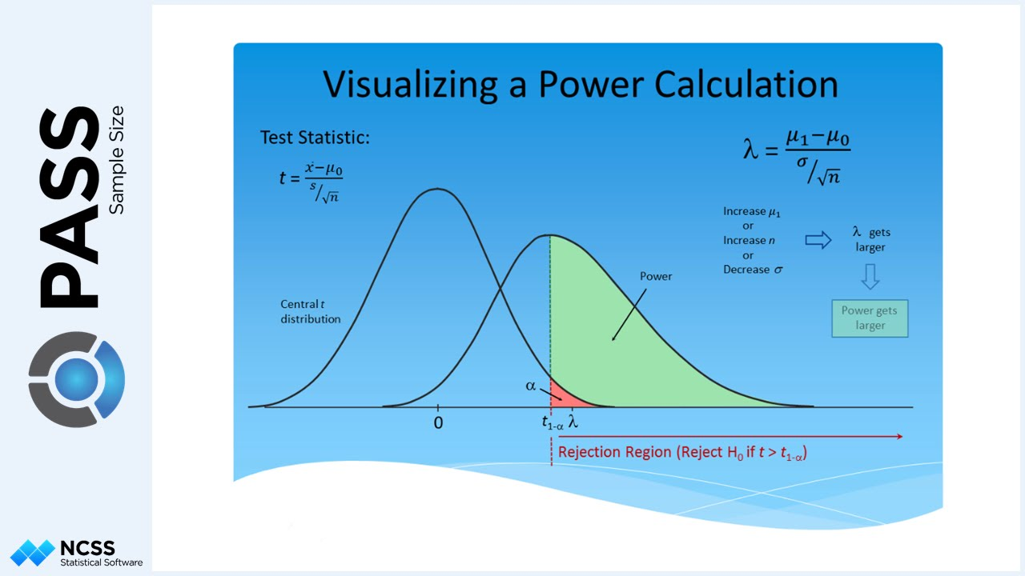
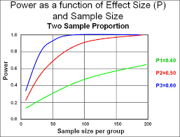
How many samples / participants / replications are needed to find a significant result?
Can you estimate the power and sample size for the study?

Slide 47

How are you going to collect the data?

Slide 48
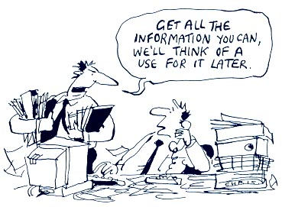
Don’t just collect everything

Slide 49
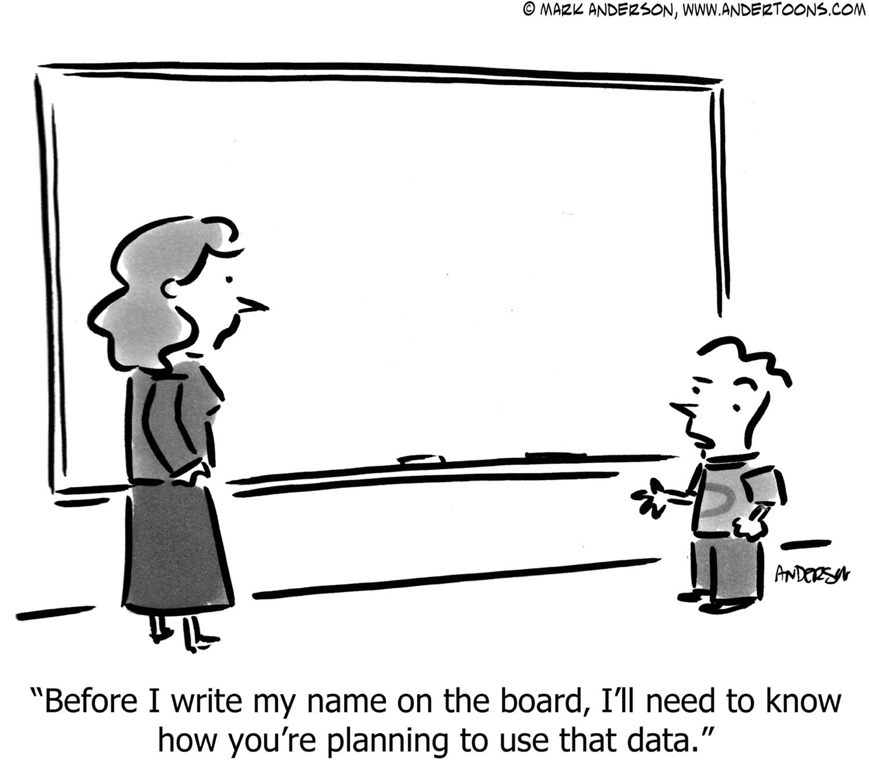
What is collected should have a specific purpose

Slide 50

How will you organize what you collect?

Slide 51
What is a database?
A database is a method of organizing and analyzing information.

Slide 52
Why use a database?
Organize & analyze information in different ways
  Sorting
  Grouping
  Querying
  Reporting
  Exporting for statistical analysis
Computerized database
  Speed
  Quality control
  Precision
  Automate repetitive tasks

Slide 53
Databases versus Excel
Excel has some limited capabilities to sort data but its primary function is to create financial spreadsheets
  Can create “what if” scenarios to determine financial consequences
  Can be used for small /limited research data sets & simple lists
  Not multi-user such that only one person can work on the file at a time

Slide 54
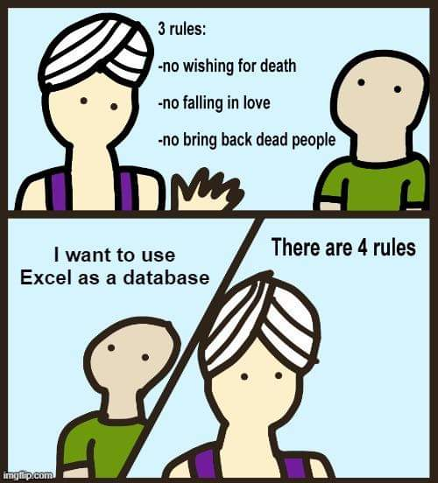

Slide 55
One Excel issue
Dates are stored as a number i.e. 35981
Mac – Excel dates prior to 1904 not supported, numbers from 1/1/1904
IBM – Excel dates number from 1/1/1900
4 years & one day difference

Slide 56
Databases
designed to collect, sort, & manipulate data
  Databases can process large amounts of data; usually limited by hardware constraints
  Structure is in the same format for each member record of a table
  Data quality control features ensure that valid data is entered
  A relational database allows for linking of an unlimited number of tables
Notes:
In contrast to Excel spreadsheets, databases are designed to collect, sort and manipulate data.

Slide 57
Databases
Many databases offer audit functions required by certain regulatory agencies
    Tracks date record created & modified
    Tracks original and changed values
    Requires user to give reason for the change

Slide 58

Where will your database live?

Slide 59
U of A / Banner resources
Qualtrics™ – Survey Monkey on steroids
Redcap™ – Clinical database
HIPAA Compliant

Slide 60

What is your primary statistical approach?
Notes:
Remember this is a question that your Biostatistician helps to answer. Your primary statistical approach depends on the type of data that you have for your primary research question and your study design. Your statistician will draft a paragraph of the statistical approach, including study power and sample size for your IRB or proposal submission.

Slide 61
Statistics:
Help understand the odds that results are real
Dependent on type and characteristics of data
Cannot fix design / data / recruitment problems
p value is the calculated probability of seeing a result. We compare this probability with the a priori level (such as 5% or 1 in 20 chance) of incorrectly rejecting the null hypothesis (no difference).
Notes:
So what does statistics do?

Slide 62
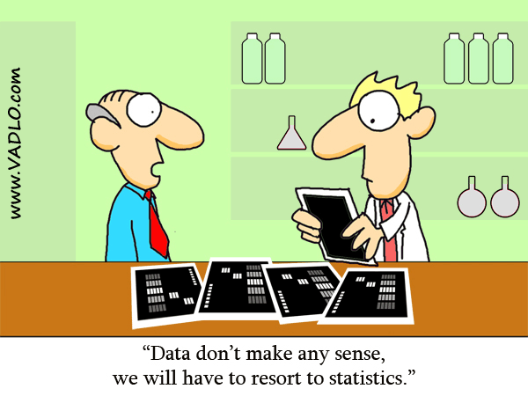
Statistics:

Slide 63

So why is type of data or distribution of values important?

Slide 64

Statistical tests require certain data properties and characteristics

Slide 65
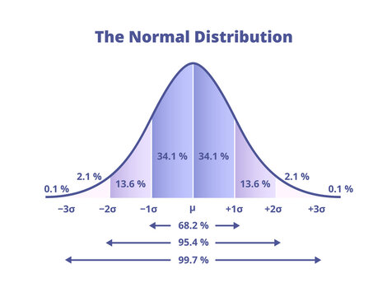
Parametric methods
Assumes a normal distribution
  T-test (1 sample/paired & 2 sample)
  Chi-Squared
  One-way ANOVA, Welch’s ANOVA
  Pearson’s Correlation
  Regression
more statistical power
Notes:
Parametric statistics are approaches that can be used if the data is normally-distributed, follows that bell-shaped curve. Procedures such as t-tests, chi-square distributions, anovas regression, pearson’s correlation are parametric statistics. These tests have more statistical power in comparison to non-parametric methods.

Slide 66
Non-Parametric methods
Assumes a non-normal distribution
  Wilcoxon Rank-Sum
  Wilcoxon Sign-Rank
  Fisher’s Exact
  Kruskal-Wallis Test
  Spearman’s Correlation
Notes:
However, non-parametric methods provide approaches that can be used for data that is not normally-distributed, or data that are counts or ranks, or small sample sizes, and these test provide appropriate results.

Slide 67

Time – different type of variable
Notes:
Time – or changes over time when that is the primary outcome (such as survival curves) is a different type of variable and requires different types of statistical tests.

Slide 68
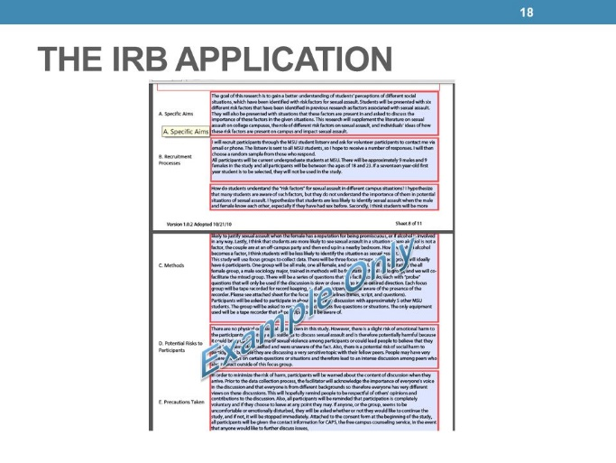


When can I start the study?
Considerations:
study design
target population
data needed
data management
statistical analyses
Notes:
You have your research question, met with the biostatistician and have your power, sample size, and analysis approach, included that in your IRB proposal and are all approved. You are ready to start – there are still a couple more considerations.

Slide 69
How will the database be organized?
Who will manage the database?
Anything else I need to consider about the data?

Slide 70
Differences between a clinical & research database
Clinical database
  Form or report oriented so data is displayed for clinical decision making
  Emphasis on displaying or reporting of individual data rather than accumulating multiple records
Research database
  Table oriented so that data is accumulated for eventual export to a statistical package for data analysis and reporting
  Less emphasis on individual records
Notes:
Research databases are different from clinical databases as they serve a different role. Clinical databases are for making decisions about a given individual.

Slide 71
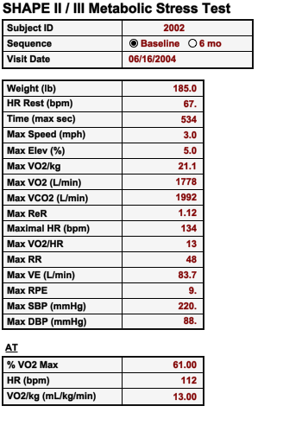
Clinical data:
Notes:
So in a clinical database, you are going to see one person’s data.

Slide 72
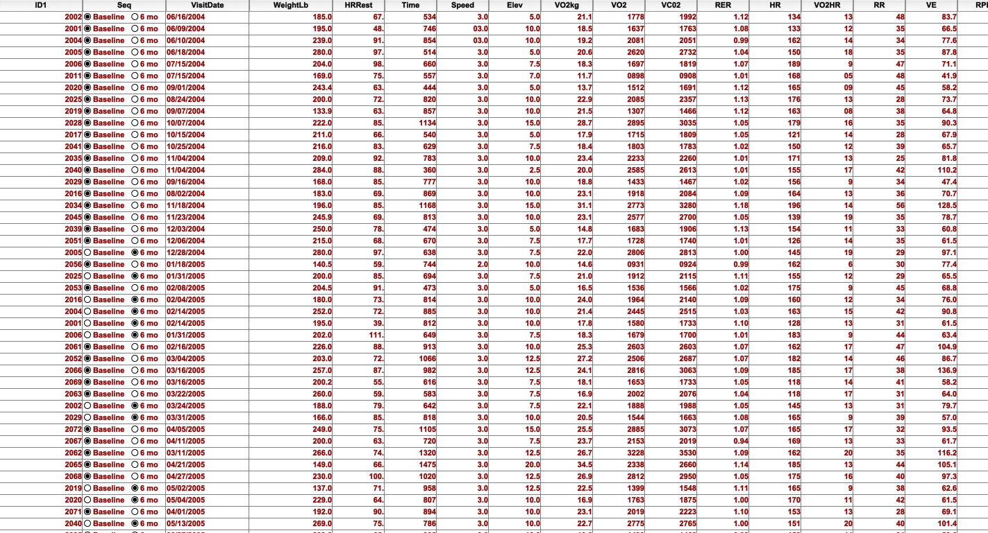
Research data:
Notes:
A research database is to make informed decisions or comparison based on aggregate data of groups. A research database is setup to look at parameters across a group or population.

Slide 73
Advantages of a database
Collection of data in a centralized location
Controls redundant data
Data stored so as to appear to users in one location
  Data can be stored in multiple tables and come from multiple sources
  A relational database brings it all together

Slide 74
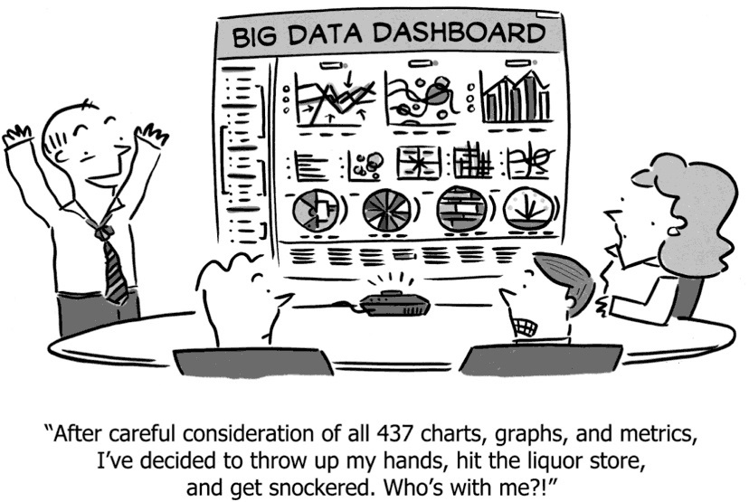
Database Design Considerations
What to collect
  What questions are to be answered?
  Think of the data tables in your future publications
  Focus on the key data elements rather than collect as much as possible

Slide 75

Selected Elements of Data Management Planning

Slide 76
Quality Control of Data Before Study
Collect only needed variables
Select appropriate computer hardware & software
Plan analyses with dummy tabulations
Develop study forms
  Pre-code responses
  Format boxes for data entry
  Label each page with date, time, ID
  Consider scan technology

Slide 77
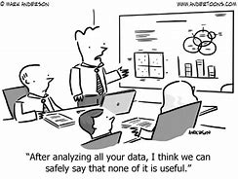
Quality Control of Data Before Study

Slide 78
What needs to be in the research database?
Research variables directly related to the hypotheses being tested-YES
Clinical measures used for screening-MAYBE
  Blood work, ECG, medical history
Administrative data-NO
  Contact information
  Scheduling

Slide 79
Common Data Elements
Standardized, unique terms and phrases that delineate discrete pieces of information used to collect data in a clinical trial
Uniform representation of demographics and data points to consistently track trends
Elements define study parameters and endpoints

Slide 80
Designing the questions
Granular primary data
    No observer conclusions, synthesis, coding
Categorical/ordinal data when possible—statistical power. Re-slice at analysis
Use validated scales/instruments
    Don’t build your own unless unavoidable
Collect key variables with >1 question
Avoid measurements that cluster at one end of scale
    Distribution problems, Likert scales
Pilot – have outside reader

Slide 81
Want to be thorough…..
…but as minimally-invasive as possible

Slide 82
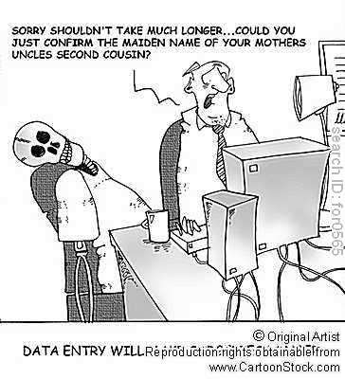

Slide 83
Operations Manual
Defines entire study protocol, sequence
Form-specific annotation, guidance
Documents all post-hoc validity checks, edit checks, data curation criteria
Evolving document with periodic updates
    Preferably on-line
Use for training, quality control, process planning

Slide 84
Data Dictionary - Operational
For every form/table, lists:
  Variable name (database field)
  Variable description (plain English)
  Variable type (string, integer, numeric, etc.)
  Variable length (or precision)
  Nullability (missing or no value indicator)
  Range checks, allowable values
  Coding conventions, with definitions

Slide 85
Why code:
Forces analyzable data structure, format
Vastly simplifies analysis
Speeds data input/transcription
Vastly simplifies data analysis/reporting

Slide 86
Example of the need for data coding
What is the subject’s sex?
  male female
  Male Female
  M F
  m f
  Man Woman
  Boy Girl
  0 1
  1 2
  Gentleman Lady
  Tarzan Jane

Slide 87
What do you mean & how will you record it?
HEADACHE
  Headache
  Pain in the head
ACHE:
  Ache:Head
  Head Pain
  HP
Unless there is a standard code for the use of terms, data retrieval becomes difficult

Slide 88
Rules for Data Entry
Each variable has its own field in the dataset
Categorical and nominal values require a number or string code (i.e 0 = blonde, 1 = brunette, 2 = redhead, etc.)
Continuous values are entered directly
Missing values must be different values from a real response
  Common formats are “99” or bullets “·”
  Don’t know is a response—do not leave blank
  “0” is not the same as missing
Coding instructions should be on form
Avoid open-ended questions

Slide 89
Avoid open-ended questions
Enter the subject’s gender:___________________
Enter the subject's level of education:__________

Slide 90
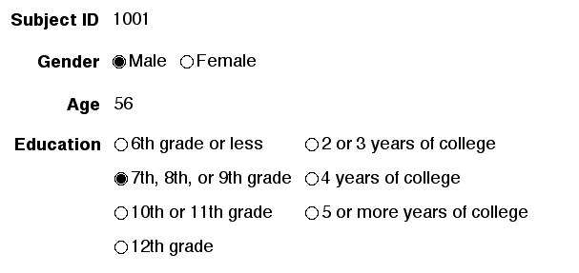
Use pre-coded, close ended responses where possible

Slide 91
If don’t code:
Data in Spreadsheet

Slide 92
Data Validation
In a database, validation “controls” what can be inserted into a field.

Slide 93
Types of Edit Checks
Patient identification and record linkage
  ID #’s, name spelling, ID#’s on all pages
Legibility
Correct form for examination
Missing data
Consistency
Range and inadmissible codes

Slide 94
Backup
Data must be backed up on a regular basis to protect against:
  Theft, fire, floods, hurricanes,
  Equipment failure
Computer backup
  Mirrored drives
  Digital tapes
  Store backup tapes off-site

Slide 95
Attributes of Successful Data Management
Attention to detail
Explicit structure and process
Robust designs
  Anticipate failures, lapses and mistakes
  Design systems that identify and correct them
Mechanisms for verification
Well documented

Slide 96
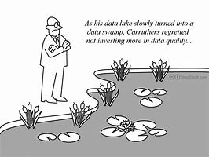
Quality
Fast is fine, but accuracy is everything.
(Wyatt Earp)

Slide 97
How will I provide the data to a statistician?
When will I get my results?

Slide 98
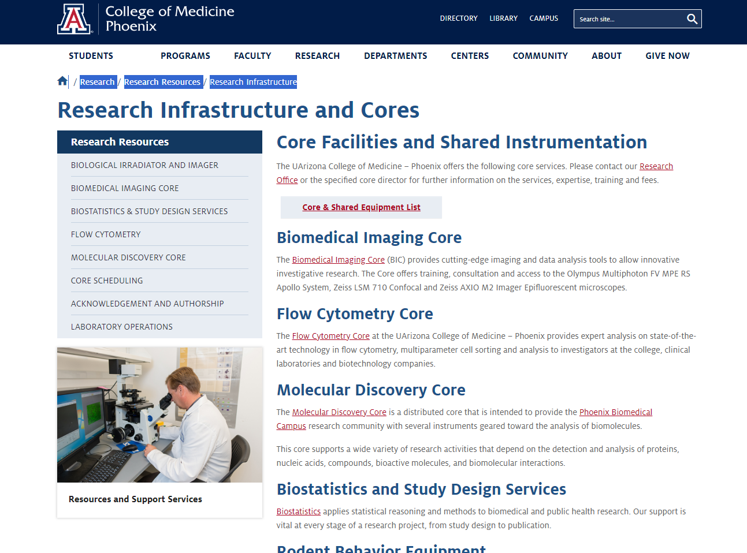
Where do I find help?

Slide 99
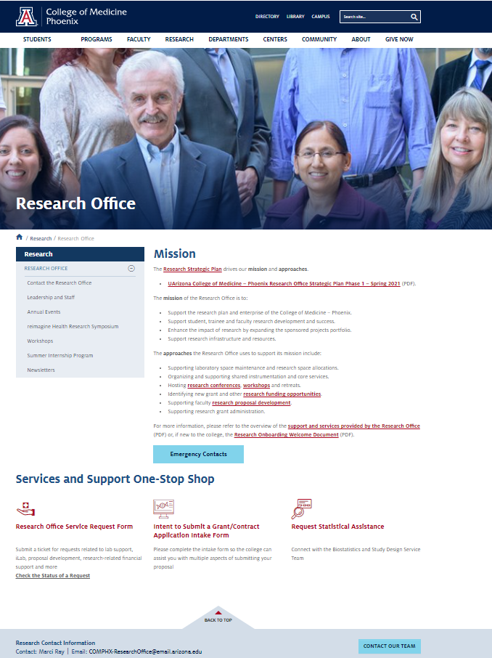
Where do I find help?

Slide 100
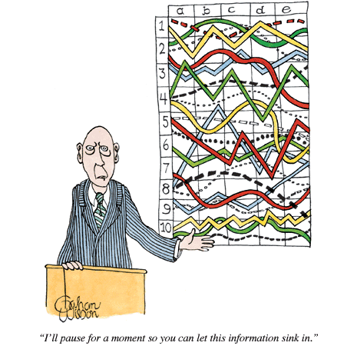
I’ll pause for a moment so you can let this information sink in.

Slide 101


