Slide 1


Introduction to research
Mehrtash Hashemzadeh, M.S.
Biostatistician, University of Arizona College of Medicine Phoenix

Slide 2
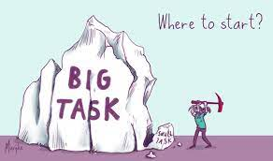
Research….

Slide 3

What is Research?
Systematic investigation
Seeks to establish facts and reach new conclusions
Basic vs Applied research

Slide 4

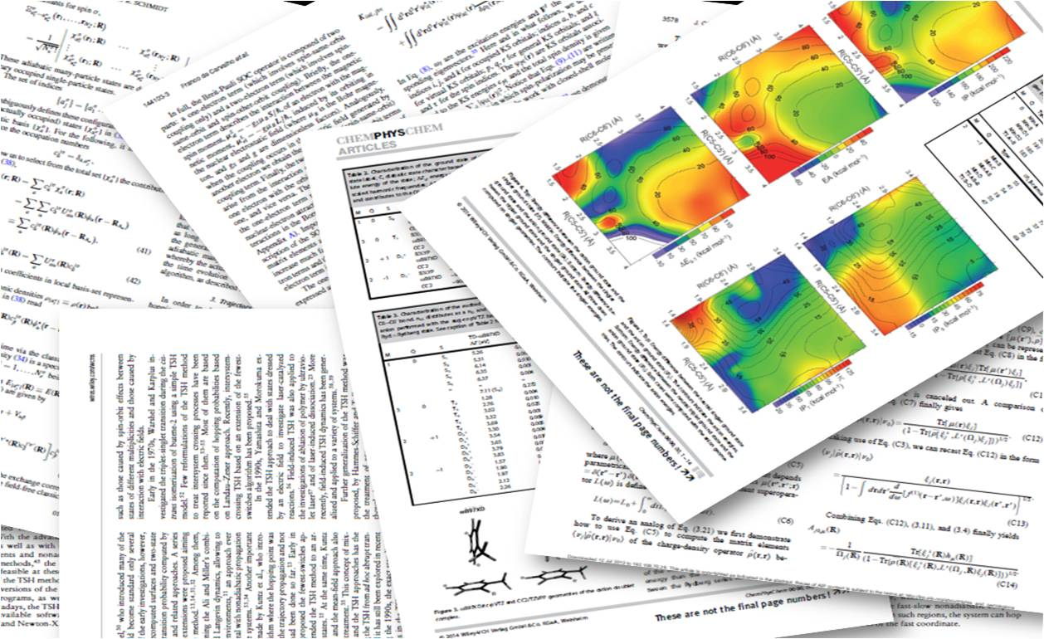
What has been done in the field?
Complete background research.
Map it out
What gap can you fill?
What is the next step?

Slide 5
Types of Research:
Basic vs Applied
Clinical vs Translational
Quantitative vs Qualitative
Retrospective vs Prospective

Slide 6
The Research Process:
Identify question
Formulate hypothesis
Design study
Collect data
Analyze data
Interpret and report findings

Slide 7
What Is a Hypothesis?
An educated guess about the relationship between variables
A tentative statement that guides your research
Example: Food insecurity is associated with higher HbA1c levels

Slide 8
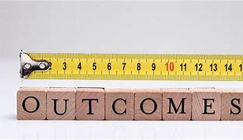
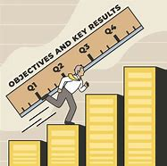
The hypothesis should be measureable, and do able.

Slide 9

Once you have your primary question, you can start to build your project.

Slide 10
Study Design
How do you think you will approach testing your Research Question?

Slide 11
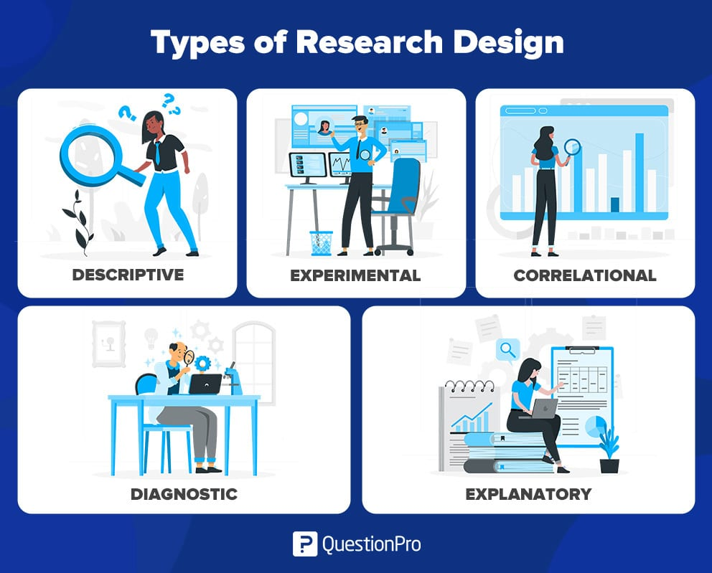
Study Designs

Slide 12
Descriptive Research Design
Purpose: Observe and document characteristics of a population or phenomenon without influencing it.
Examples: Surveys, case reports, cross-sectional studies.
Biostatistician Role: Summarize data (mean, frequency, percentages); visualize trends (bar charts, histograms).

Slide 13
Experimental Research Design
Purpose: Establish cause-effect relationships by manipulating variables.
Examples: Randomized Controlled Trials (RCTs).
Biostatistician Role: Randomization, hypothesis testing (t-tests, ANOVA), power analysis.

Slide 14
Correlational Research Design
Purpose: Examine associations between variables.
Examples: Cohort studies, observational datasets.
Biostatistician Role: Calculate correlation coefficients (Pearson’s r), regression analysis.

Slide 15
Diagnostic Research Design
Purpose: Evaluate the accuracy of diagnostic tools or criteria.
Examples: Sensitivity/specificity studies, ROC curves.
Biostatistician Role: Compute sensitivity, specificity, AUC (Area Under Curve).

Slide 16
Explanatory Research Design
Purpose: Identify underlying causes of observed phenomena.
Examples: Investigating how a new drug lowers blood pressure by analyzing its effect on angiotensin pathways.
Biostatistician Role: Mixed-effects models to account for repeated measures in lab assays.

Slide 17
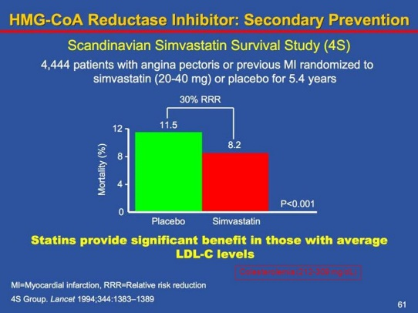
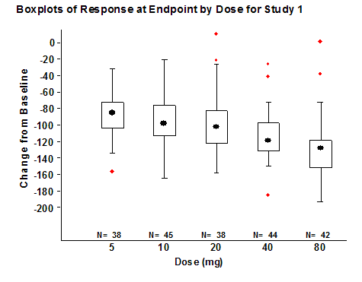
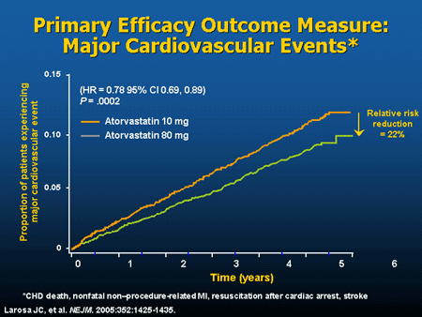
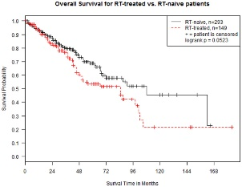
What is your primary outcome measure?

Slide 18

What type of data is your primary outcome?

Slide 19
Data Types
Categorical
Quantity
Nominal
Ordinal
Binary
Discrete or continuous data.
Interval or ratio variables
Qualitative
Quantitative
Characteristics of data

Slide 20
Categorical Data
The objects being studied are grouped into categories.
Categories are usually based on a qualitative trait.
These data are merely labels or categories.
May or may not have any underlying order.

Slide 21
Examples:
Nominal Data
Categorical data in which objects fall into unordered categories.
Type of Bicycle
  Mountain bike, road bike, chopper, folding, BMX.
Ethnicity
  Asian, Pacific Islander, African American, Caucasian, Latinx, Native American
  Smoking status
  smoker, non-smoker, former smoker

Slide 22
Ordinal Data
Categorical data in which order is important.
Highest Education level – elementary, high school, college graduate
Degree of illness- none, mild, moderate, acute, chronic.
Opinion of students about stats classes-
  Very unhappy, unhappy, neutral, happy, ecstatic!

Slide 23
Binary Data
Special type of categorical data in which there are only two categories.
Binary data can either be nominal or ordinal.
Answer: true, false
Current smoking status: smoker, non-smoker
Attendance: present, absent
Class mark: pass, fail.
Status of student: undergraduate, postgraduate.

Slide 24
Quantity or Quantitative Data
Whatever is under study is being ‘measured’ based on some quantitative trait.
Data are set of numbers.
Examples
Pulse rate
Height
Age
Exam marks
Size of bicycle frame
Time to complete a statistics test
Number of cigarettes smoked

Slide 25
Discrete Data
Quantity data can be classified as
Discrete or Continuous
Only certain values are possible (there are gaps between the possible values). Implies counting.
Continuous Data
Theoretically, with a fine enough measuring device, no gaps.

Slide 26

What bio-statistician do I know that can help me…..?

Slide 27
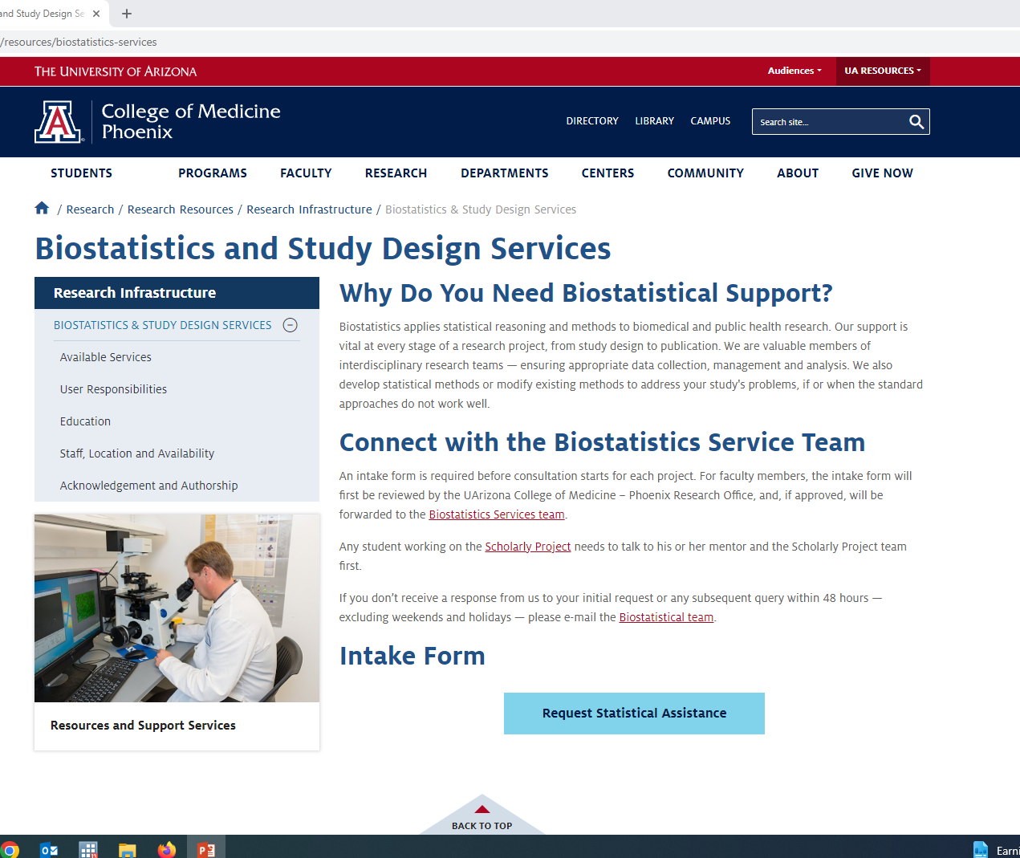
Where do I find help?
https://phoenixmed.arizona.edu/research/resources/biostatistics-services

Slide 28


Ask the biostatistician, will you look over my study design?

Slide 29
Important Information:
What is your overall research question?
What are your specific aims to answer your question?
Who is you target population?
What approach do you think you’ll be using (i.e. measurements, surveys, observations/chart reviews, etc)?
How much difference / change / variation is important?
When do you need this?

Slide 30
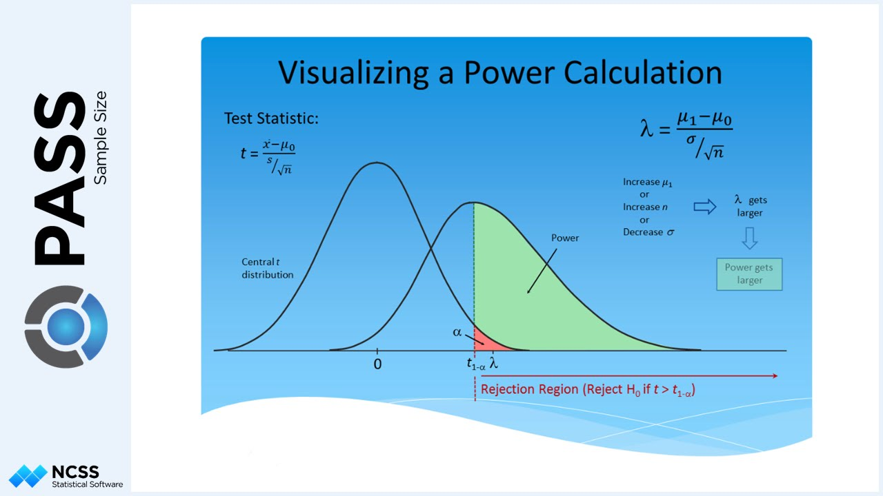
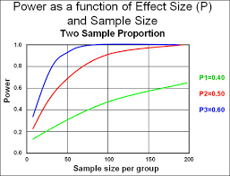
How many samples / participants / replications are needed to find a significant result?
Can you estimate the power and sample size for the study?

Slide 31
To determine sample size, you need to know:
What is your primary outcome?
What difference is meaningful?
What is the standard deviation or expected variability?
What is your alpha (commonly 0.05)?
What power do you want? (usually 80–90%)

Slide 32
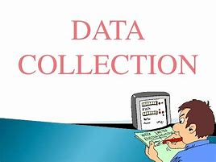
How are you going to collect the data?

Slide 33
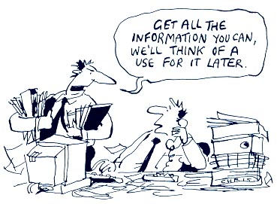
Don’t just collect everything

Slide 34
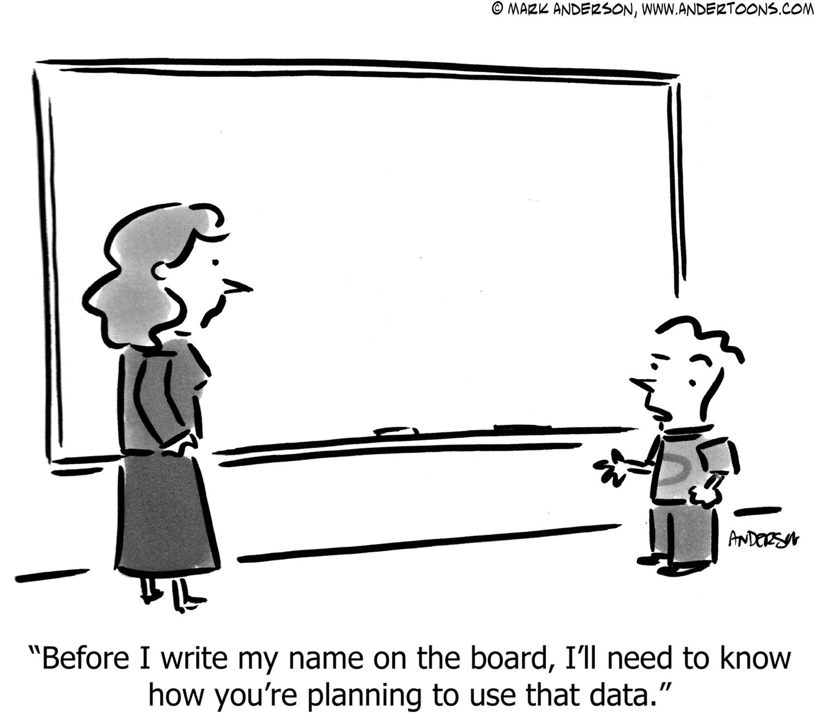
What is collected should have a specific purpose

Slide 35

How will you organize what you collect?

Slide 36
What is a database?
A database is a method of organizing and analyzing information.

Slide 37
Why use a database?
Organize & analyze information in different ways
  Sorting
  Grouping
  Querying
  Reporting
  Exporting for statistical analysis
Computerized database
  Speed
  Quality control
  Precision
  Automate repetitive tasks

Slide 38
Databases versus Excel
Excel has some limited capabilities to sort data but its primary function is to create financial spreadsheets
  Can create “what if” scenarios to determine financial consequences
  Can be used for small /limited research data sets & simple lists
  Not multi-user such that only one person can work on the file at a time

Slide 39
One Excel issue
Dates are stored as a number i.e. 35981
Mac – Excel dates prior to 1904 not supported, numbers from 1/1/1904
IBM – Excel dates number from 1/1/1900
4 years & one day difference

Slide 40
Databases
designed to collect, sort, & manipulate data
  Databases can process large amounts of data; usually limited by hardware constraints
  Structure is in the same format for each member record of a table
  Data quality control features ensure that valid data is entered

Slide 41
Databases
Many databases offer audit functions required by certain regulatory agencies
    Tracks date record created & modified
    Tracks original and changed values
    Requires user to give reason for the change

Slide 42
Advantages of a database
Collection of data in a centralized location
Controls redundant data
Data stored so as to appear to users in one location
  Data can be stored in multiple tables and come from multiple sources
  A relational database brings it all together

Slide 43

Where will your database live?

Slide 44
U of A / Banner resources
Qualtrics™ – Survey Monkey on steroids
Redcap™ – Clinical database
HIPAA Compliant

Slide 45

What is your primary statistical approach?

Slide 46
Statistics:
Help understand the odds that results are real
Dependent on type and characteristics of data
Cannot fix design / data / recruitment problems
p value is the calculated probability of seeing a result. We compare this probability with the a priori level (such as 5% or 1 in 20 chance) of incorrectly rejecting the null hypothesis (no difference).

Slide 47

So why is type of data or distribution of values important?

Slide 48

Statistical tests require certain data properties and characteristics

Slide 49
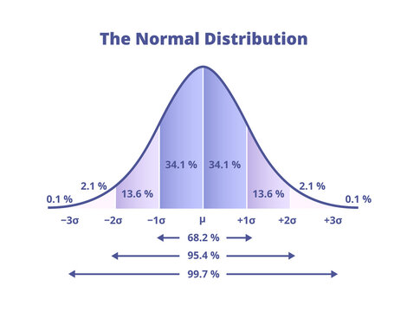
Parametric methods
Assumes a normal distribution
  T-test (1 sample/paired & 2 sample)
  Chi-Squared
  One-way ANOVA, Welch’s ANOVA
  Pearson’s Correlation
  Regression
more statistical power

Slide 50
Non-Parametric methods
Assumes a non-normal distribution
  Wilcoxon Rank-Sum
  Wilcoxon Sign-Rank
  Fisher’s Exact
  Kruskal-Wallis Test
  Spearman’s Correlation

Slide 51

Time – different type of variable

Slide 52
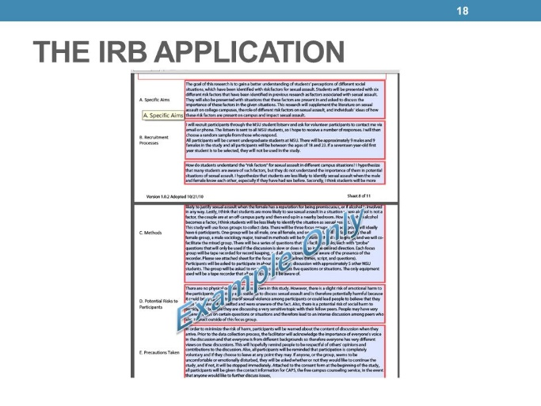


When can I start the study?
Considerations:
study design
target population
data needed
data management
statistical analyses

Slide 53
How will the database be organized?
Who will manage the database?
Anything else I need to consider about the data?

Slide 54
Differences between a clinical & research database
Clinical database
  Form or report oriented so data is displayed for clinical decision making
  Emphasis on displaying or reporting of individual data rather than accumulating multiple records
Research database
  Table oriented so that data is accumulated for eventual export to a statistical package for data analysis and reporting
  Less emphasis on individual records

Slide 55

Data Management Planning

Slide 56
Quality Control of Data Before Study
Collect only needed variables
Select appropriate computer hardware & software
Plan analyses with dummy tabulations
Develop study forms
  Pre-code responses
  Format boxes for data entry
  Label each page with date, time, ID
  Consider scan technology

Slide 57
What needs to be in the research database?
Research variables directly related to the hypotheses being tested-YES
Clinical measures used for screening-MAYBE
  Blood work, ECG, medical history
Administrative data-NO
  Contact information
  Scheduling

Slide 58
Common Data Elements
Standardized, unique terms and phrases that delineate discrete pieces of information used to collect data in a clinical trial
Uniform representation of demographics and data points to consistently track trends
Elements define study parameters and endpoints

Slide 59
Designing the questions
Granular primary data
    No observer conclusions, synthesis, coding
Categorical/ordinal data when possible—statistical power. Re-slice at analysis
Use validated scales/instruments
    Don’t build your own unless unavoidable
Collect key variables with >1 question
Avoid measurements that cluster at one end of scale
    Distribution problems, Likert scales
Pilot – have outside reader

Slide 60
Operations Manual
Defines entire study protocol, sequence
Form-specific annotation, guidance
Documents all post-hoc validity checks, edit checks, data curation criteria
Evolving document with periodic updates
    Preferably on-line
Use for training, quality control, process planning

Slide 61
Data Dictionary - Operational
For every form/table, lists:
  Variable name (database field)
  Variable description (plain English)
  Variable type (string, integer, numeric, etc.)
  Variable length (or precision)
  Nullability (missing or no value indicator)
  Range checks, allowable values
  Coding conventions, with definitions

Slide 62
Why code:
Forces analyzable data structure, format
Vastly simplifies analysis
Speeds data input/transcription
Vastly simplifies data analysis/reporting

Slide 63
Rules for Data Entry
Each variable has its own field in the dataset
Categorical and nominal values require a number or string code (i.e 0 = blonde, 1 = brunette, 2 = redhead, etc.)
Continuous values are entered directly
Missing values must be different values from a real response
  Common formats are “99” or bullets “·”
  Don’t know is a response—do not leave blank
  “0” is not the same as missing
Coding instructions should be on form

Slide 64
Avoid open-ended questions
Enter the subject’s gender:___________________
Enter the subject's level of education:__________

Slide 65
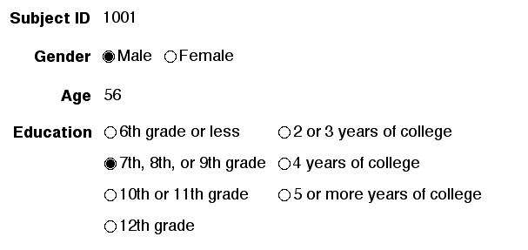
Use pre-coded, close ended responses where possible

Slide 66
Data Validation
In a database, validation “controls” what can be inserted into a field.

Slide 67
Types of Edit Checks
Patient identification and record linkage
  ID #’s, name spelling, ID#’s on all pages
Legibility
Correct form for examination
Missing data
Consistency
Range and inadmissible codes

Slide 68
Backup
Data must be backed up on a regular basis to protect against:
  Theft, fire, floods, hurricanes,
  Equipment failure
Computer backup
  Mirrored drives
  Digital tapes
  Store backup tapes off-site

Slide 69
Attributes of Successful Data Management
Attention to detail
Explicit structure and process
Robust designs
  Anticipate failures, lapses and mistakes
  Design systems that identify and correct them
Mechanisms for verification
Well documented

Slide 70

Informed consent
IRB approval
Vulnerable populations

Slide 71
How will I provide the data to a statistician?
Clean, well-labeled, and coded dataset
Data dictionary and operations manual included
Secure transfer (encrypted email, institutional drives, REDCap export, etc.)
When will I get my results?
Depends on:
Data quality and completeness
Complexity of the analysis
Prioritization and workload of the statistician

Slide 72

Peer-reviewed publications
Posters and presentations
Community impact

Slide 73
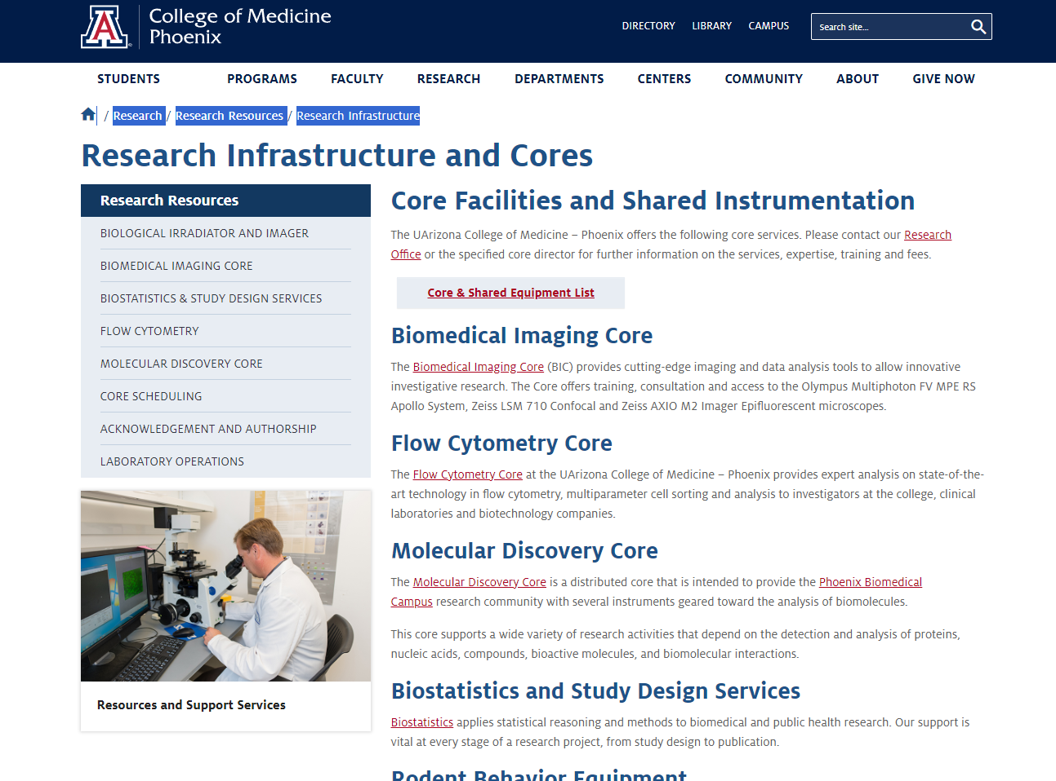
Where do I find help?

Slide 74
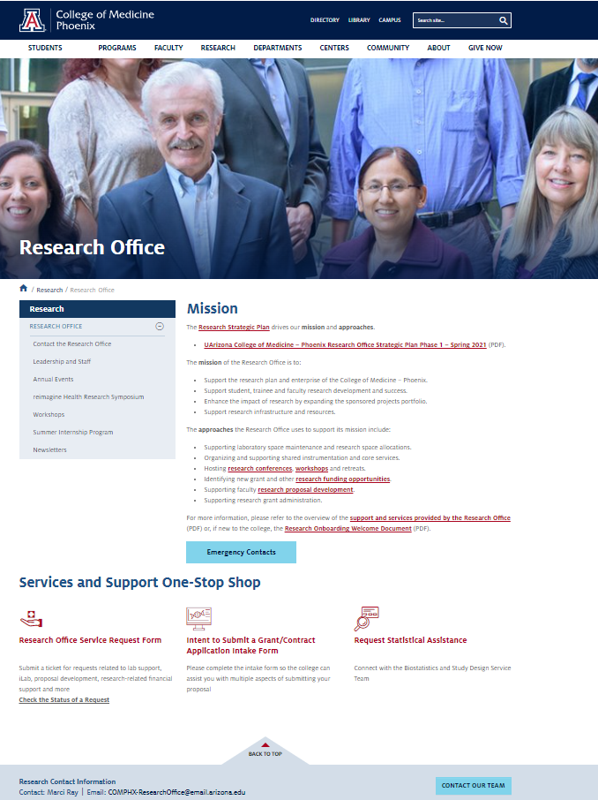
Where do I find help?

Slide 75
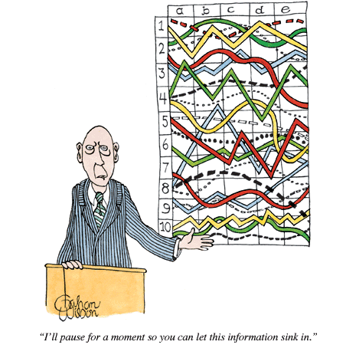
I’ll pause for a moment so you can let this information sink in.

Slide 76


