Slide 1


Introduction to
POWER ANALYSIS
Chengcheng Hu, PhD
pbc-treo-biostat@arizona.edu
Biostatistics and Study Design Service
University of Arizona College of Medicine-Phoenix

Slide 2
Objectives
To understand the context and basic concepts of power analysis and sample size determination
To recognize the information needed to perform power analysis
To perform power analysis for simple study designs using a free software

Slide 3
Outline
Brief review of statistical inference and hypothesis testing
Introduction to power analysis
Software demonstration
Multiple comparisons

Slide 4
In research, the aim is to find a consistent, believable result
We want to make sure our finding is unlikely to “happen by chance”

Slide 5

If I throw 8 heads in a row…
- you would say “it’s rigged” or “those results aren’t right?”

Slide 6

Any number of “heads” has
a certain chance to happen
for a perfectly fair coin
If, assuming the coin is fair, the chance for an actual
observation is too small,
the coin might not be fair
This is the logic behind statistical hypothesis testing

Slide 7
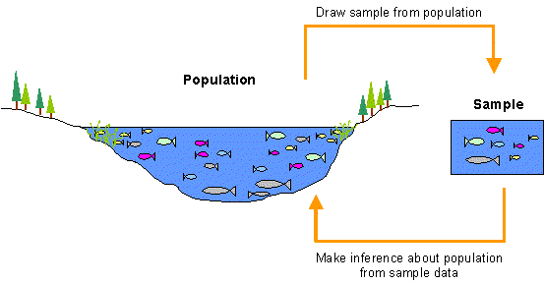
Hypothesis testing is about inference
Inference - conclusion

Slide 8
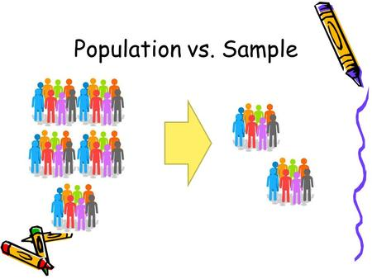
Statistical Inference
Based on observed data from a sample and certain assumptions about the distribution of data, we can deduce properties of certain parameters in a population

Slide 9
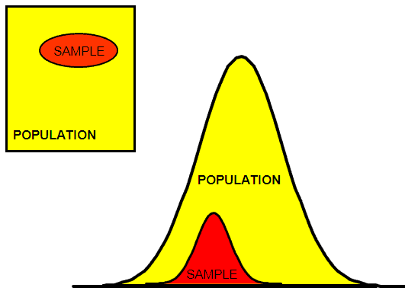
Statistical Inference
We are assuming that the sample data is representative and meets assumptions.

Slide 10
Hypotheses to Be Tested
Null hypothesis H₀ –
No effect / No difference / No relationship
Alternative hypothesis H_{A}
(or called Research hypothesis) –
New discovery: Effect / Difference / Relationship

Slide 11
Logic of Hypothesis Testing
H₀ – no effect or no difference
Assuming H₀ is true, calculate the probability of observing the actual result or anything more extreme – this probability is called p-value
If the p-value is too small, say below a nominal value (significance level α), we reject H₀ and conclude that H_{A} is true

Slide 12
Steps of A Hypothesis Testing Procedure
State the research/alternative hypothesis (e.g. drug has an effect compared to placebo)
State the null hypothesis (e.g. no drug effect)
Identify a test statistic based on data
Calculate p-value: if the null hypothesis is true, the probability of observing a value of the test statistic as extreme as or more extreme than the actually observed value
If the p-value is smaller than the pre-determined alpha level (usually 0.05), reject the null hypothesis and conclude that the alternative hypothesis is true

Slide 13
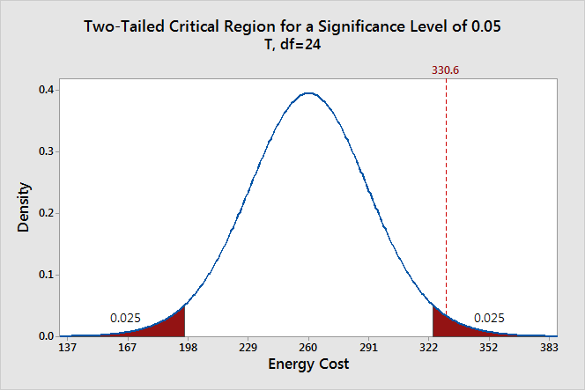
How far away the parameter estimate is from the null value to be unusual enough to reject H₀
Figure from J. Frost, https://statisticsbyjim.com/hypothesis-testing/hypothesis-tests-significance-levels-alpha-p-values/

Slide 14
Possible Outcomes of A Testing Procedure
Truth
 | Null hypothesis H₀ is FALSE | Null hypothesis H₀ is TRUE
Reject H₀ | Correct | Wrong
Not to Reject H₀ | Wrong | Correct
Your decision
Notes:
In this testing framework we never say to “accept H₀”.

Slide 15
Possible Outcomes of A Testing Procedure (with probabilities)
 | Null hypothesis H₀ is FALSE | Null hypothesis H₀ is TRUE
Reject H₀ | Correct decision POWER (1 – β) | Type I error (α)
Not to Reject H₀ | Type ll error (β) | Correct decision (1 - α)

Slide 16
Errors of A Testing Procedure
Type I error (with probability α): finding an effect that is not there
Type II error (with probability β): not finding an effect that actually exists
Power is equal to 1 – β (one minus the type II error probability)

Slide 17

Commonly Used $α$ and $β$Values
Maximum probability of type I error (α) is commonly set at 0.05, though other values could be used depending on the study
Target power level (1- β): typically, 0.8 is required and 0.9 is desirable

Slide 18
Power
Power – probability that you will find a statistically significant difference when a difference actually exists (you reject H₀ when you should)

Slide 19
Factors that affect power:
Experimental design (including outcome measures and statistical methods)
Level of significance
Sample size
Effect size
Other factors (attrition, etc.)

Slide 20
What to do first?
Study design
Significance level
Sample size
Effect size….

Slide 21
Factors that affect power
Experimental design (including outcome measures and statistical methods)
Level of significance
Sample size
Effect size
Other factors (attrition, etc.)
Notes:
Other factors: loss to follow-up, adherence, etc.

Slide 22
Research Question
Research hypothesis H_{A} : what do you expect to happen?
  Group on treatment A has lower systolic blood pressure than group on treatment B
  Group with a certain trait is more likely to get sick compared to group without trait
Null hypothesis H₀ – no expected effect in the population

Slide 23
Experimental Design
Prospective study
Retrospective study
Cohort study
Case-control study
Cross-sectional study/survey
Randomized controlled trial
etc., etc.

Slide 24
Outcome Measure to Address
the Research Question
Continuous / numerical
Normally distributed continuous
Binary
Multi-level / multi-categorical
Counts
Survival time (right-censored)
Independent vs. correlated data

Slide 25
Objectives of Analysis
Compare one-sample mean/proportion to a fixed value
Two-sample comparison
More than two samples/groups
Regression / correlative analysis
Estimation of certain parameters

Slide 26
Factors that affect power:
Experimental design (including outcome measures and statistical methods)
Level of significance
Sample size
Effect size
Other factors (attrition, etc.)

Slide 27

Effect Size (ES)
Magnitude of difference / strength of correlation
For two-group comparisons, ES is commonly defined as standardized mean difference; when the groups have identical standard deviation $σ$:
ES = $\frac{μ_{1}−μ_{2}}{σ}$
Effect size depends on both absolute difference and variability

Slide 28
When other factors are fixed, power increases for
larger sample size
larger significance level (α)
larger effect size

Slide 29
Parameters for power analysis
With any three, the fourth can be determined.
Originally taken from D. Bondareva, https://www.slideshare.net/dbondareva/introduction-to-power-analysis

Slide 30
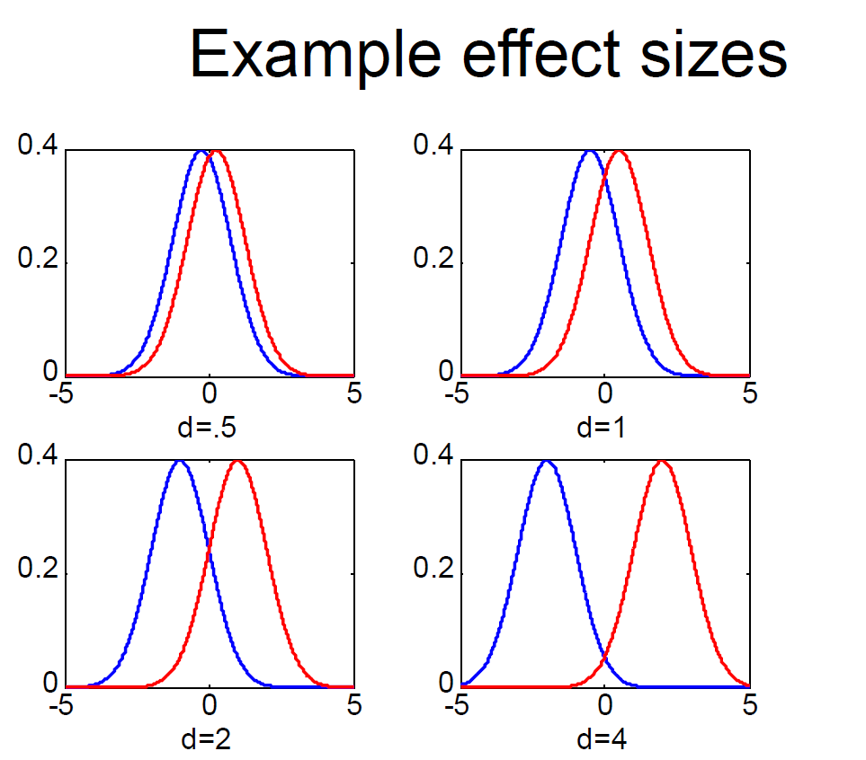
Effect Size
Strength of relationship/size of effect:
Effect size is not influenced by sample size

Slide 31
Effect Size (ES)
Larger ES, greater power (fixed sample size)

Slide 32
At a given effect size:

Slide 33
With larger ES, smaller n can achieve the same power

Slide 34
Effect Size
The effect size used in power analysis needs to be realistic for the population under study
The effect size also needs to be “clinically significant” – a change of that size makes a meaningful difference in the health status of a study participant
Example: we might have enough power to detect a 3 mmHg difference in SBP under different conditions but that change is well within the range of biological variation

Slide 35
Effect Size (cont.)
Small effect size may be impressive if
  Difficult to change
  Valuable (increased life expectancy)
Large ES may or may not have any practical value
Interpretation is subjective; compare with similar studies in field

Slide 36
Literature Review
Commonly used study designs
Which outcome measure is commonly used / well accepted in the specific field
Distribution of the outcome?
Effect size (rough range is fine)

Slide 37
Pilot Study
If no prior information is available, a pilot study is recommended to acquire such knowledge
A pilot study, typically with a small sample size, provides knowledge like group difference and variability of the outcome in the target population
A rough “guesstimate” or a range for the parameters is often sufficient

Slide 38
Sample Size Determination
If the primary objective is to test a hypothesis like whether a treatment has a beneficial effect compared to placebo, the sample size calculation is based on power, the chance to identify a treatment effect of a certain level
If the primary objective is to estimate a parameter, the sample size calculation is based on precision of the estimation

Slide 39
Sample Size for Estimation Problems
Estimator of any parameter of interest is accompanied by a precision measure of the estimator, like a 95% confidence interval (CI)
Increasing the sample size will shrink the CI
When the primary objective is to estimate a parameter, sample size is based on a certain level of precision to be achieved (measured, for example, by width of CI)
Expected range of the parameter and variability in the outcome measure need to be obtained from literature review or pilot data

Slide 40
Sample Size for Hypothesis Testing
Sample size: minimum number of study participants to achieve a certain power (at least 80%, preferably 90%) for assumed effect size (or a certain level of precision for estimation)
After sample size is determined, due to uncertainty in the assumed effect size, the power (or precision for estimation) needs to be calculated for a number of possible scenarios, with parameters taking different values in a reasonable range

Slide 41
Software
Power analysis can be conducted in general statistical packages: SAS, SPSS, STATA, R
Specialized software: PASS, nQuery
Online/free: G*Power, Powerandsamplesize.com, PS, sample-size.net
Simulation for complicated designs

Slide 42
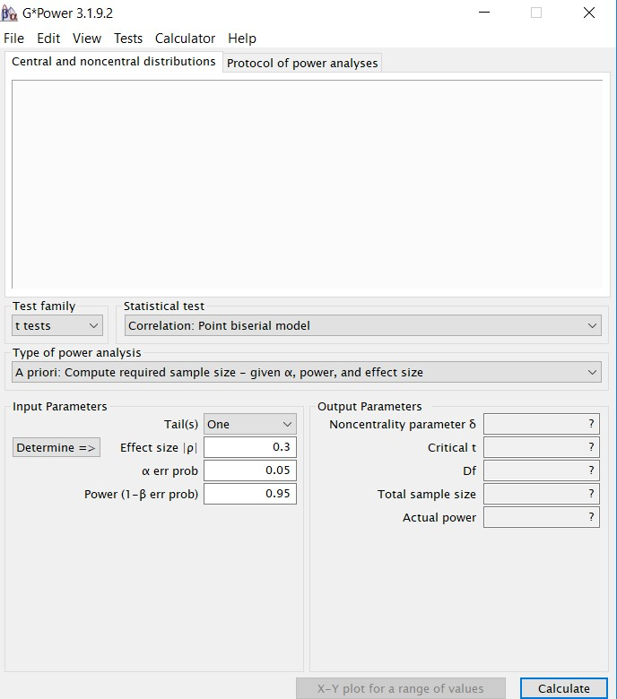
G*Power https://www.gpower.hhu.de/
Windows or mac versions
Download & unpack

Slide 43
Study Planning:
Fixed power – determining sample size
Diabetic patients on Diet A vs. Diet B
Followed for 6 weeks
Outcome: fasting blood glucose level
Expect: ~ 10 mg/dl difference
St. Dev: Diet A = 15, Diet B = 17
Significance level α = 0.05
Desire 80% power

Slide 44
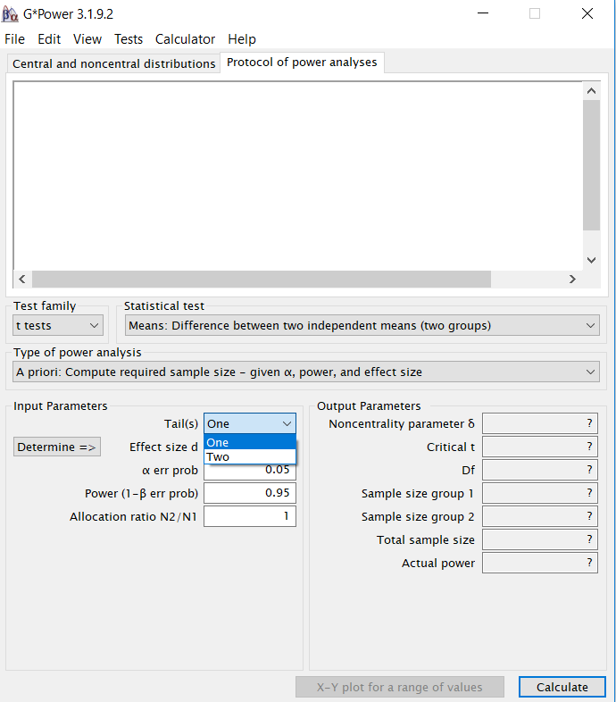
G*Power

Slide 45
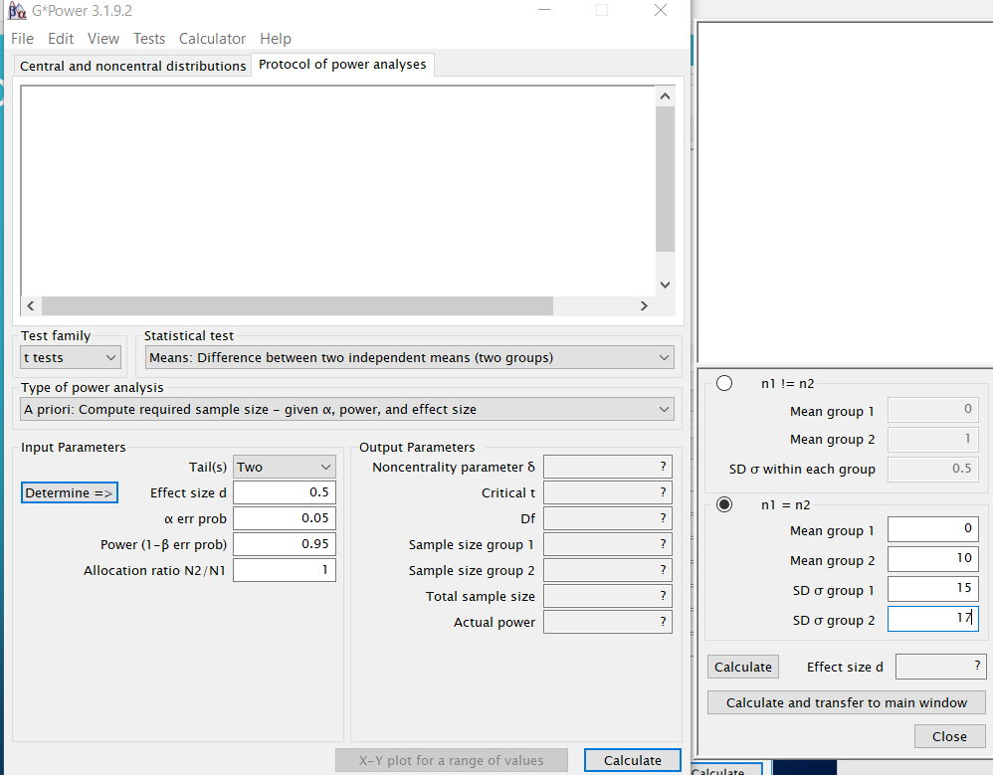
G*Power

Slide 46
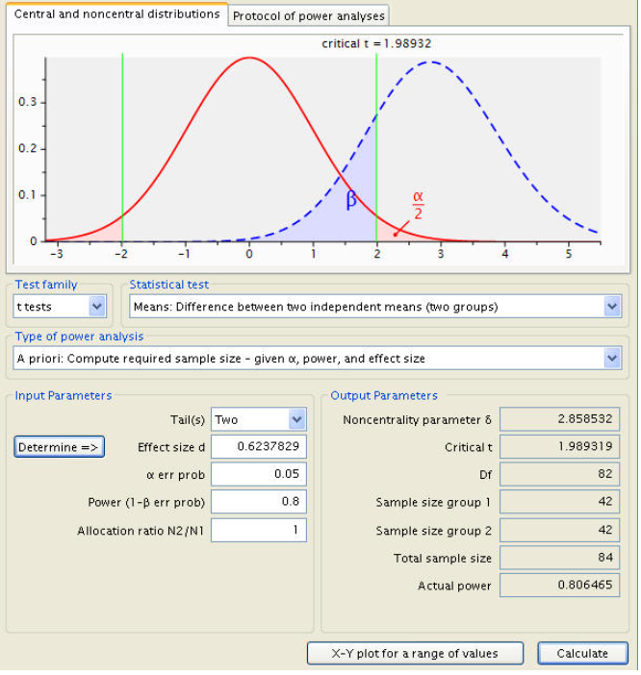
G*Power

Slide 47
Power curve in relation to sample size

Slide 48
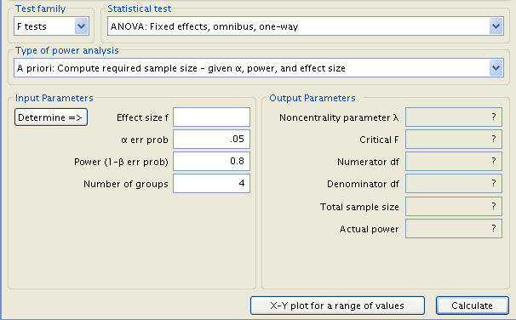
To test if four groups have different mean scores using one-way ANOVA
Assuming equal standard deviation of 80
Assuming group means 550, 598, 598, 646

Slide 49
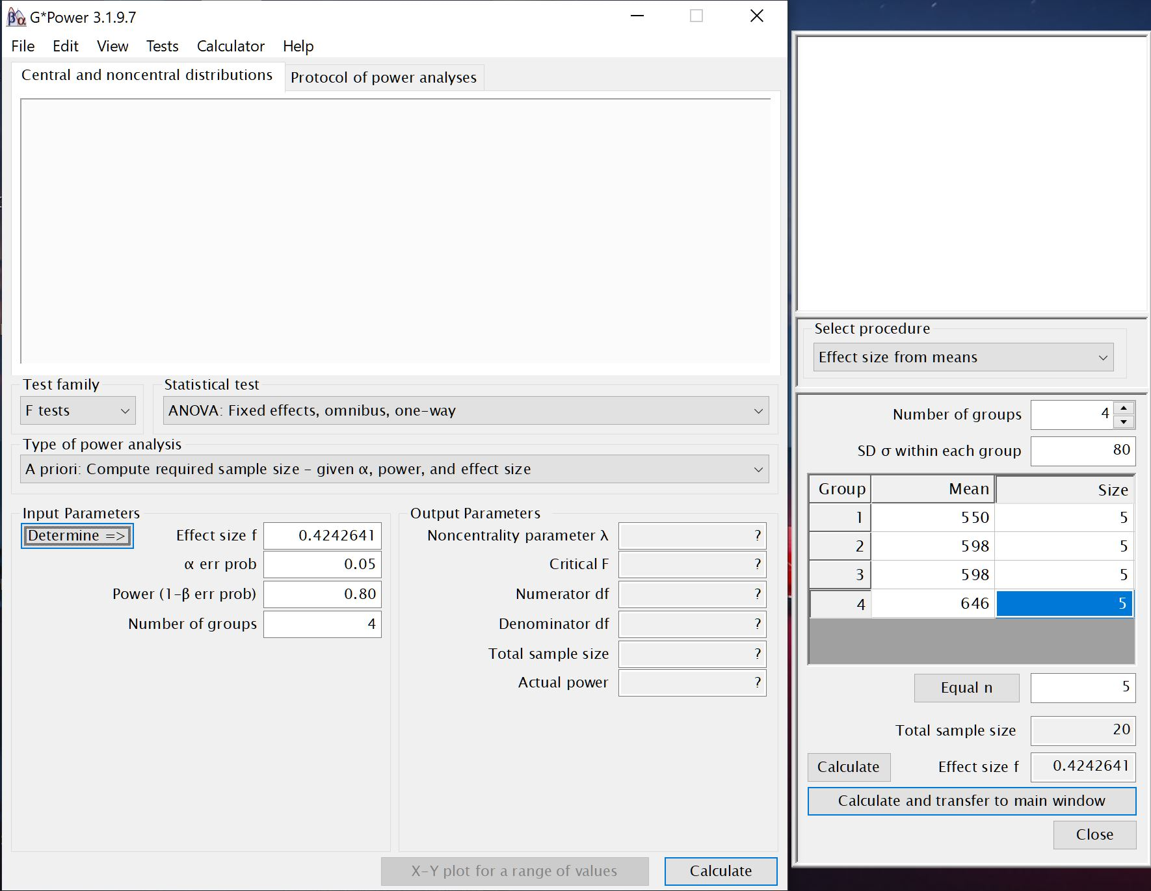

Slide 50
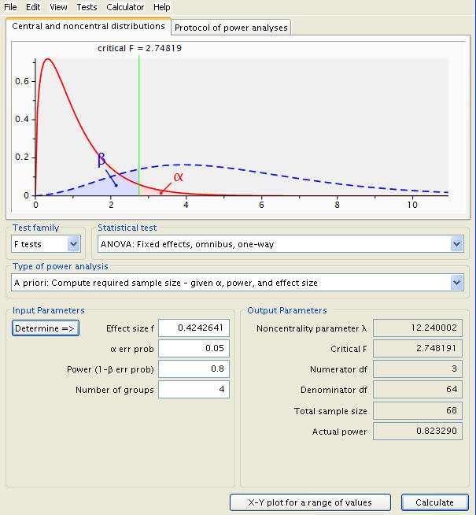
n = 17 / group

Slide 51
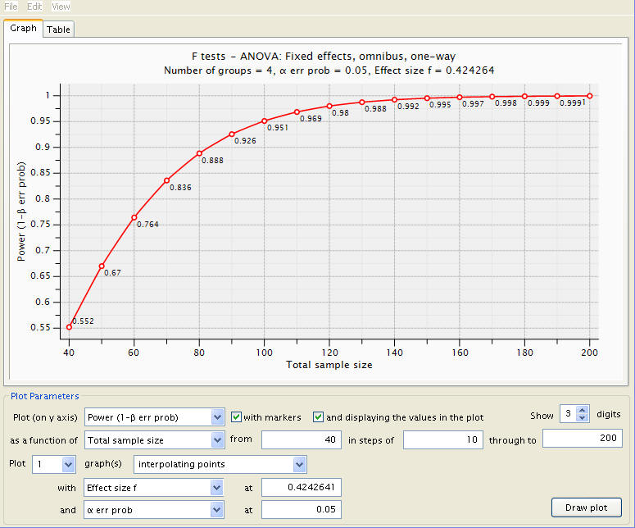

Slide 52

Multiple Comparisons
In the same study, we test two null hypotheses H₀₁ and H₀₂
Each type I error rate is controlled at 0.05:
$$P\left(reject H_{01} \right| H_{01} is true)≤0.05$$
$$P\left(reject H_{02} \right| H_{02} is true)≤0.05$$
However, when both H₀₁ and H₀₂ are true, the probability that we wrongly reject at least one of them is $>0.05$
For example, when the two test statistics are independent, the chance we wrongly reject H₀₁ or H₀₂ or both will be ≤ 0.0975

Slide 53
Familywise Error Rate
Familywise Error Rate (FWER): the probability of one or more false rejections of null hypotheses (false discoveries)
Also called experimentwise error rate (EWER), though sometimes the two phrases have different meanings
When all M test statistics for M true null hypotheses are independent (all with significance level 0.05):
M | 2 | 3 | 4 | 5 | 10 | 20 | 50
FWER | .098 | .143 | .185 | .226 | .401 | .642 | .923

Slide 54

FWER (cont.)
FWER can be much higher than the nominal significance level $α$ (say 0.05)
If we test multiple null hypotheses at level $α$ in the same study, when many of them are true we are very likely to (falsely) reject at least one of them
Remedy: test each individual hypothesis with significance level $<α$

Slide 55

Bonferroni Procedure
To control FWER at $α$ level when testing M null hypotheses, we reject any of them when the corresponding p-value $<α/M$
This is a conservative method, i.e., we might unnecessarily sacrifice some power to guarantee that FWER $<α$
Power analysis is straightforward: we just use $α/M$ instead of $α$ in the regular power calculation for one single null hypothesis

Slide 56
Alternative Procedures
For all pairwise comparisons across multiple groups (three or more), some popular tests:
  Tukey/Tukey-Kramer test
  Scheffé’s test
  Sidak’s test
  Duncan’s test
  etc., etc.
There are also several tests for comparisons of multiple groups with a single control group

Slide 57
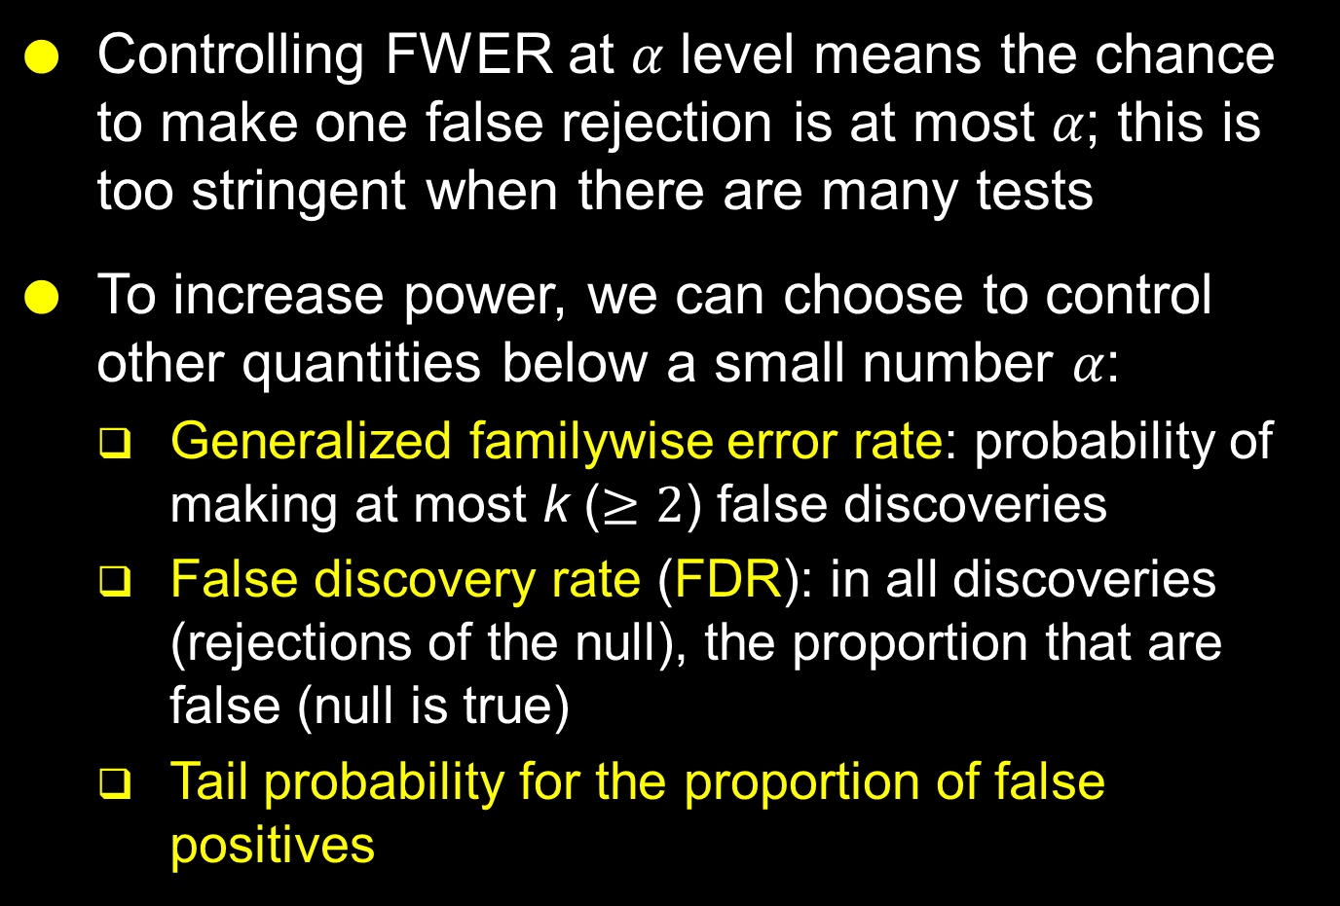
Controlling Other Quantities
Controlling FWER at 𝛼 level means the chance to make one false rejection is at most 𝛼; this is too stringent when there are many tests
To increase power, we can choose to control other quantities below a small number 𝛼:
  Generalized familywise error rate: probability of making at most k ($≥2$) false discoveries
  False discovery rate (FDR): in all discoveries (rejections of the null), the proportion that are false (null is true)
  Tail probability for the proportion of false positives

Slide 58
Methods for General Settings
The following methods only need a sequence of p-values as input:
Holm’s method
Hochberg’s method
Benjamini-Hochberg method
Benjamini-Yekutieli method
The q-value approach

Slide 59

Power Analysis for Multiple Comparison Methods
If the Bonferroni approach is to be used, in the power/sample size calculation we only need to lower the significance level from $α$ to $α/M$
Certain commercial software, like PASS, can handle other quantities like EWER and FDR for simple situations
R has many user-contributed packages for power analysis
For more complicated situations, power analysis relies on simulation techniques

Slide 60
Power Analysis by Simulation
Through discussion with investigators we identify a number of realistic scenarios for the data to be collected
For each scenario, a large number (say 10,000) of datasets are generated, and the specific statistical test is applied to each of them
The proportion of datasets with each (false) null hypothesis rejected is an estimate of the power to be expected for that hypothesis under the specific scenario

Slide 61
We are here to help with your sample size/power analysis; information we need:
Background and research question
Target population
Specific aims
Outcome measures and other relevant variables
Approach
Effect size, mean/median, variability from the literature and/or pilot data
Your timeline

Slide 62
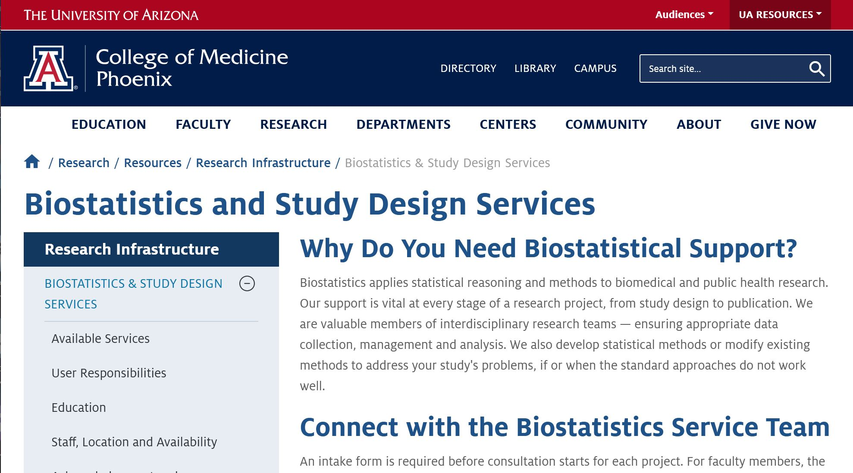
Biostatistics & Study Design Services webpage
https://phoenixmed.arizona.edu/research/resources/biostatistics-services

Slide 63
