Slide 1

Intro to Qualtrics Workshop
How to initiate survey-based research using the U of A licensed survey software
Kory Johnson, PhD

Slide 2

Outline
Getting started in Qualtrics
Survey creation
Survey customization
Qualtrics tools
Analyzing results
Notes:
This workshop is the 3rd workshop in our Fall 2025 Biostatistics & Study Design Workshop Series: with the first being our Intro to Research workshop, and the second being the Intro to Power Analyses workshop.
In this workshop, I will be reviewing a bit of the set up, features and tools available to use with Qualtrics software, and how that can help facilitate survey-based research projects, as you can see in the outline provided.
Whereas the two previous workshops addressed topics related to identifying a research project, developing testable research hypotheses, and identifying the tests and sample size necessary to evaluate your hypotheses; this workshop focuses more on the next steps of the research process.
Specifically, this workshop addresses the process of getting a survey project off the ground, and some considerations you should be aware of during this process, by providing a walkthrough on how to implement a survey-based project in Qualtrics.
So, why focus on Qualtrics? Qualtrics software is specifically built to be a survey resource. As such, it has lots of great features that you will not find in Redcap or more generalized resources, and ones that we can use from survey creation through analysis stages. When conducting research we want to use the best resources available to us, and Qualtrics is one of these resources for survey-based projects.

Slide 3
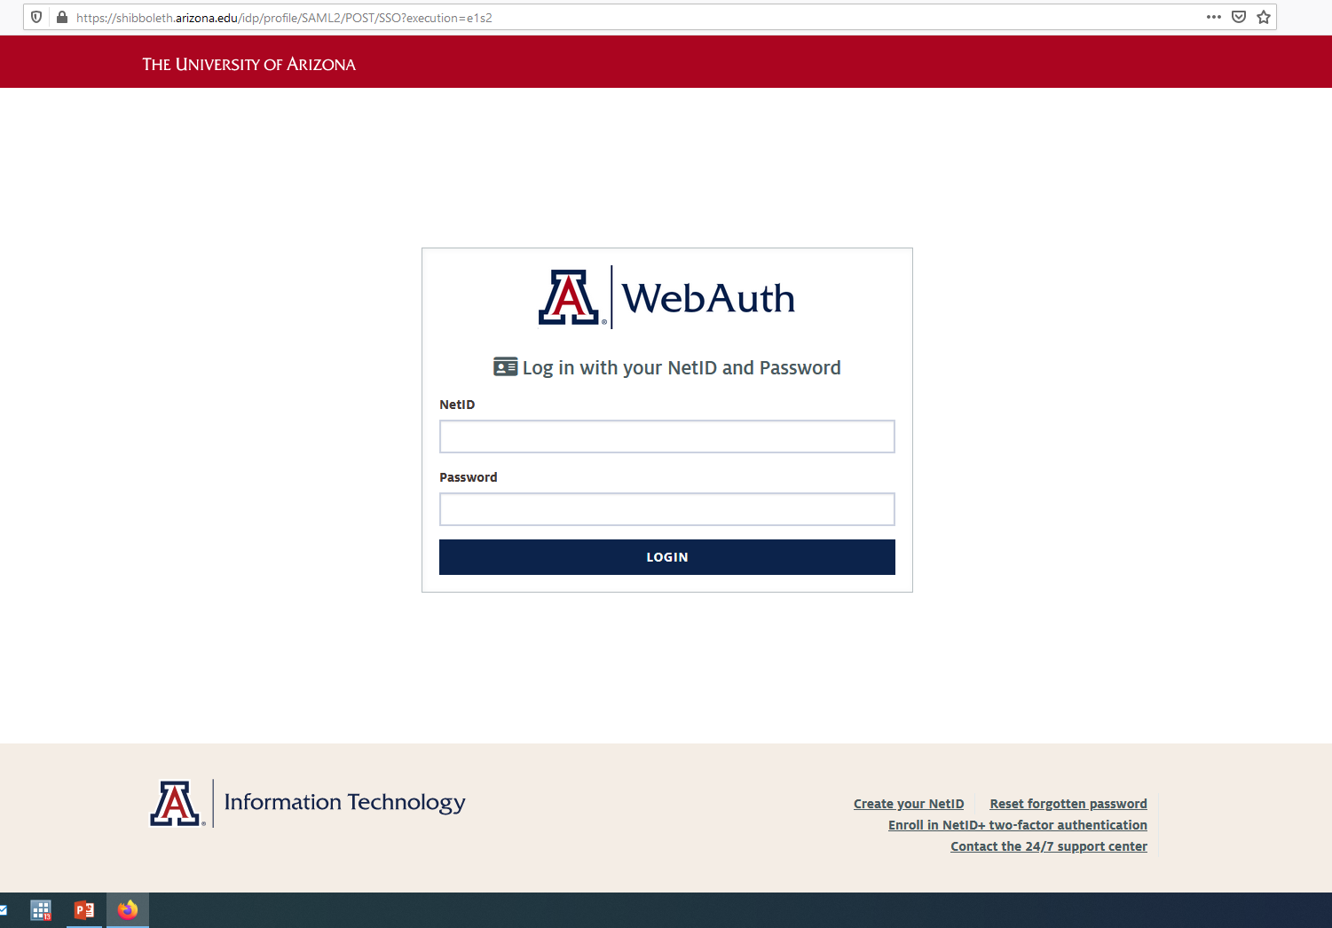
Uarizona.co1.qualtrics.com
Notes:
Qualtrics can be accessed via the link provided. I encourage everyone to login and follow along in Qualtrics as we walkthrough using the software.

Slide 4
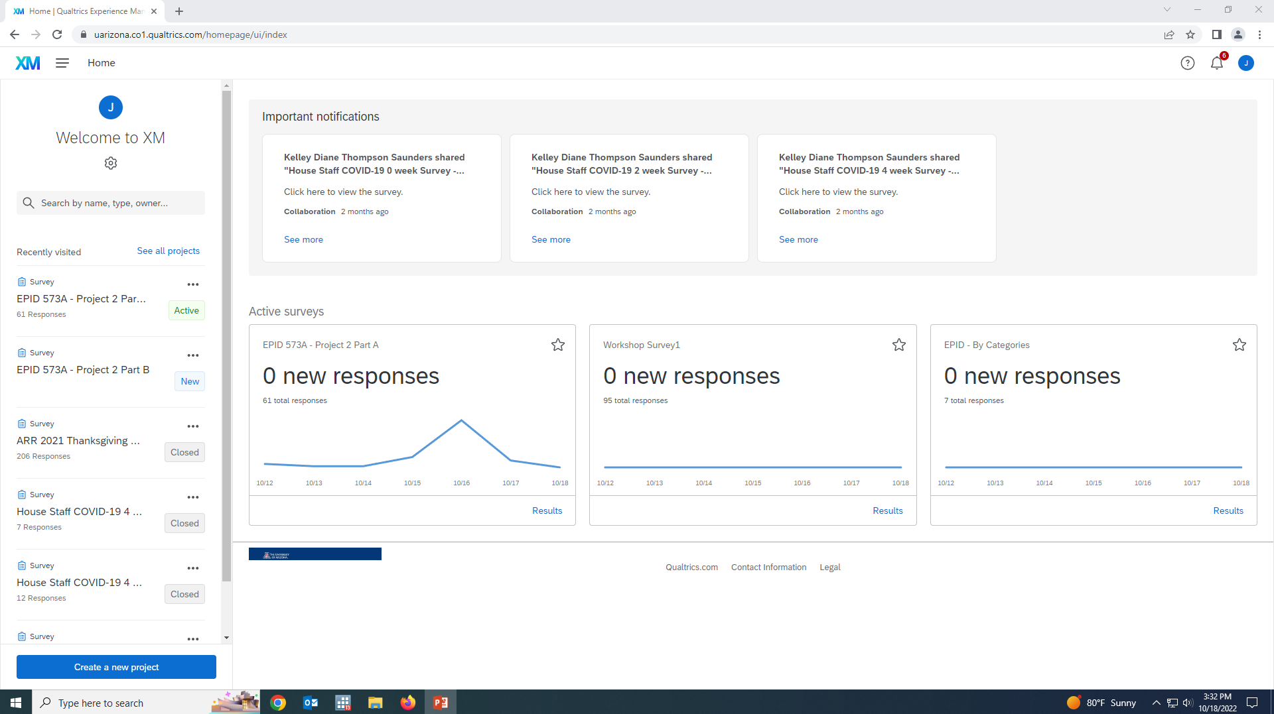
Landing page is “Home” page.
Any surveys you have and any collaborations will be visible.
Notes:
If you are already working on survey projects in Qualtrics, this is what your landing page will look like.

Slide 5
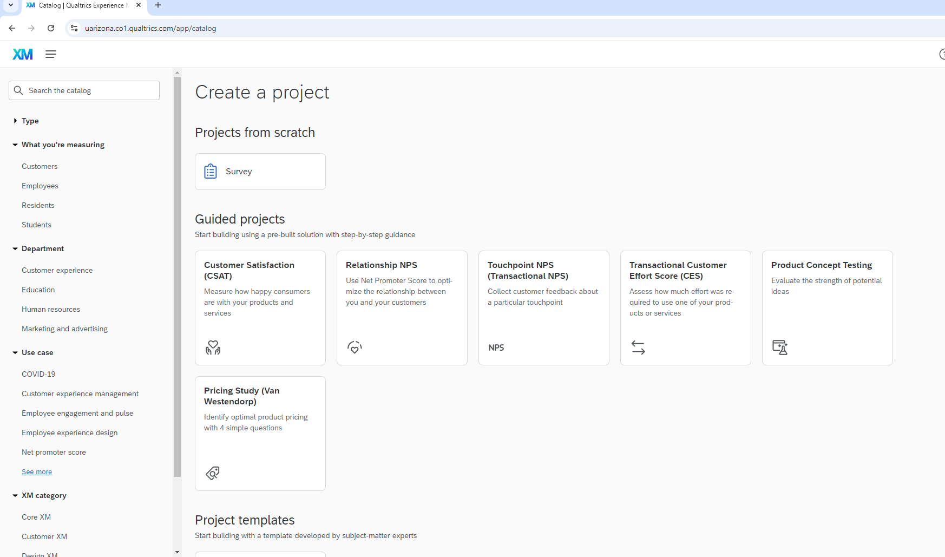
It is possible that Qualtrics took you directly to the
Welcome Dashboard
Notes:
If you have not, Qualtrics will likely direct you here to the welcome dashboard.

Slide 6
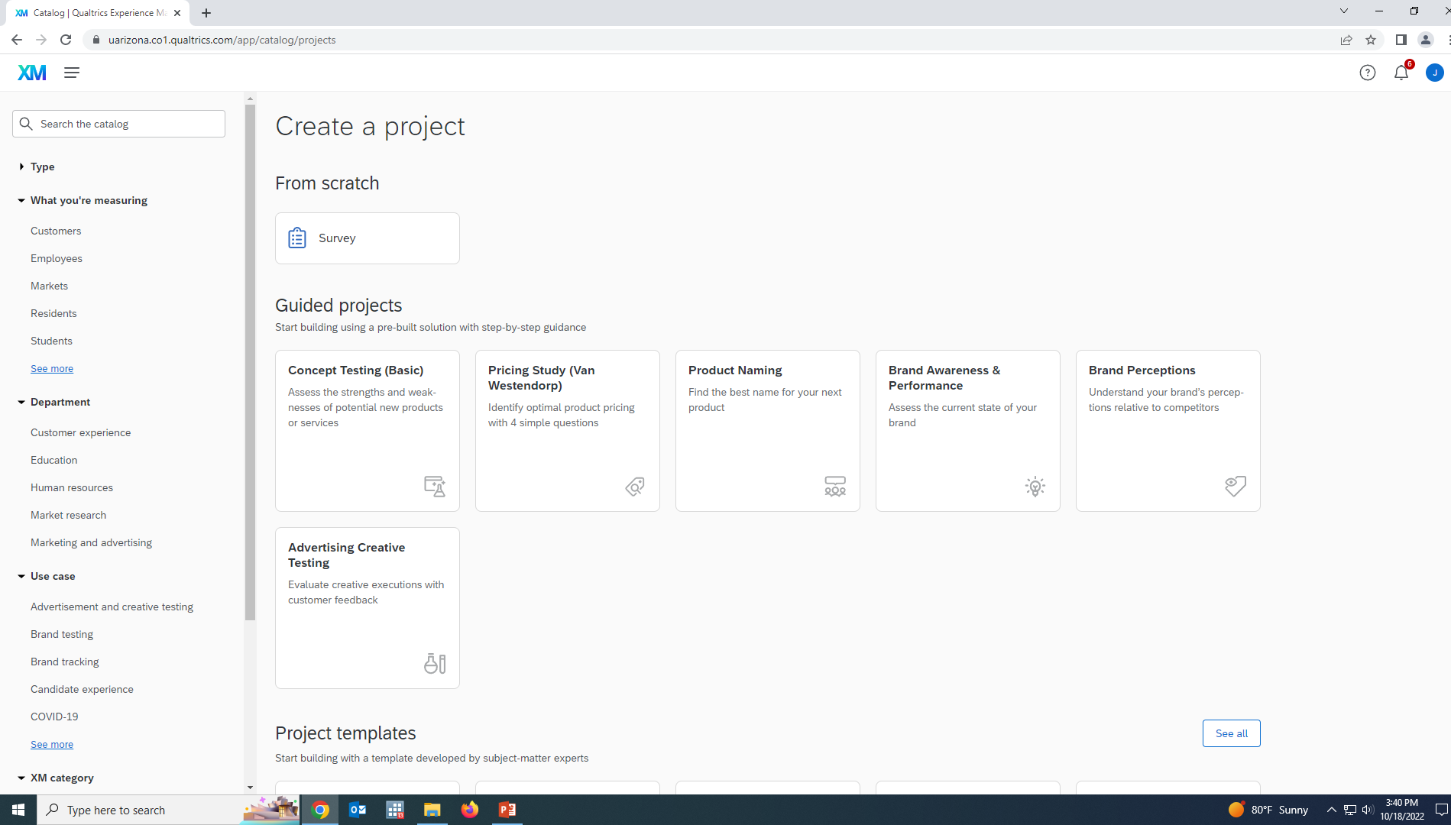
Create a Project page has several options: Scratch, Guided, Templates, and COVID-19 projects

Slide 7
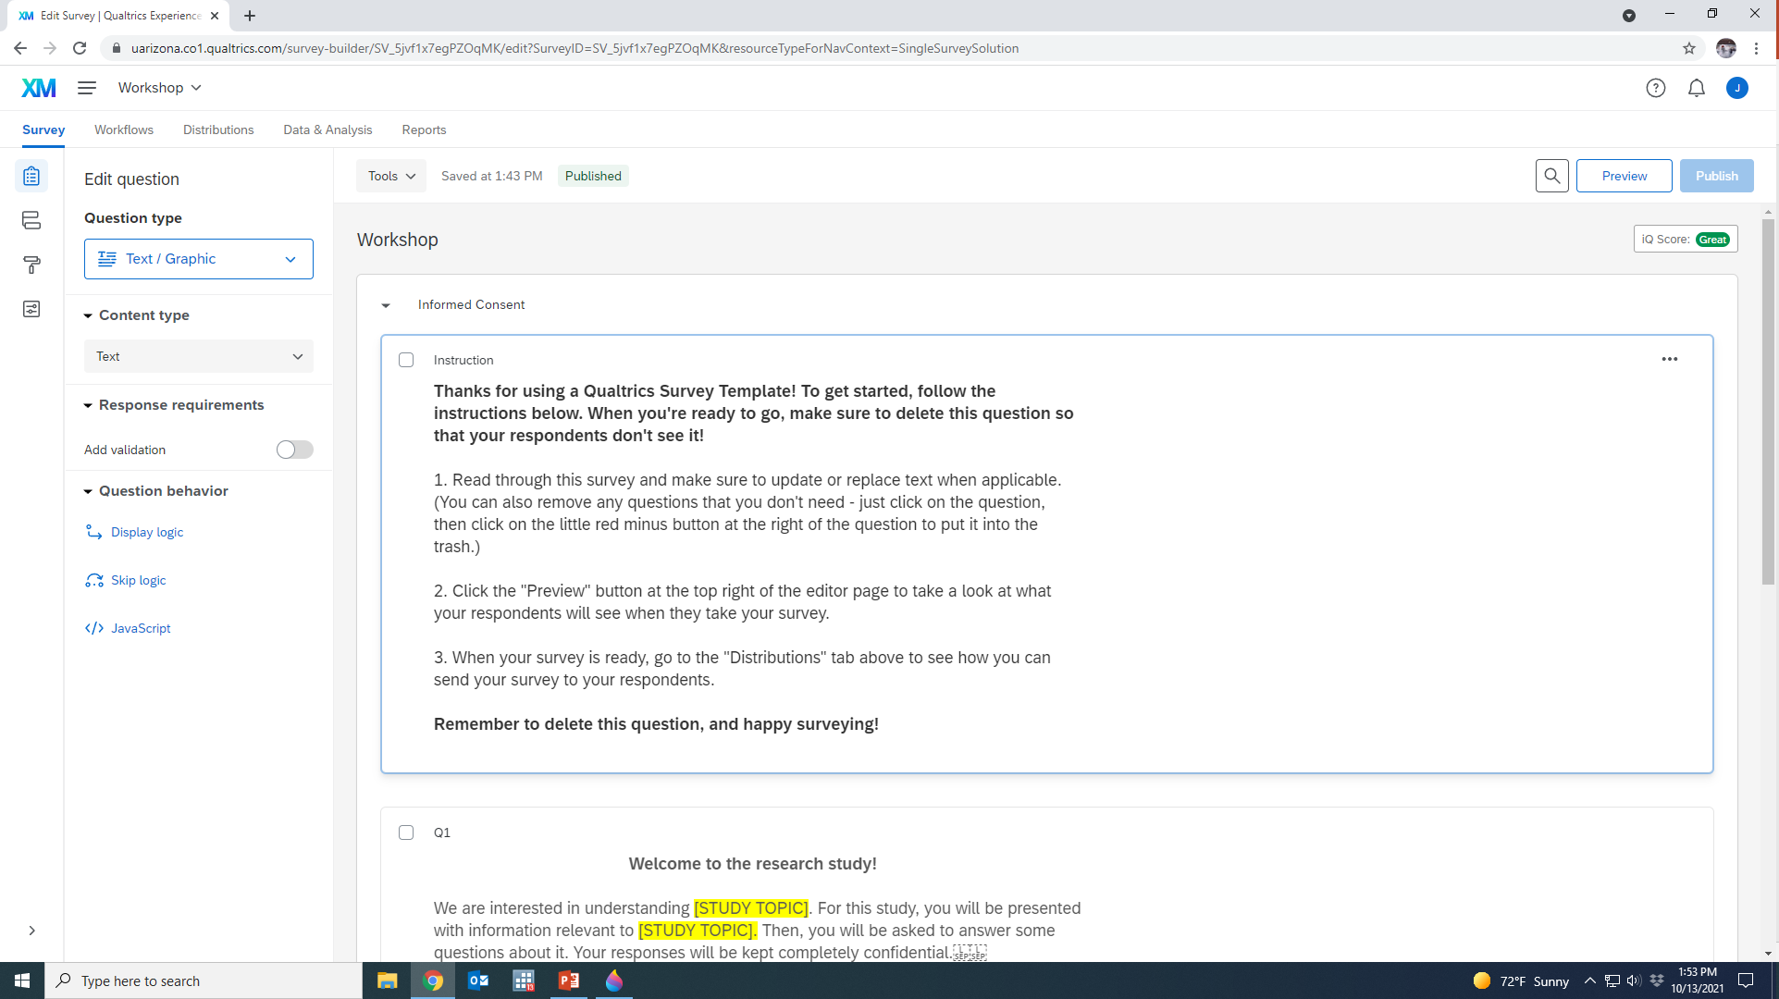
Example surveys are fully customizable & will walk you through steps.
Make sure you delete setup instructions through out survey!
Delete by selecting the 3 dots
Notes:
If you use a Qualtrics template, it will walk you through the survey creation process.

Slide 8
We will start a survey from Scratch.
This tab is on the top of the Projects Page
Notes:
However, we will start a survey from scratch using the tab that has been circled.

Slide 9
If you have worked on other surveys, you will first want to use the blue tab, to “create a new project”.

Slide 10
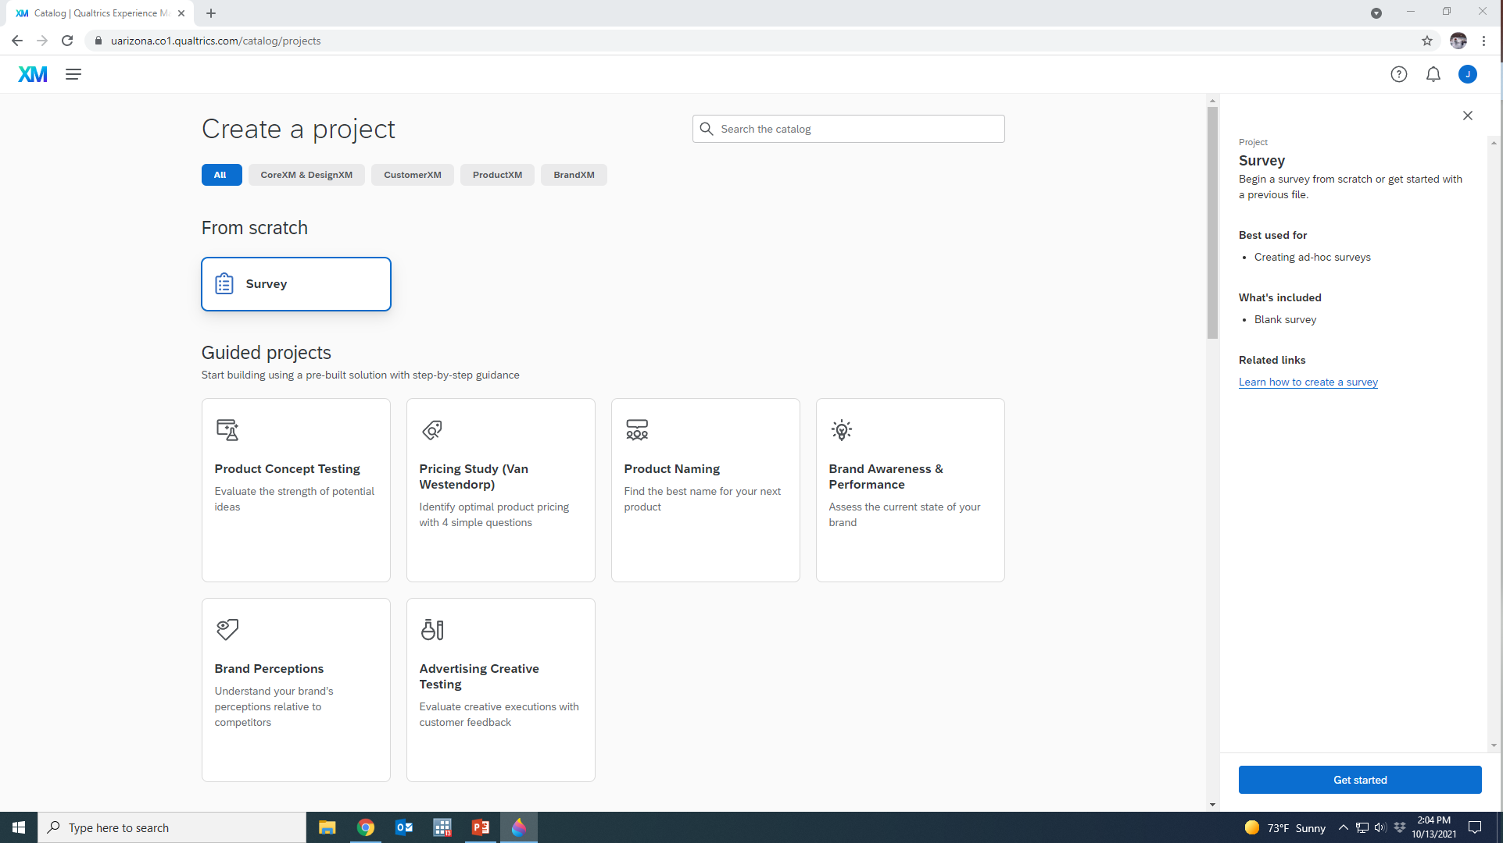
Select “From Scratch”
Then select “Get Started”

Slide 11
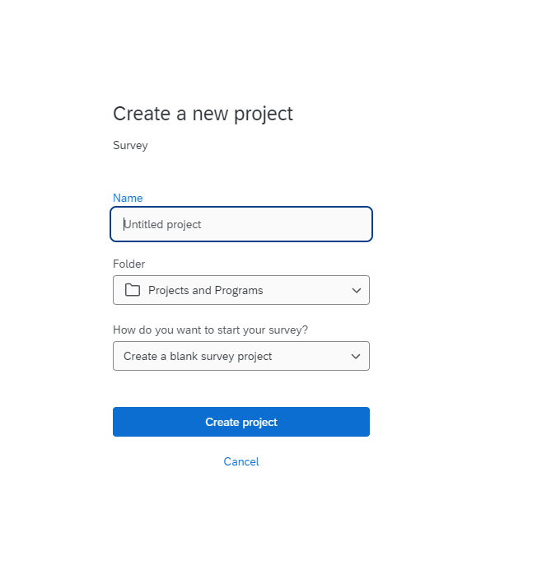
Need to name your project.
Notes:
The first step in any project is to name the project, so we first do that here. You can easily change this later on if you want or need to.

Slide 12
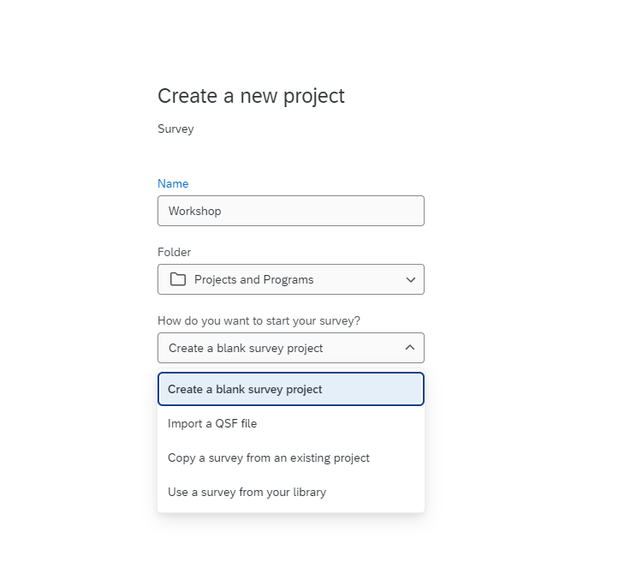
Options: Create, QSF, Copy, Survey from Library
Qualtrics Survey File *.XML
Notes:
After writing in the name of the project (“Workshop”), we are going to select the option to create a blank survey project. But there are, as you can see, options for importing existing surveys into your project at the start.

Slide 13

Today, we will start from scratch to create a hypothetical survey – one examining ice cream consumption and preferences
Notes:
What will our survey project focus on, then? Here our example survey will focus on ice cream consumption and preferences.

Slide 14
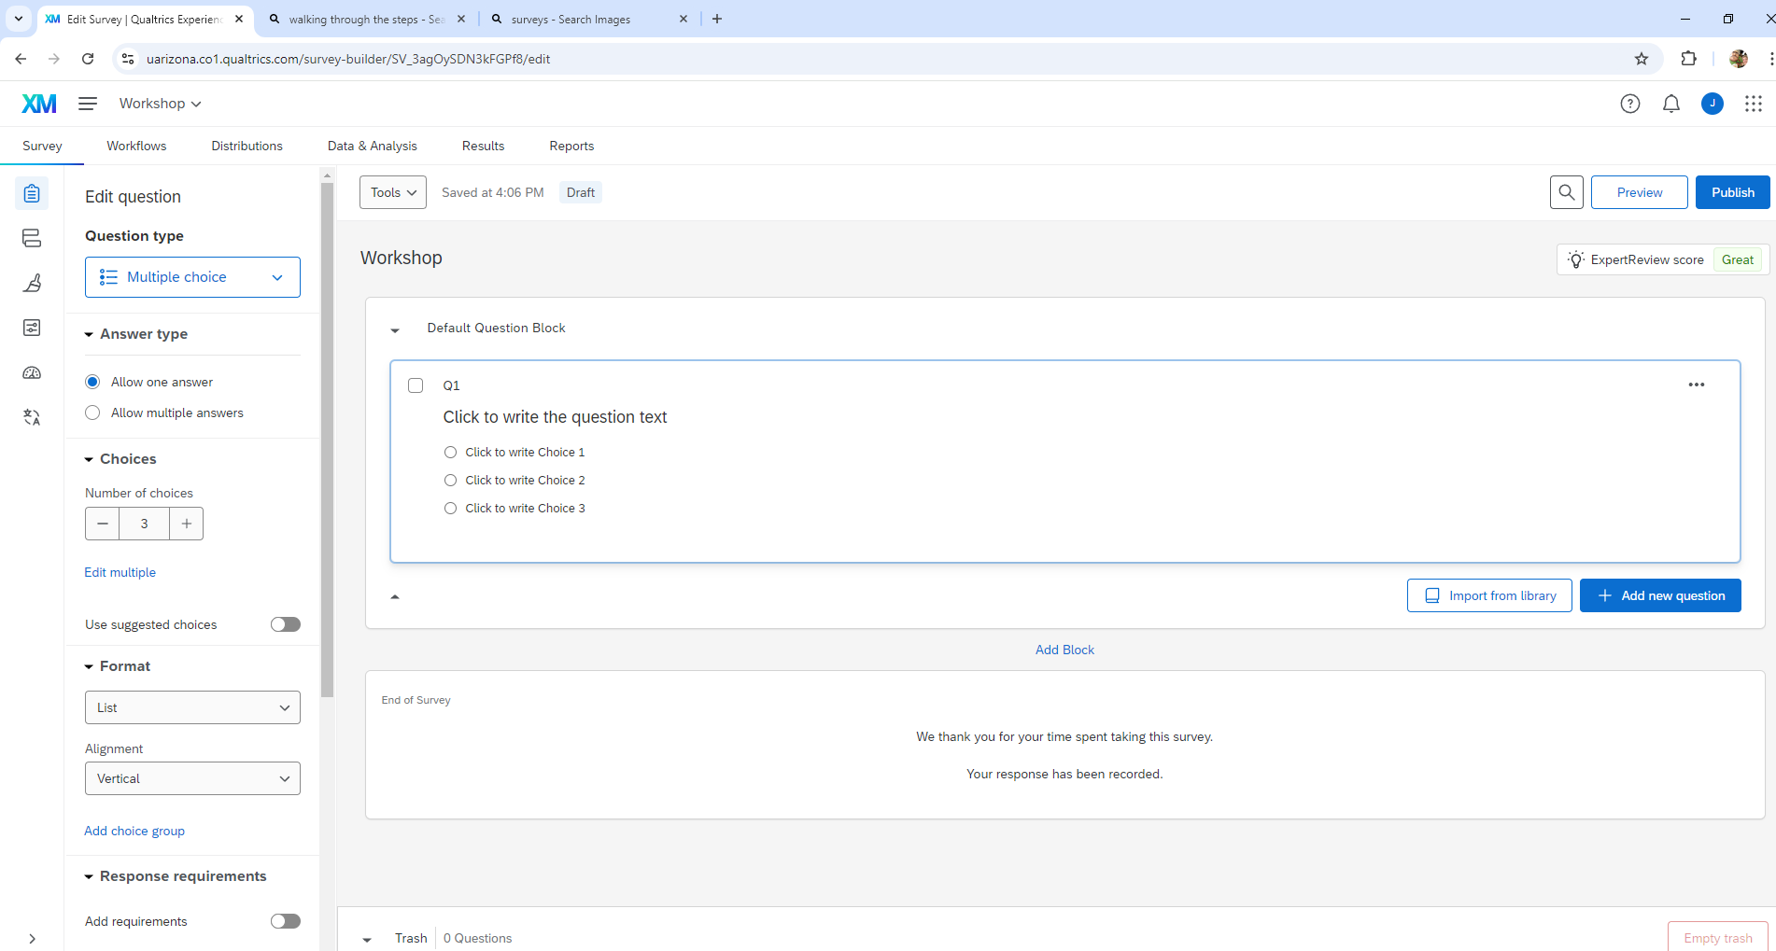
Your screen should appear with a default 3 option question at the top. This is the Survey Creation dashboard.
Notes:
After you create your project you should appear on a screen that looks like this, the survey creation dashboard.

Slide 15


Take a moment to review the Survey Creation dashboard

Slide 16
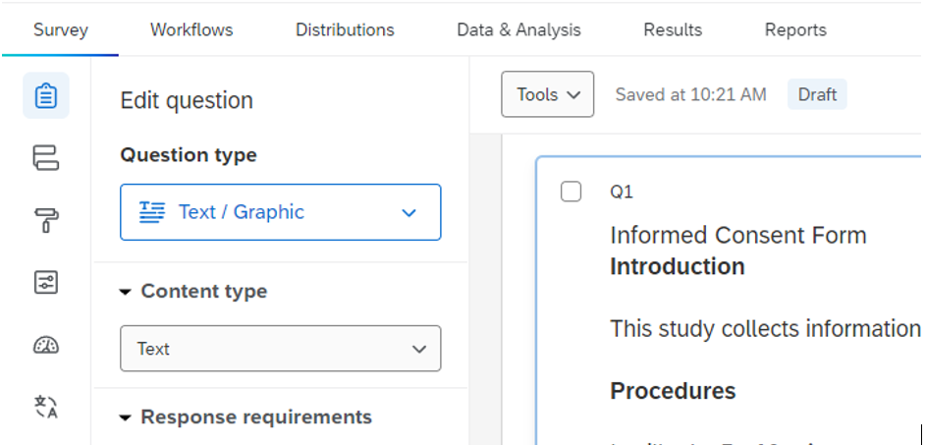
Qualtrics Project Menu
Post - development
Use during creation
Notes:
The items circled in blue are those we will use during the survey creation process. Those circled in green we will look at after we have created our survey.

Slide 17


Dashboard basics
Side Tabs
Survey setup options:
Builder (clipboard)
Flow (connected boxes)
Look & Feel (paint brush)
Survey Options
Quotas
Translations

Slide 18
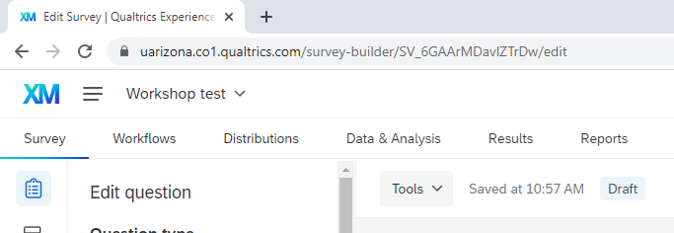
Dashboard basics
Post-creation options:
Workflows
Distributions
Data & Analysis
Results
Reports
Top Tabs

Slide 19
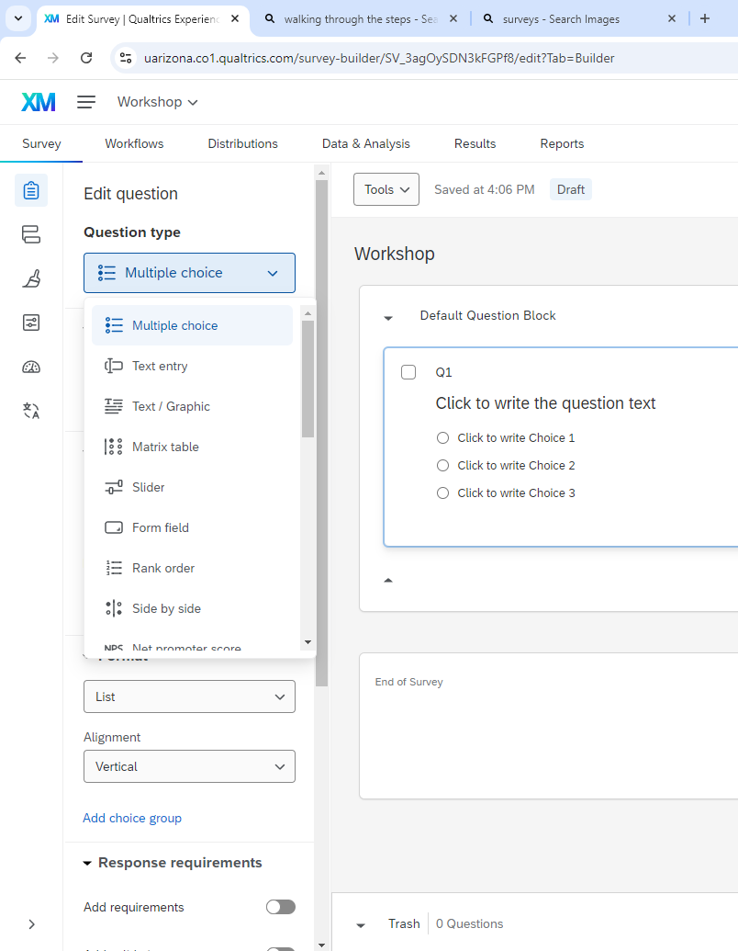
Setup Options
Post-creation
Question Types
Notes:
There are multiple question types from which to choose, and all of these are editable to fit one’s needs. A list of these question type options is provided in the next slide.

Slide 20
Builder – Question types in Qualtrics
Text entry
Multiple choice
Text / Graphic
Matrix table
Slider
Form Field
Rank order
Side by side
Net promoter score
Graphic slider
Constant sum
File upload
Pick, group, rank
Drill down
Signature
Heat map
[Timing – does not display but tells how long respondent spent on a page]
Meta info
Captcha verification
Highlighted information in questions
Notes:
There are quite a few different options provided by Qualtrics. If you are unsure of what these options refer to, the following slide shows how to see an example of each.

Slide 21
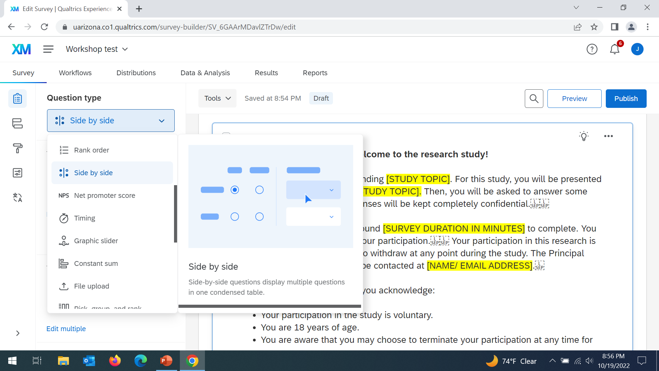
Different question types
Hovering over each will give an example
Notes:
Just need to hover over the question type to get an example of what that kind of question would look like if selected.

Slide 22

Now that we are a bit familiar with the set up, let’s start creating our survey,

Slide 23
Start Our Survey with a Consent Form
The Qualtrics Library, has an editable version. We will put that in its own block.
Select Add Block
Notes:
When conducting IRB-approved survey research, we will need to include a Consent Form, so let’s add one here. To do so, we can select the import from library tab directly below our default question, or we can select add block to put the consent form in its own block. Let’s do the latter.

Slide 24

Blocks – build groups of questions within survey
Blocks make it easy to readily move groups of questions within your survey
Notes:
What are blocks? They are questions that we have group together so that we can easily move and implement features or conditions across them.

Slide 25
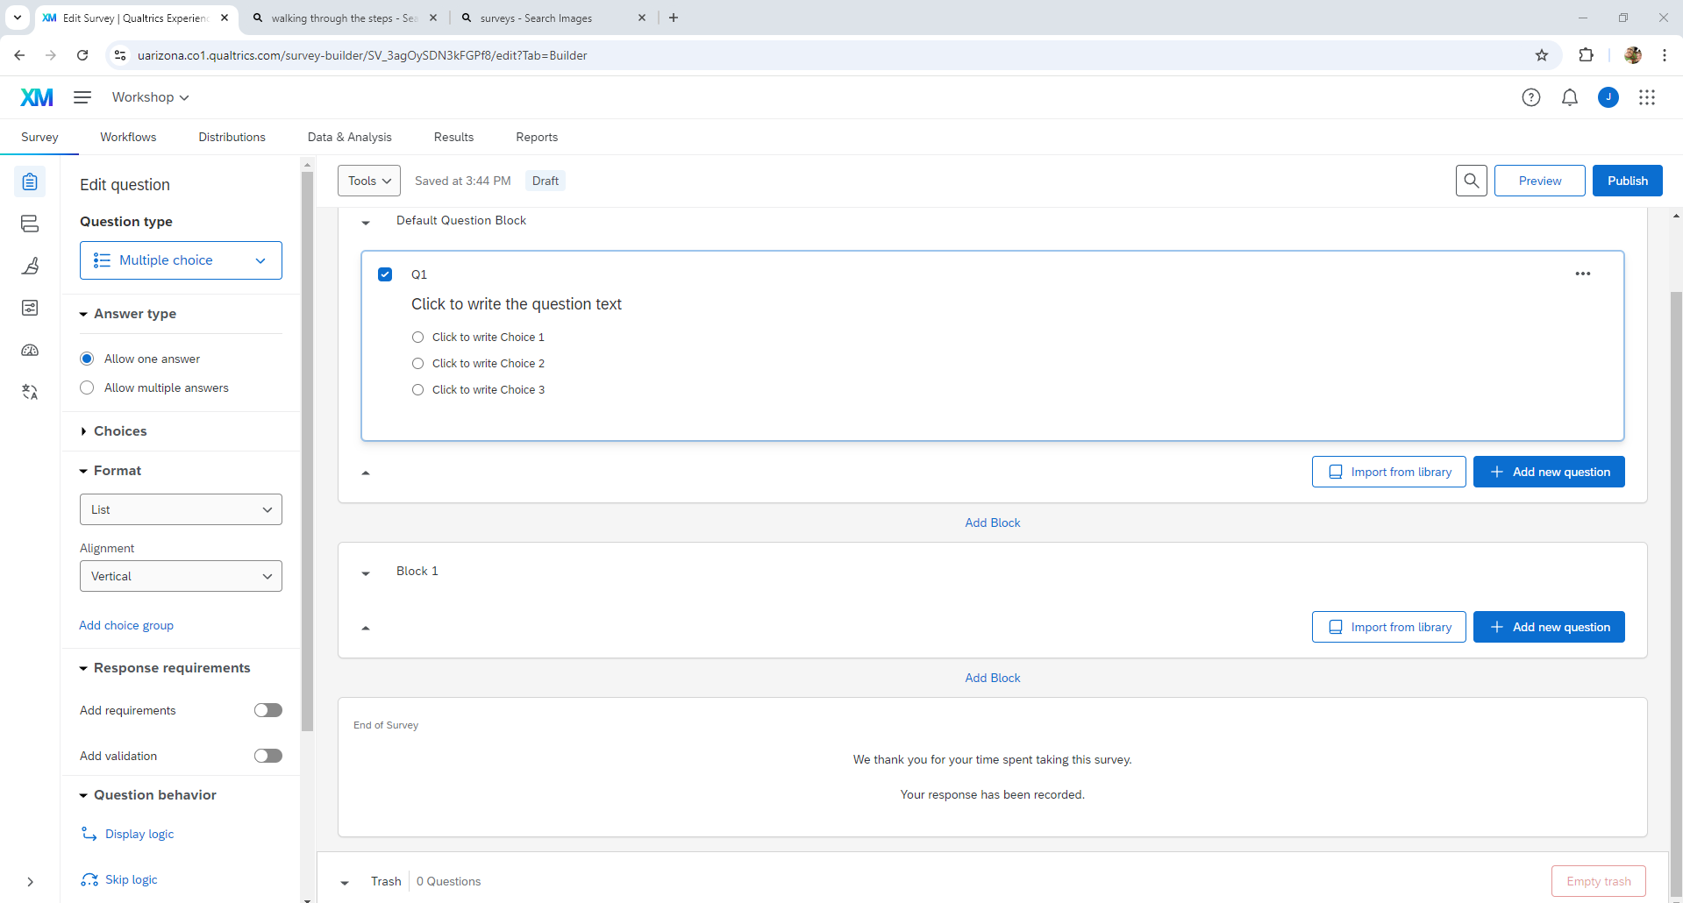
We are going to IMPORT the consent question from the library.e
Qualtrics Library > Survey Library >
Higher Education > Informed Consent Template > Import Entire Survey
Notes:
You can find a sample informed consent form template through the directory provided here.

Slide 26
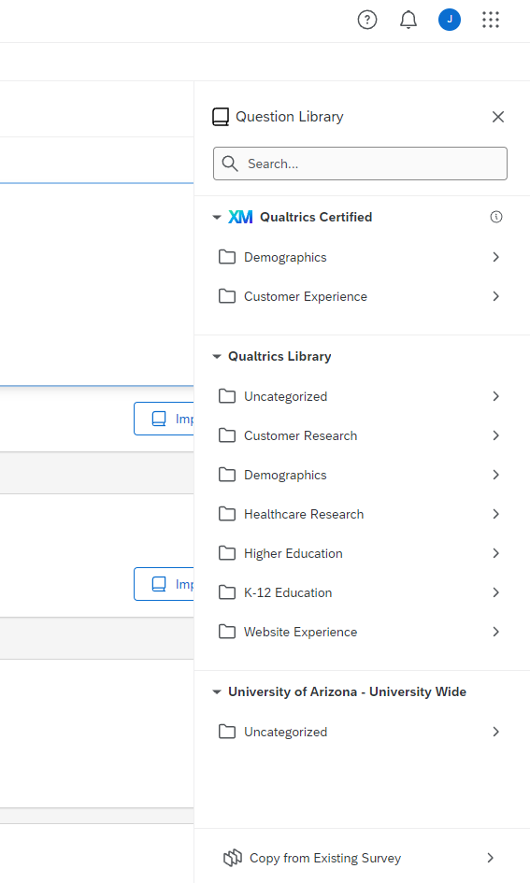
Qualtrics Library > Survey Library >
Higher Education > Informed Consent Template > Import Entire Survey
Notes:
All you need to do is click each of the directory locations listed, like the “Higher Education” one circled here.

Slide 27
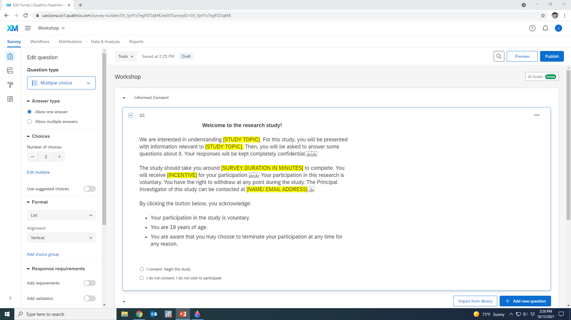
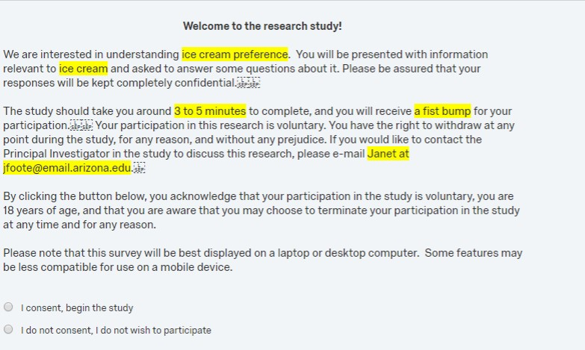
You can easily edit the Consent Template from this screen. Click on the writing to edit.
Consent response questions should be same size as info above it
Notes:
Once you select the consent form template you can easily start editing the template to fit your project. The first thing we want to do with this template, though, is to edit the consent response question options to make them the same size as the consent form above. We want to make sure that potential participants can clearly see and distinguish between the consent and do not consent options. After that we can then edit the template to make sure potential participants know what they would be consenting to participate in.

Slide 28
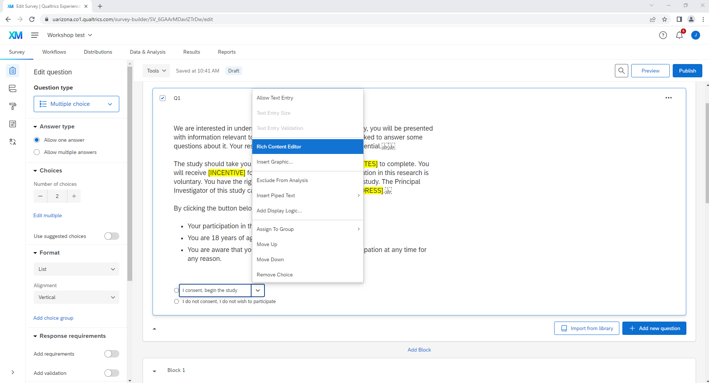
Changing font and formatting
– Use RICH CONTENT EDITOR
Select this pull down tab to see choices
Notes:
To make these edits here, the rich content editor is our friend.

Slide 29
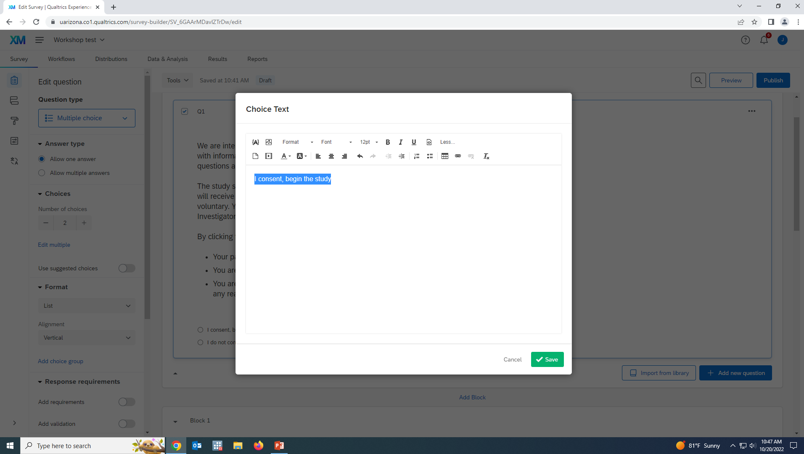
Select your text and edit as desired. Note, options to include pictures, hyper links, videos, etc…..
Notes:
Afte the choice text box pops up, we can start making changes that will improve the survey taking experience.

Slide 30
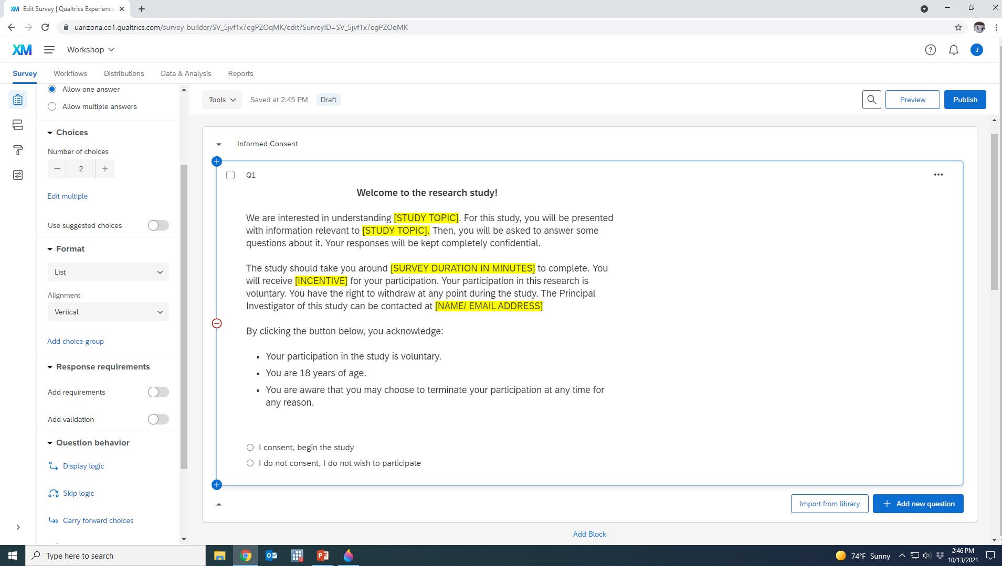
Scroll down from Question Type menu to find Question Behavior
Notes:
Because we are currently working on the consent form, another Qualtrics element we will want to incorporate is Skip logic, which is found in the question behavior section of the survey builder.

Slide 31

Back to consent form….
If potential participant does not consent, survey must go to closing page.
We use SKIP LOGIC to make this happen.
Notes:
Why do we need to incorporate skip logic here? If the potential participant provides consent, we want them to move forward with taking the survey. But if a potential participant decides that they do not consent, we want to ensure that they are re-directed to the end page.

Slide 32
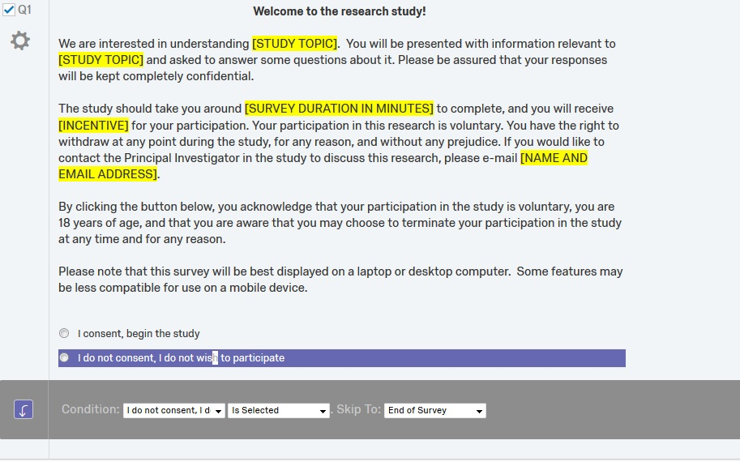
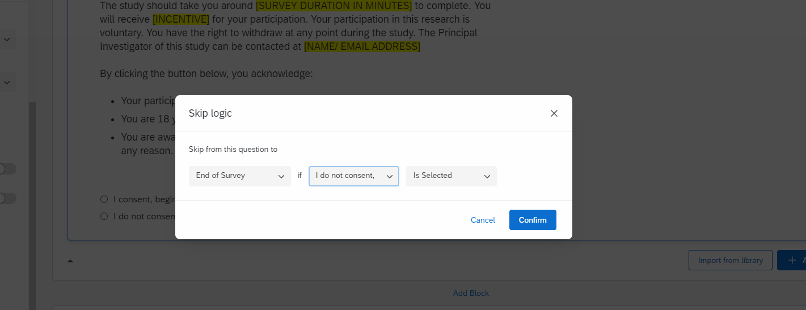
Skip logic – what happens based on question answer selected.
Notes:
This is what the skip logic pop-up screen looks like when selected. As you can see, we have specified that when someone selects I do not consent, they will be redirected to the end of the survey.

Slide 33
Skip Logic – skips questions based on response choice
Display Logic – displays questions based on response choice
Cannot use logic across separate blocks
Notes:
There are actually two types of logic that can be found under “Question Behavior” in Qualtrics: skip logic and display logic. As we have discussed, skip logic is typically used when you want to send respondents to a specific section of the survey, or the end of the survey, based on how they answered a question.
Display logic, on the other hand, is typically used to customize the survey to the respondent. In our hypothetical ice cream survey, for example, we can add follow-up questions like do you like vanilla, chocolate and/or strawberry ice cream if they responded yes to a previous question about whether they eat ice cream or not. There are a number of situations in which you might want to ask follow-up questions to those who selected into a group of interest of yours in your project.
It’s important to note, though, that you can use these logics within blocks, not across multiple blocks.

Slide 34
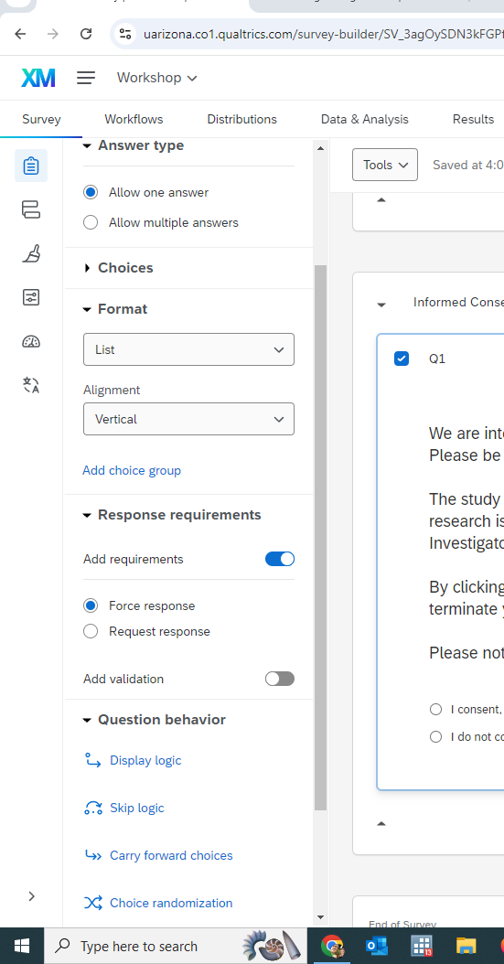

Consent question must be required.
Response requirements > Add requirements > Force response
Notes:
Additionally, when working on the consent form component of a study, we want to ensure that participants are answering the question and not skipping it. While for other questions in the survey we will generally want participants to have the option to skip a question if they do not know what to answer or feel uncomfortable doing so, with the consent form component we need to ensure that they have provided their consent before moving forward with the survey. We can ensure this by selecting the force response feature circled.

Slide 35
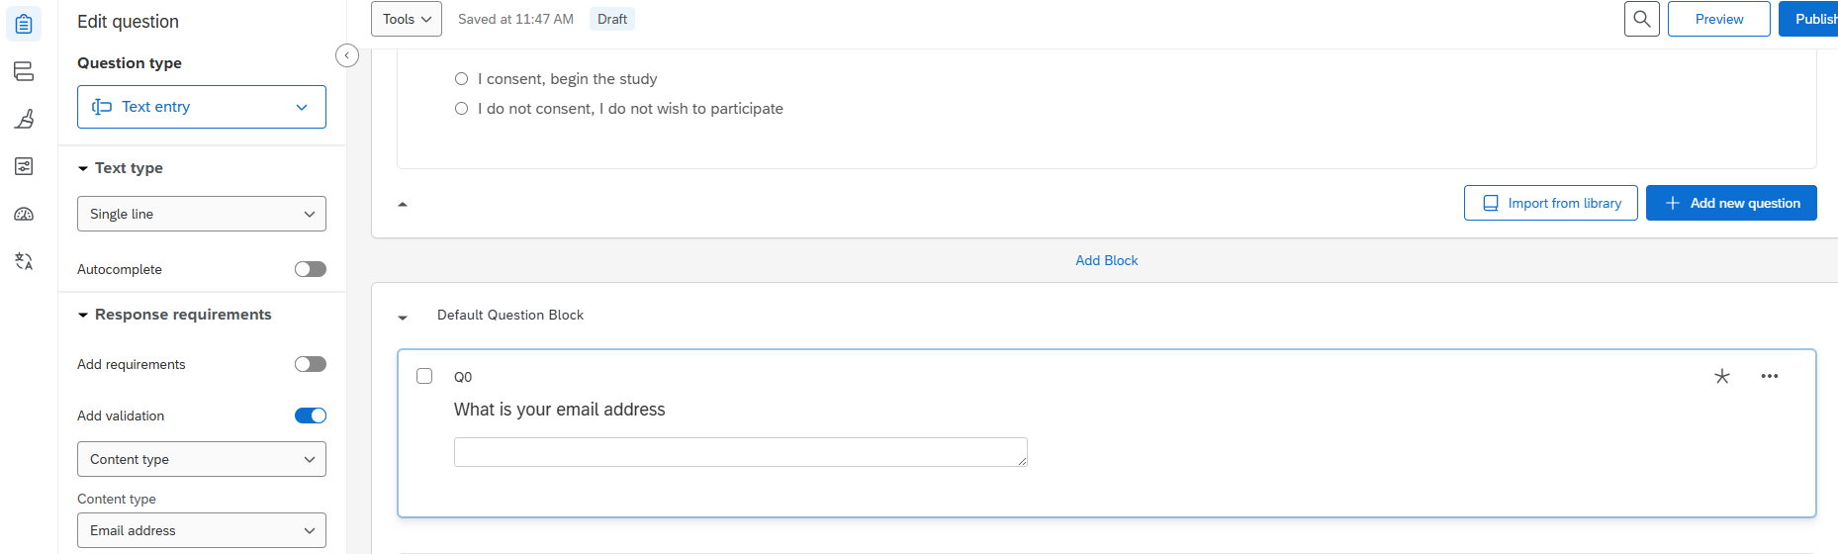
“Add validation” and “Content type” conditions can also be found in this area.
Notes:
Add validation is another tool you can use to require that participants answer a specific question to move forward with the survey. The respondent will not be able to proceed without doing so.
Content type allows you to request specific information types such as phone number, address, email address or zip code, and verifies that the information entered is appropriate, which you can use to ensure that your survey is reaching the population you want it to reach.

Slide 36
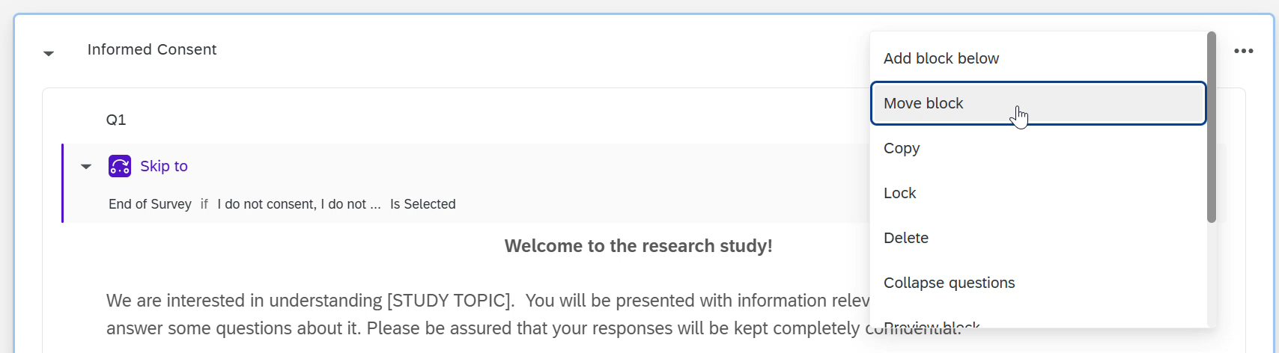
Now let’s move the informed consent block to the top of the survey so that it is the first question respondents see (click on the “…” in the block corner)
Notes:
Select top of survey location

Slide 37
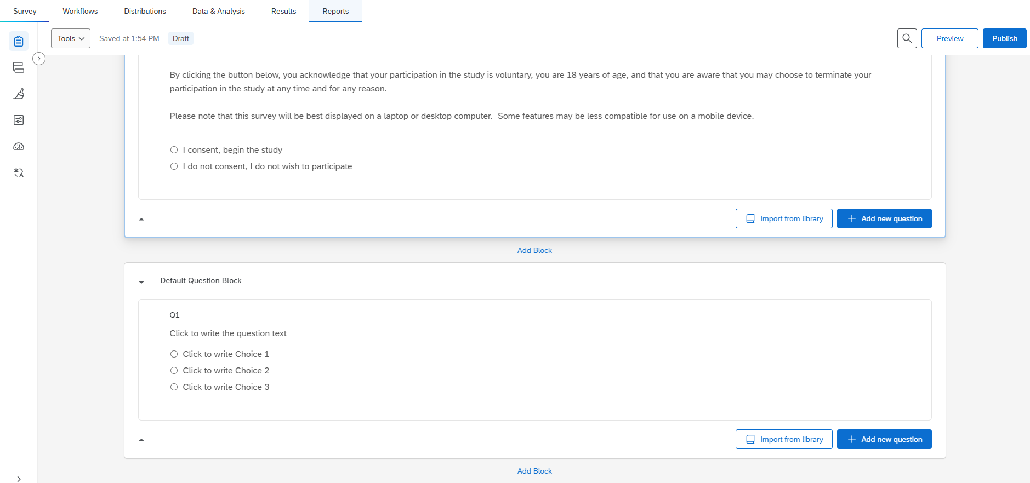
Current survey creation dashboard
Notes:
Once we have finished working on the consent form, your survey should look like this. We can now start adding our survey questions now.

Slide 38
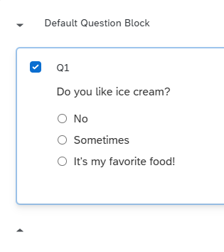
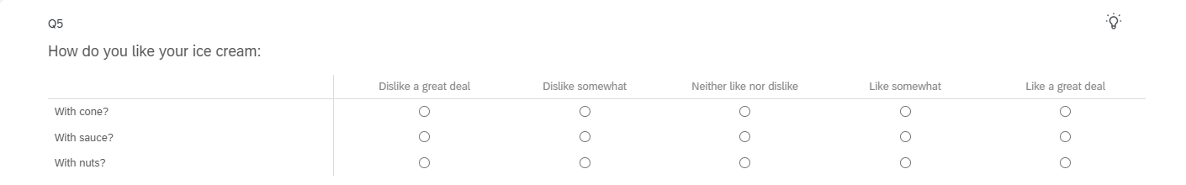
Let’s start adding questions!
Do you like ice cream?
Start with Default Block multiple choice question – 3 choices
No/Sometimes/It’s my favorite food!
Could change to no/sometimes/yes or just no/yes, adjust font, etc…
+ Add new question
How do you like your ice cream:
Matrix Table – 3 statements
With cone, sauce, nuts?
Notes:
We can start by editing the default question originally provided. Can edit the question text directly, or edit the question responses by using the rich editor we talked about earlier. For this example project, the first question I will add is: Do you like ice cream? I have provided three response options, but other response options, including a simple yes/no framework would work. That question is then followed by: How do you like your ice cream? With multiple conditions provided for respondents to evaluate using a Likert scale in each case.

Slide 39
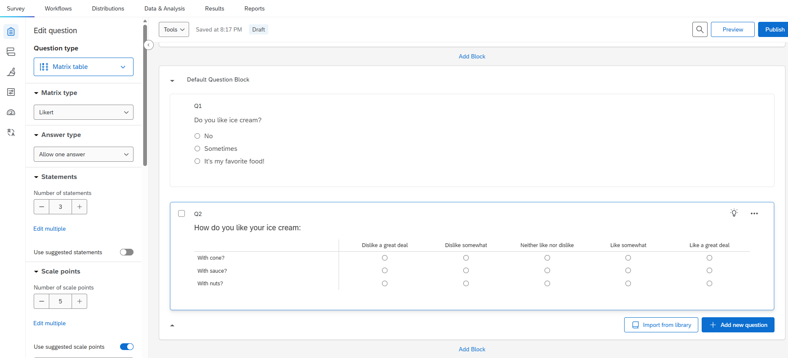
How to add questions:
Add new question
Add Block
Import from Library
Notes:
How do you add subsequent survey questions after you have transformed the default question template into your first question?
There are 3 means of doing so: 1) add a new question, 2) import a question for the library, or 3) add a new block. Using the import from the library is a great way to find questions that have already been formatted well, a consent form template – or to find questions that are validated instruments such as, depression scales, burnout scales etc.. In my case, I selected the add new question tab and selected the matrix question option.

Slide 40
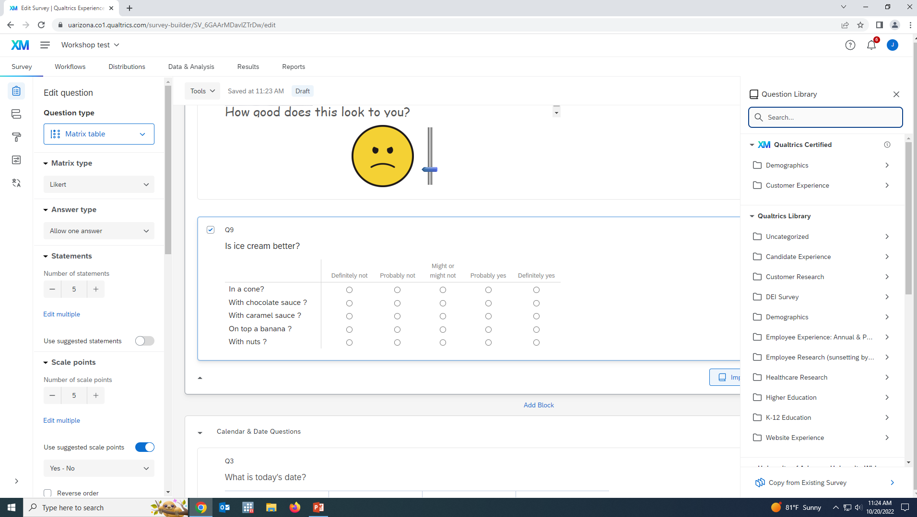
Import from Library: Adding Calendar and Date Questions
Qualtrics Library > Qulatrics Library > Demographics > Calendar & Date
Notes:
You may also want to collect date and time information from survey respondents, whether that is something like when they completed the survey or when they were born. You can collect this kind of info in Qualtrics as well through the pathway described above.

Slide 41
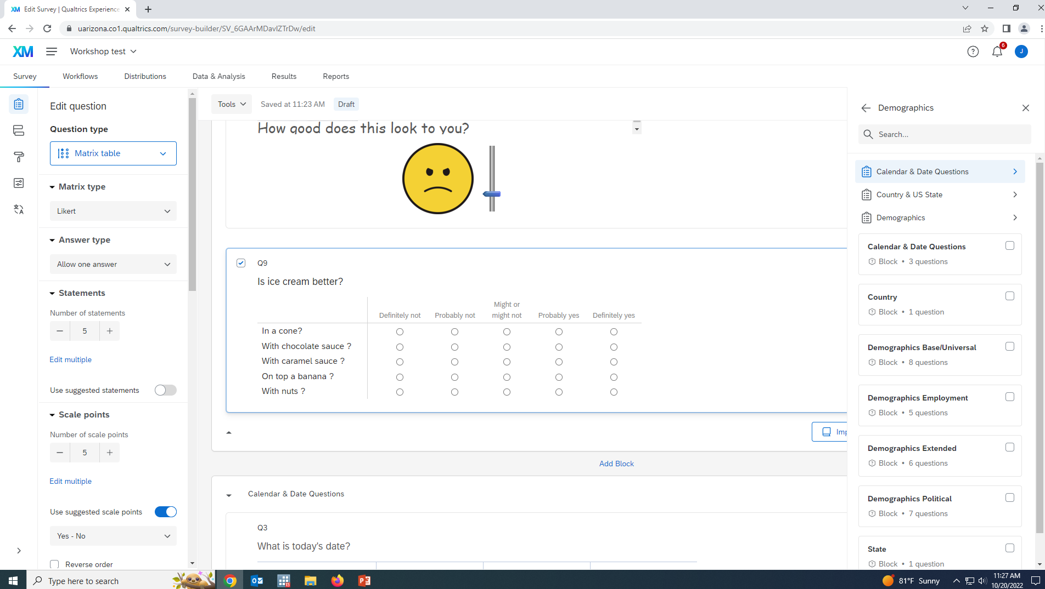
Import > Qualtrics Library > Demographics > Calendar & Date Questions

Slide 42
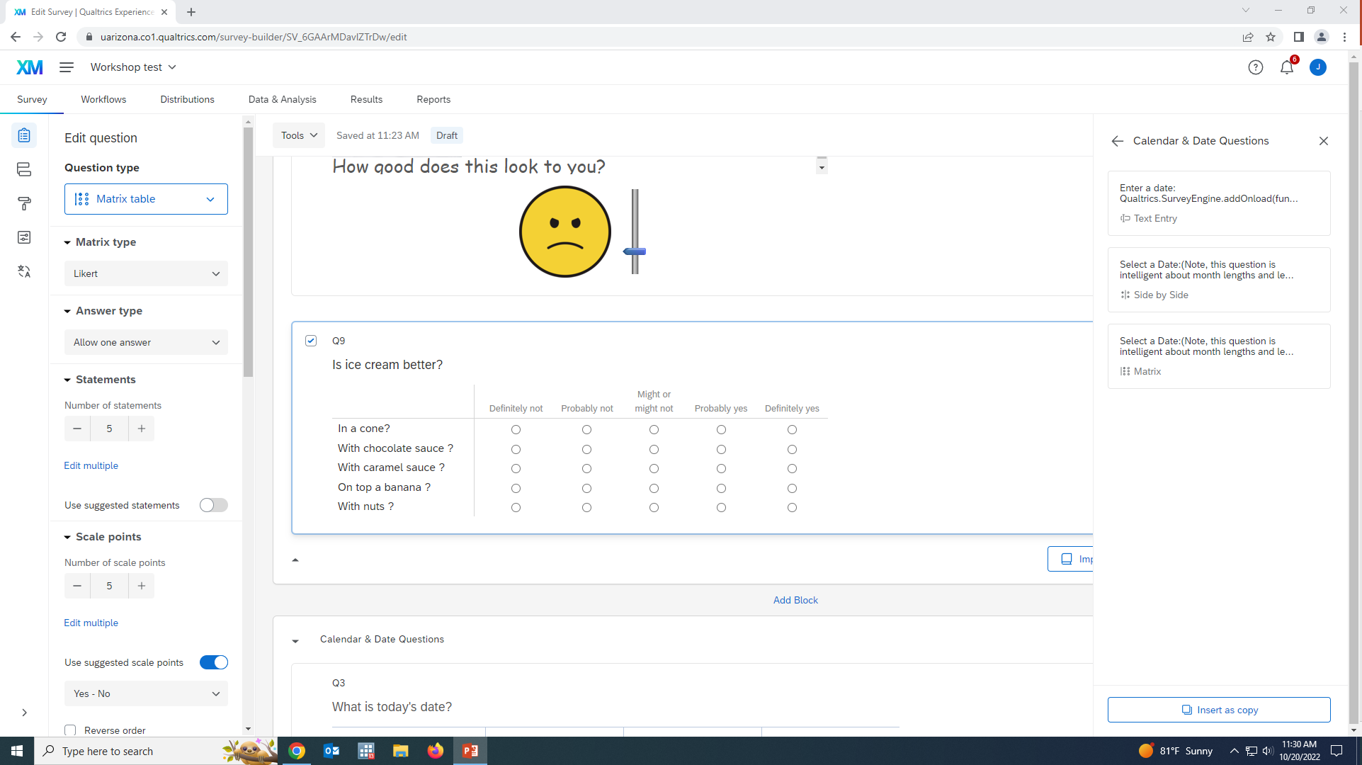
3 choices: Bottom 2 are “intelligent” dates
Notes:
There are three different options that pop-up, the bottom 2 are “intelligent” options that are easy to work with.

Slide 43
Make your survey is tailored and easy to complete!
If asking today’s date and know all will be surveyed in 2025, you can delete the year column.
Or if just want participant’s birth month, you can only keep the month column.
Only collect information to the level of what you need (but make sure you are collecting what you need)!
Notes:
We want to make the survey participation and data collection process is as smooth and simple as can be. For this reason, we want to collect only the info that we need so that we are not burdening the participants or ourselves with additional question responses that we are not interested in. On the flipside, we want to make sure we are collecting all the info we need, so if there is a question or two that you think you may need but are unsure about, you should probably include them because we cant analyze information we don’t collect. These are two elements that you will need to balance when drafting your survey.

Slide 44

With that said, Qualtrics automatically records the date and time that the survey is started and completed.
Could rely on the Qualtrics info in the former example case - one less question for respondent
Notes:
So with all that said, when working on Qualtrics we can opt against including a question like when did the participant take the survey because Qualtrics will already collect that info for us. So we can save the participant and ourselves from processing that question.

Slide 45
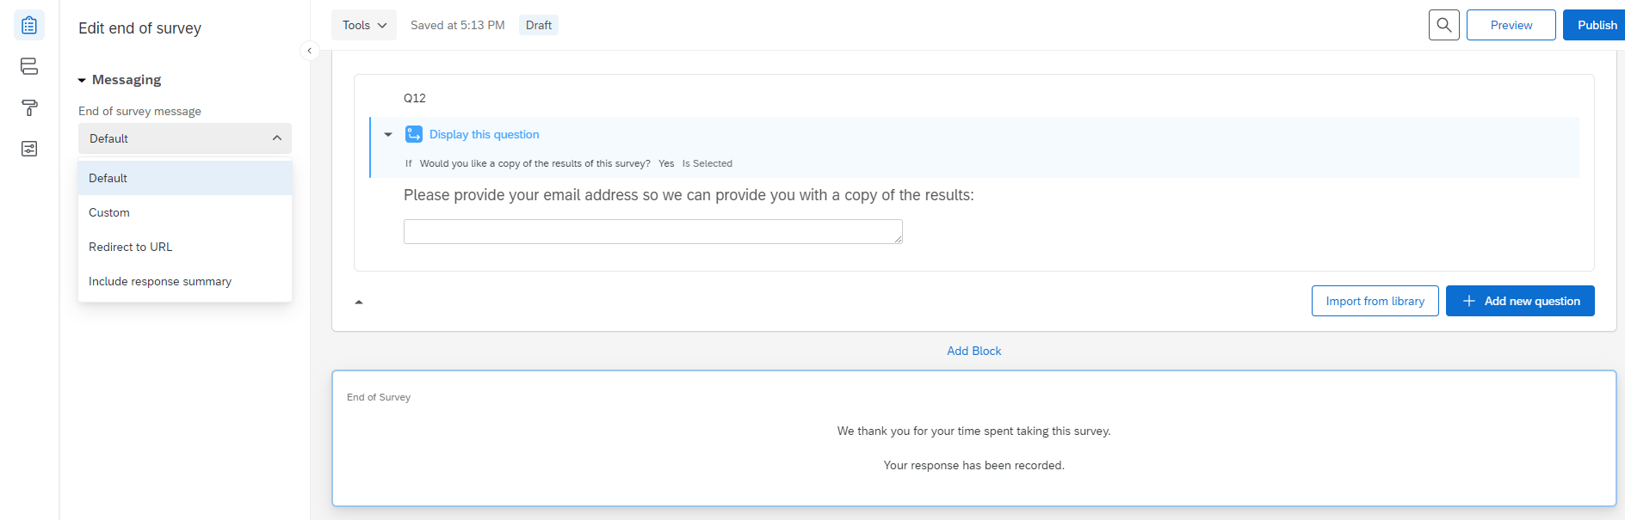
End of Survey
Can customize verbiage at end of survey by Edit end of survey and making a “custom” message.
Notes:
Once you have reached the end, it’s time to let the participant know that they have completed the survey. Qualtrics provides a default message that we can easily edit with the circled option.

Slide 46

Check spelling
Remove unwanted “help” text
Remove extra questions and/or blocks
Notes:
Once the survey is complete, the next step is to review what you have drafted and address any issues that you spot. This would be a good time to get someone to look over your survey, like one of the biostats team members.

Slide 47

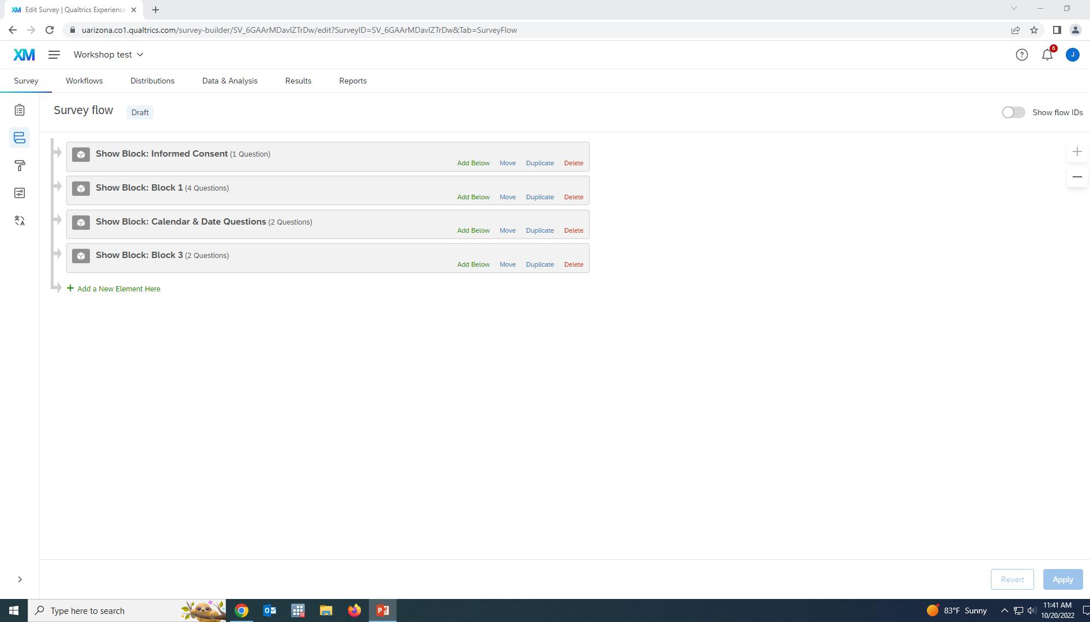
Survey Flow
Easy way to move around different question BLOCKS
Notes:
You have edited the survey as recommended in the prior slide; what now? One thing you may need to do is reorder the questions in your survey, as we did earlier. The survey flow tab shown here provides another easy method for moving blocks of questions around.

Slide 48

Look and feel (looks like a paint roller)
Most UArizona Colleges have preset themes
Also Presets from Qualtrics
General – adding Progress bar, Next & Back buttons etc.
Notes:
We want our surveys to look and feel professional. The look and feel tab provides options to ensure that and provide a good experience for the survey participant.

Slide 49
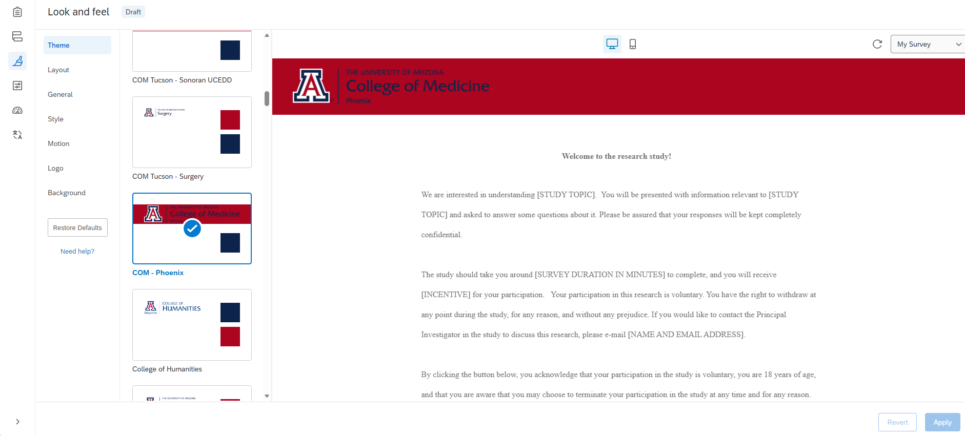
Look and feel – Theme Presets
Notes:
For this example project, I have added a College of Medicine – Phoenix Theme. You can do the same, or select one of the other UofA themes that you like.

Slide 50
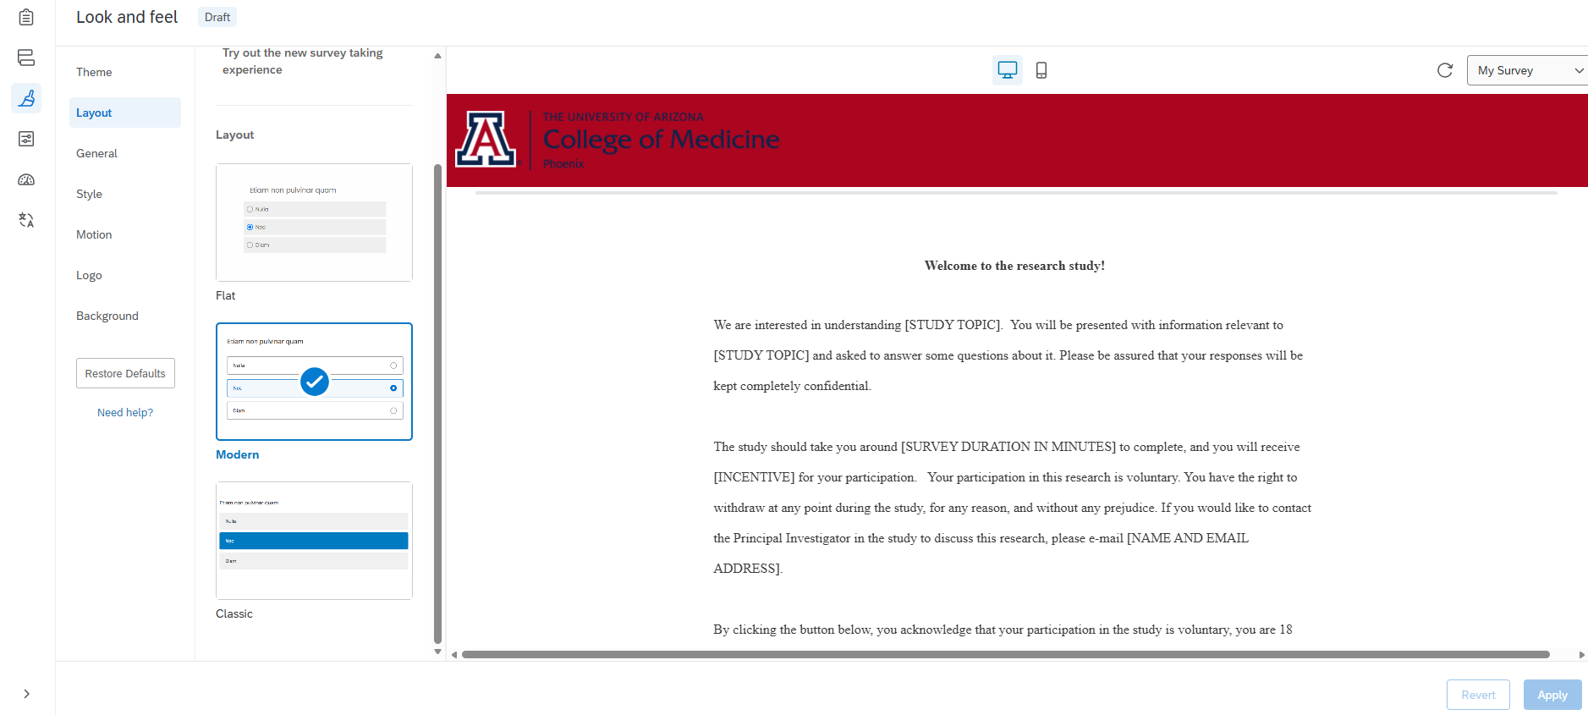
Look and feel – Layout options
How questions appear
Notes:
We can adjust the question layout as well. I have changed the layout to a modern look that helps the response options pop out to the participant and make it easier to identify them.

Slide 51

Survey Options
General – Language, showing question numbers or not, expert review
Reponses – choices about how your respondent can answer, return to survey etc.
Security – invitation or password protected, etc.
Post-Survey – can send thank you, trigger an email or contact etc.
Notes:
There are a number of other options you can incorporate to improve the survey experience and ensure you are receiving the info you want to collect from the population you have targeted your survey to.

Slide 52
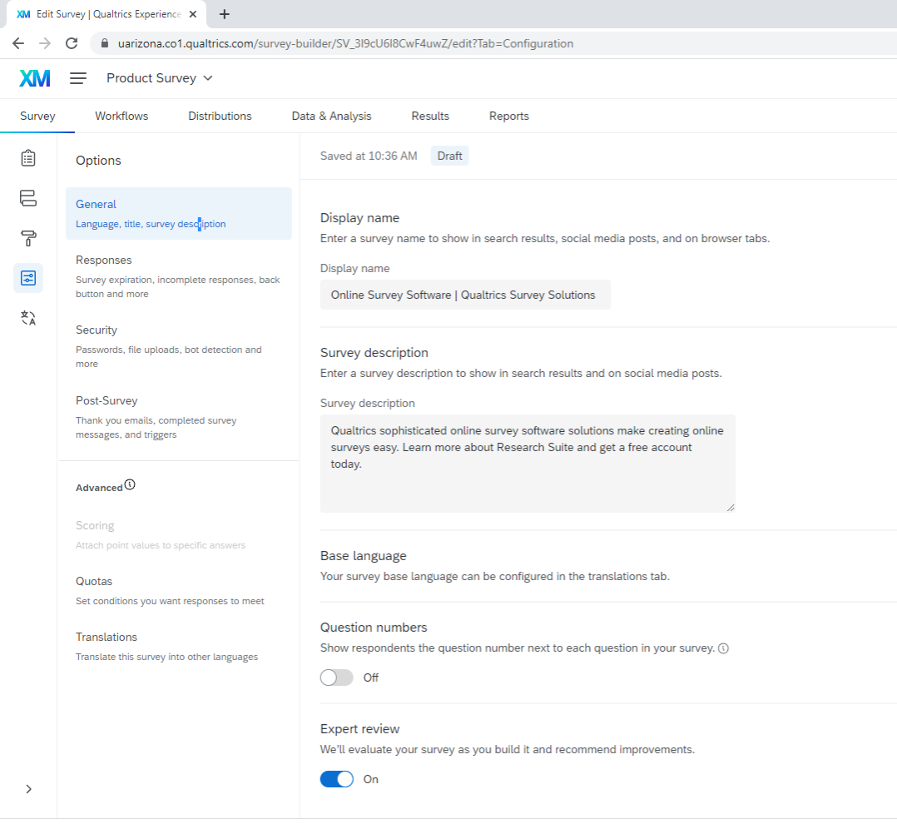
Survey Options
Notes:
Under the General survey options, you can add in a display name, description, have the question numbers shown to respondents or not, and receive the “Expert review” which is feedback while previewing your survey to estimate how user-friendly it may be – including accessibility issues.

Slide 53
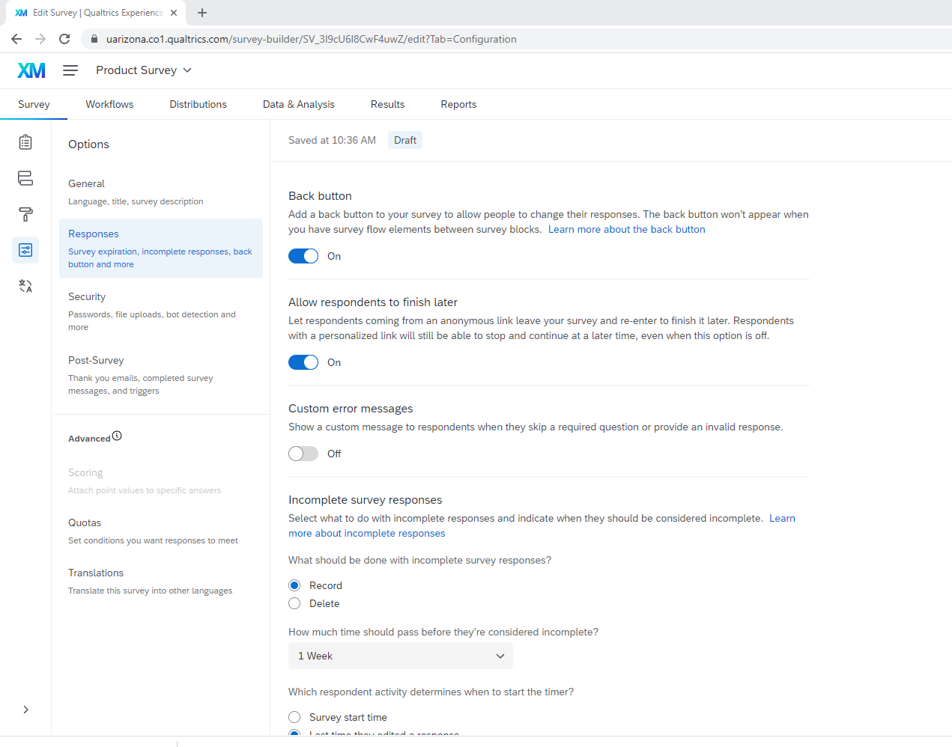
Survey Options
Notes:
Under the Response options, you can allow respondents to go back to the last question, allow them to come back to where they were if they are interrupted in completing the survey rather than start over, decide how you want to handle incomplete surveys, make availability options.

Slide 54
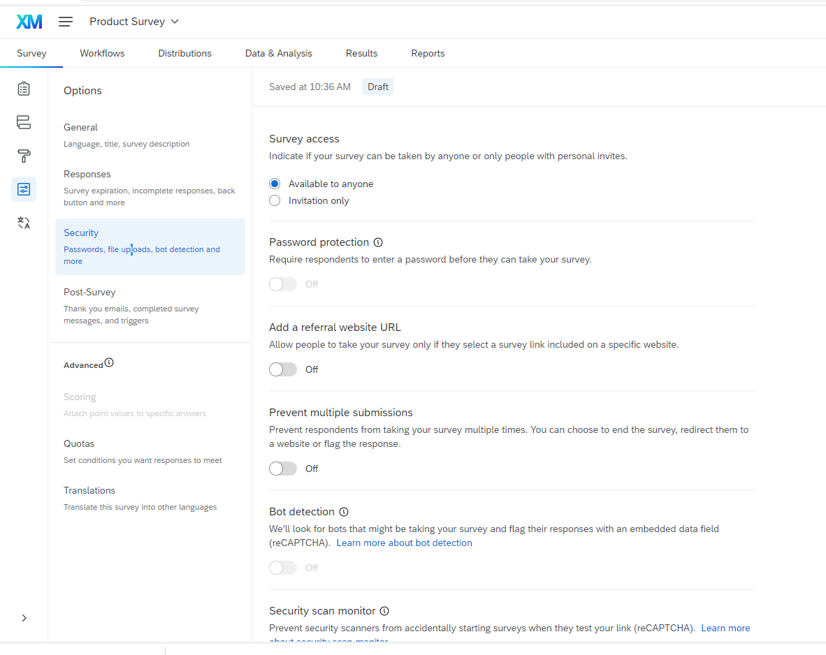
Survey Options
Notes:
Security is important, you can make decisions on the survey availability, prevent multiple submissions, add “bot” (autonomous program) detection, prevent indexing and IMPORTANTLY – Anonymize responses. This Anonymize toggle eliminates recording of the IP address, location data and any contact info that may be drawn from the device on which the survey is being completed. For research, we have typically do not collect this information – and the default is not to do so, but one should always verify

Slide 55
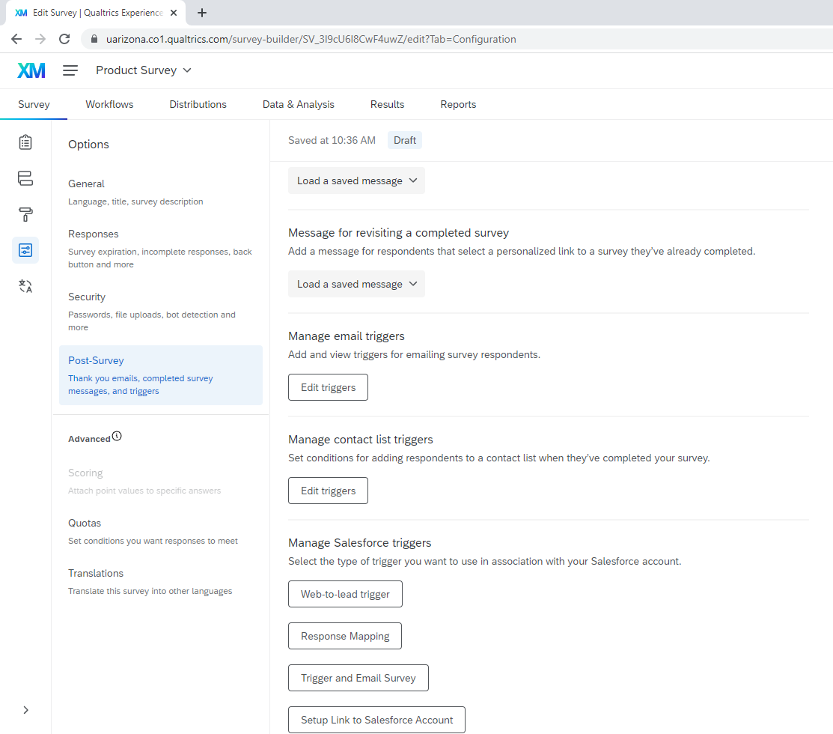
Survey Options
Notes:
Post survey options include sending out thank you emails and updates to yourself, although Qualtrics regularly emails updates about response collection once your survey is published. Note underneath the Post-Survey tab you have options to set quotas, and translate the language of your survey.

Slide 56

After you have completed the creation steps, preview your survey
Check your survey’s IQ Score

Slide 57
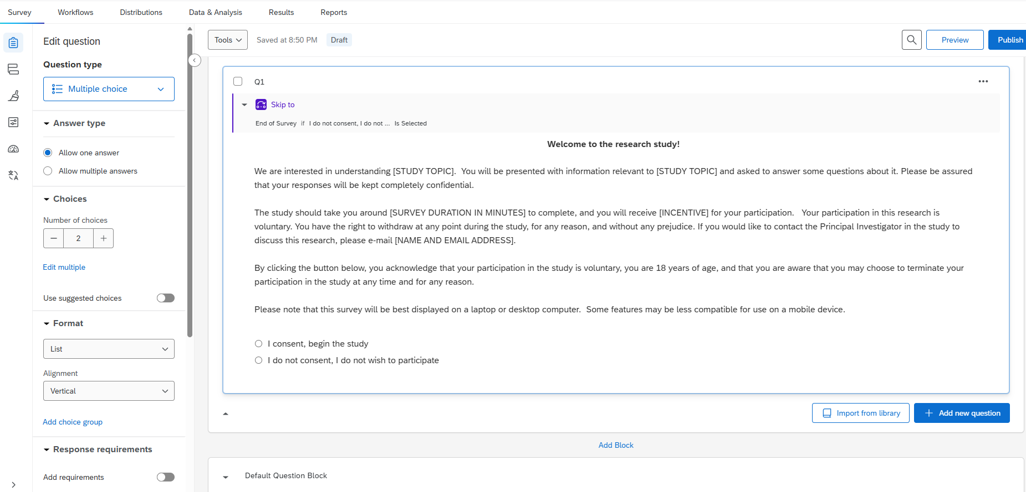
Preview button
Notes:
You can see what your survey will look like to respondents with the preview button circled

Slide 58
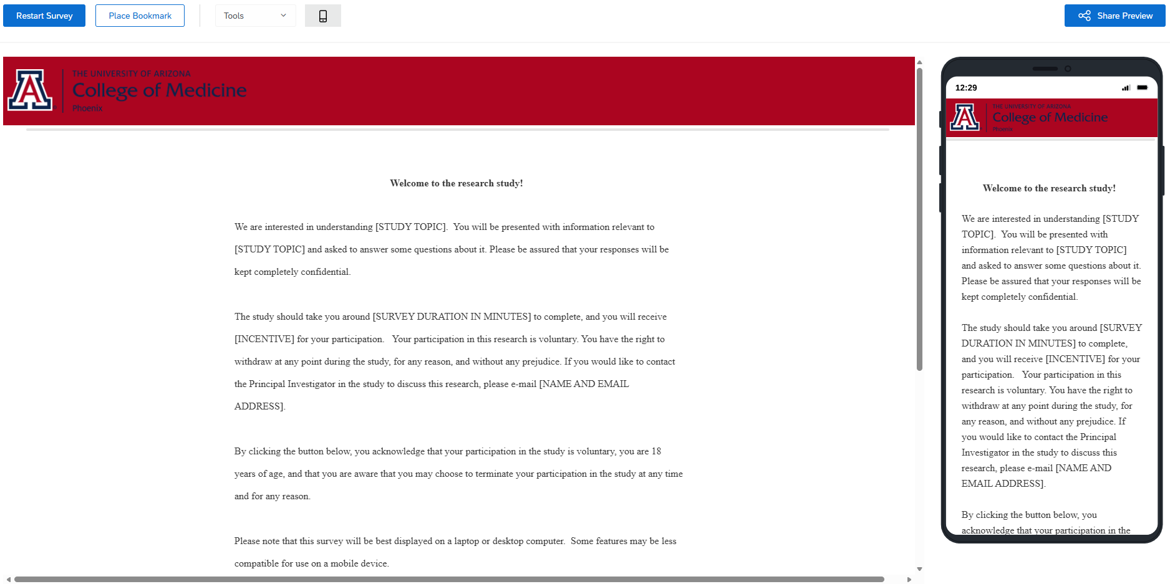
Preview Survey – shows mobile device look also
Notes:
You can see how the survey will look on both a computer and a mobile device.

Slide 59
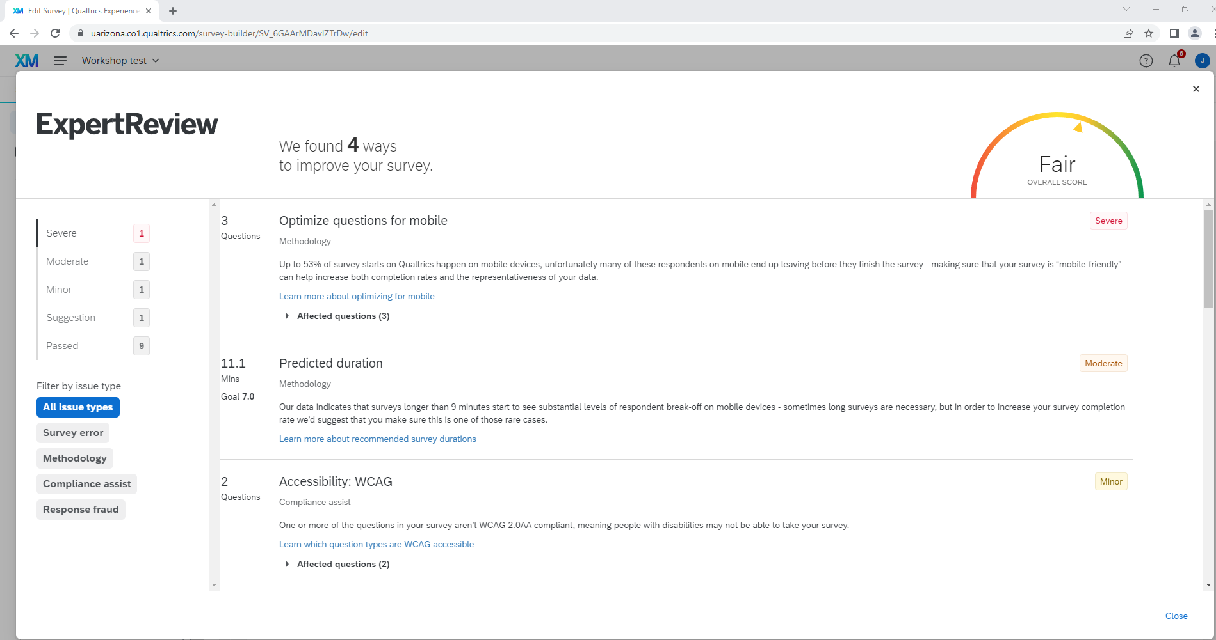
Notes:
The expert review function is a unique feature of Qualtrics. The “Expert Review” provides some feedback on the questions that may have some issues or be more likely to be left blank. Question types can be optimized for appearance on mobile devices. The review will tell you that words are needed on the progress bars to enhance usability for those with disabilities and estimate survey response time. So while you may not adopt all of the suggestions, the iQ assessment is definitely worth the few minutes spent.

Slide 60
Tools tab
Fix numbering
Review
Generate test responses
Collaborate – Sharing Projects and Permissions
Import/Export – print hard copy, export to Word
IRB
Data dictionary – show coded/recoded values
Notes:
Can readily auto-number when you are ready, particularly if you have moved around question or blocks.
Reset Recode – from Tools tab would reset the coding on ALL questions in the survey. It is typically better to use the recode values on the individual question.
Collaborate – can add other Qualtrics users to collaborate and set specific permissions for each team member. You can add a biostatistician like myself to your project with this.
Review – nice feature – allows “search and replace” if there is word or phrase you need to change throughout, spell check, “Check survey accessibility” please use this before you publish,
Generate test responses so can see what the data looks like or set up queries/analyses in advance.
Print, import, export are all under the Import/Export tab and you will need these to provide a copy of your survey to the IRB and also a to use as a coding dictionary for analysis.

Slide 61
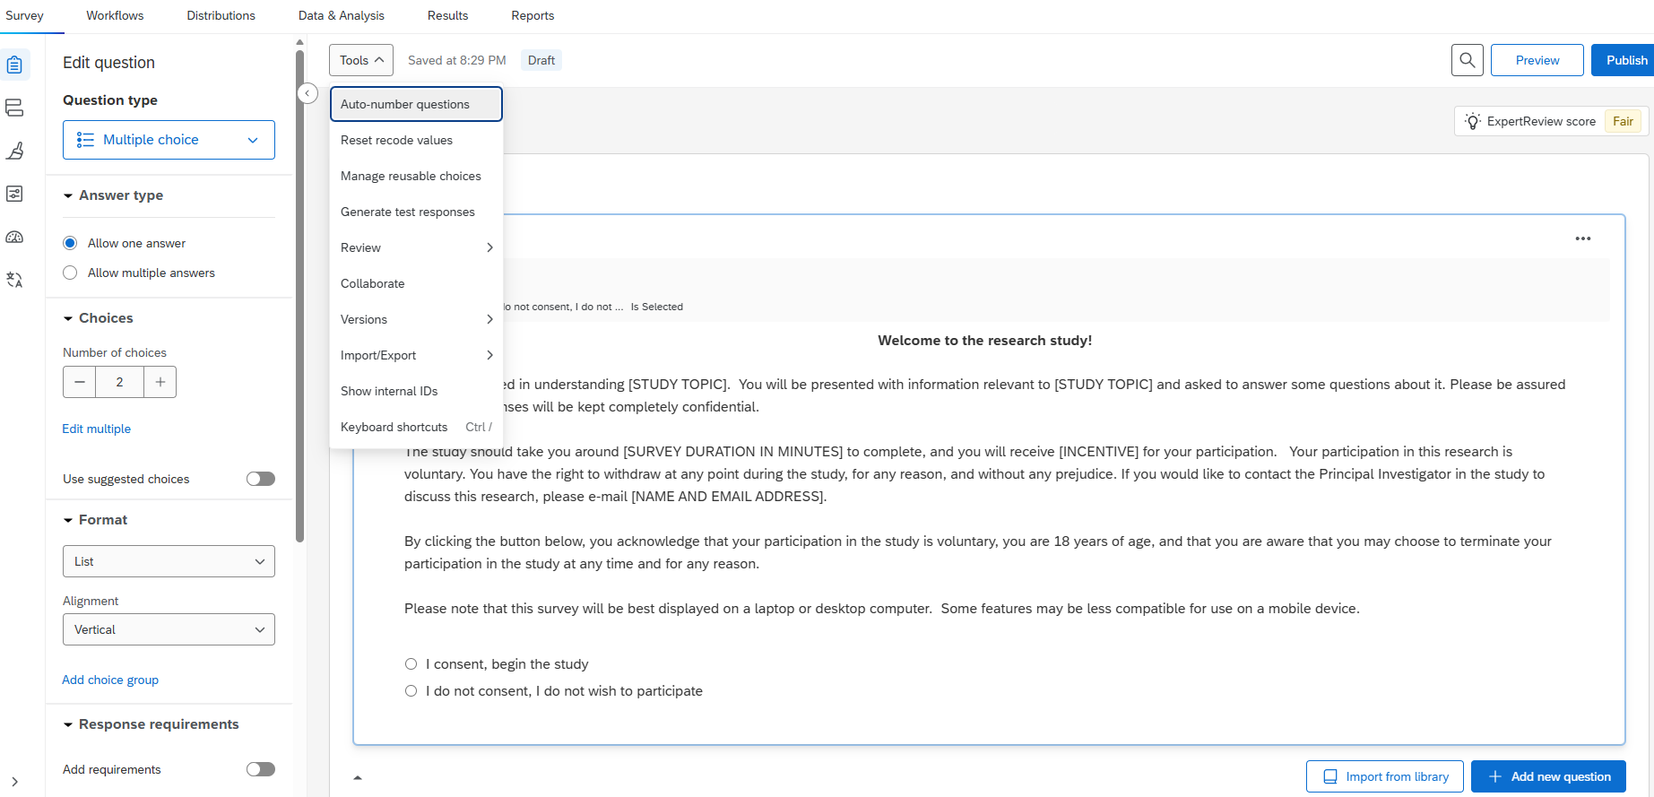
Tools tab
Notes:
Each of these functions can be found here.

Slide 62
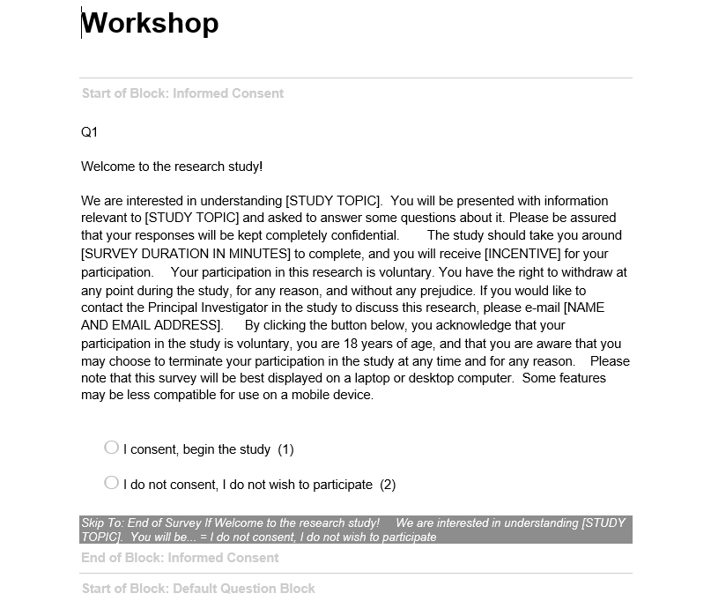
Word version of survey
Note coding of each response
Note skip (or display) logic
Notes:
When printing – save to PDF and then print the PDF saved file on your computer to better maintain format (look) of actual survey.

Slide 63
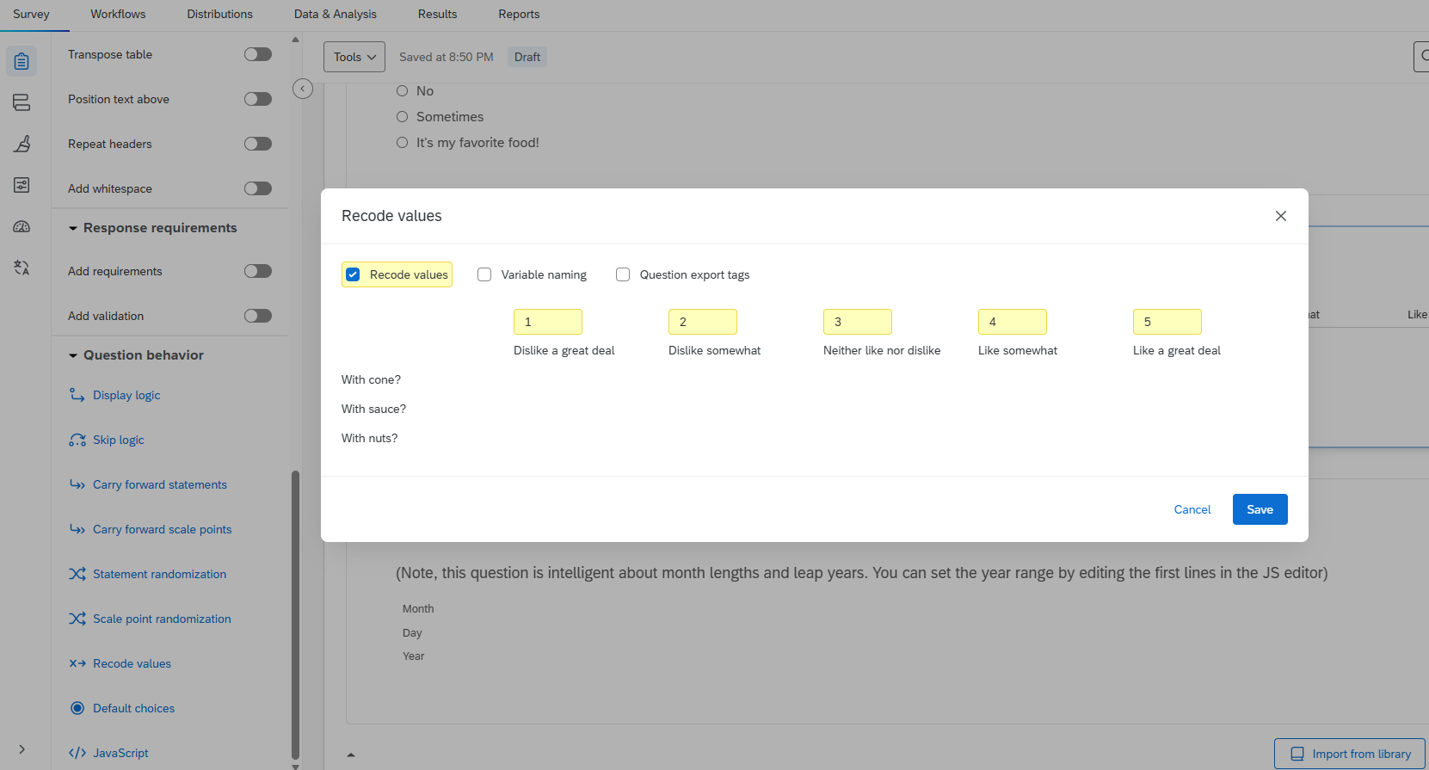
Recode screen:
Change values for easier analyses
So default is the program will just follow across, from 1 to 5. But you can change so your “Dislike a great deal” is a 5 and the other choices follow appropriately.
Notes:
You can find the recode screen through Survey builder > Edit Question > Question behavior

Slide 64
To Recap: Review, Review, & Review Again
Check that each response works
Have someone else take survey to check (invite a biostatistican to review)
Spell check
Check display and response logic

Slide 65
Top Tabs
Post-creation options:
Workflow
Distributions
Data & Analysis
Results
Reports
Notes:
What do you do after you have drafted and finalized your survey? The next steps require that we turn out attention now to the post-creation tabs at the top

Slide 66

Distributions
Several choices: email, links, QR code, app, etc
Once you distribute your survey, it is active.
If you must edit, it will pause distribution
Notes:
Qualtrics provides a number of modalities to send out your survey directly. Just make sure that your survey is finalized before you do so because if you need to make edits it will stall the distribution and data collection process.

Slide 67
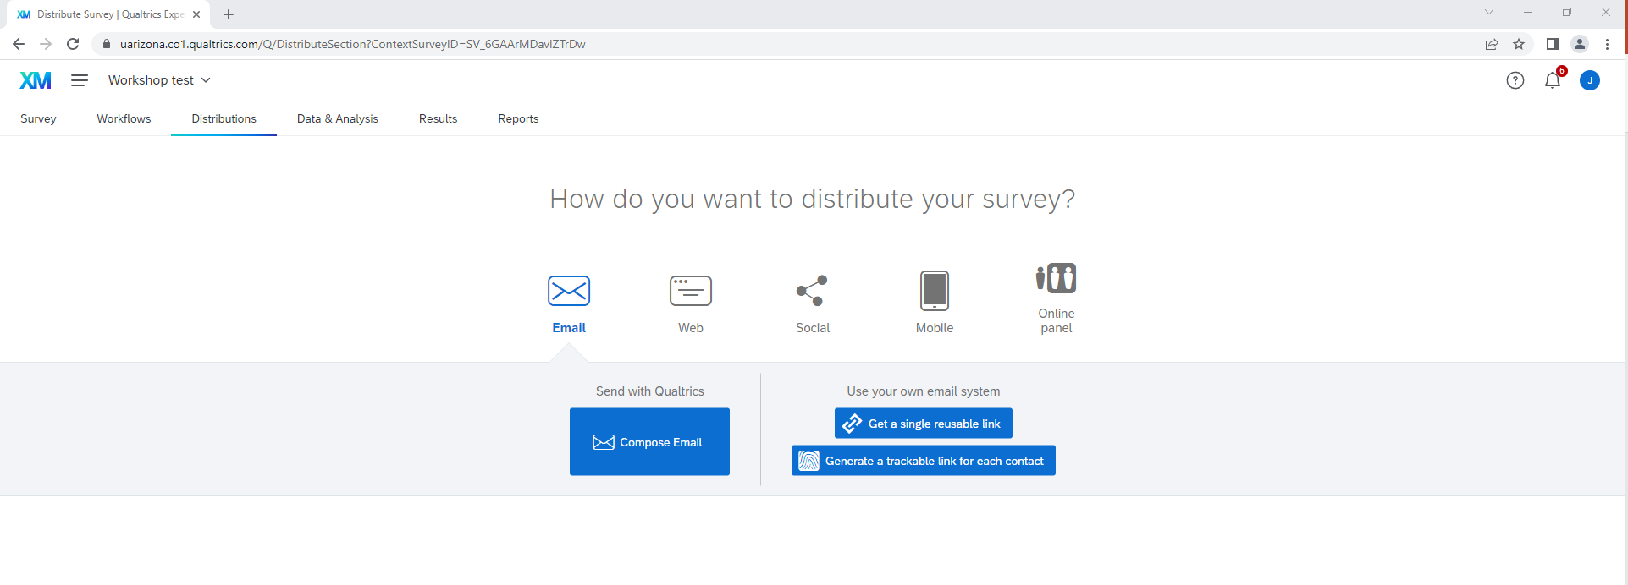
Distributions
Notes:
This is what the distribution options look like. These are fairly self-explanatory. Once you have a survey active, this screen will also provide a summary of responses received over the recent past, and by what source (anonymous link, email sent, QR code, etc.).

Slide 68
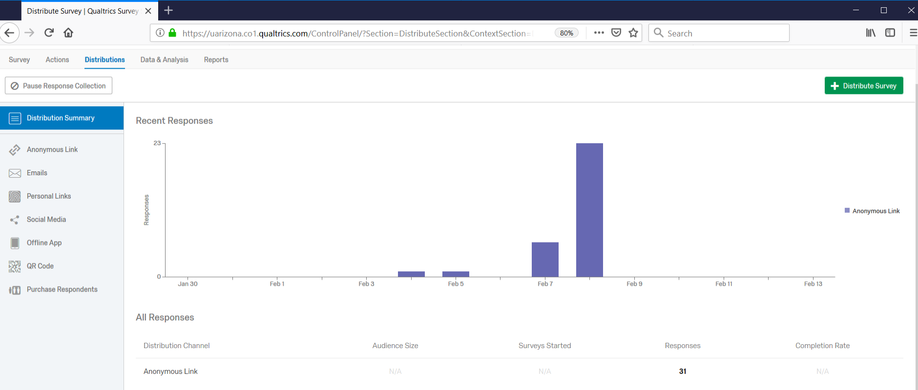
Distribution Tab
Choices – how to distribute
Summary of responses received
Notes:
The distribution of responses can be seen on this page.

Slide 69
Let’s look at results
Reports
Bars – default, add visualization, export
Data & Analysis
Cross tab – can export
Notes:
Once you have collected all the responses you need, it’s time to start looking at the data you have collected. The two main ways of doing so within Qualtrics are listed here: the Reports and Data & Analysis tabs

Slide 70
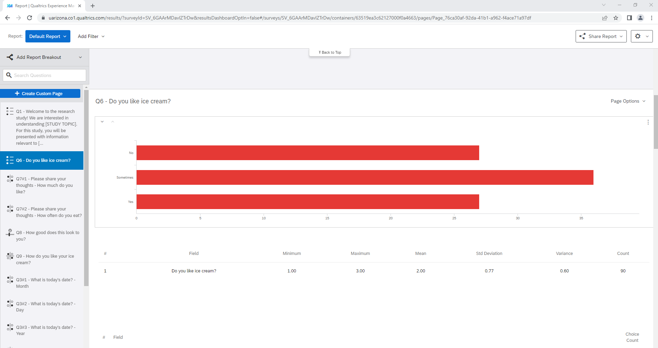
Let’s look at results
Notes:
Here is what a barchart of responses to the first question might look like.

Slide 71
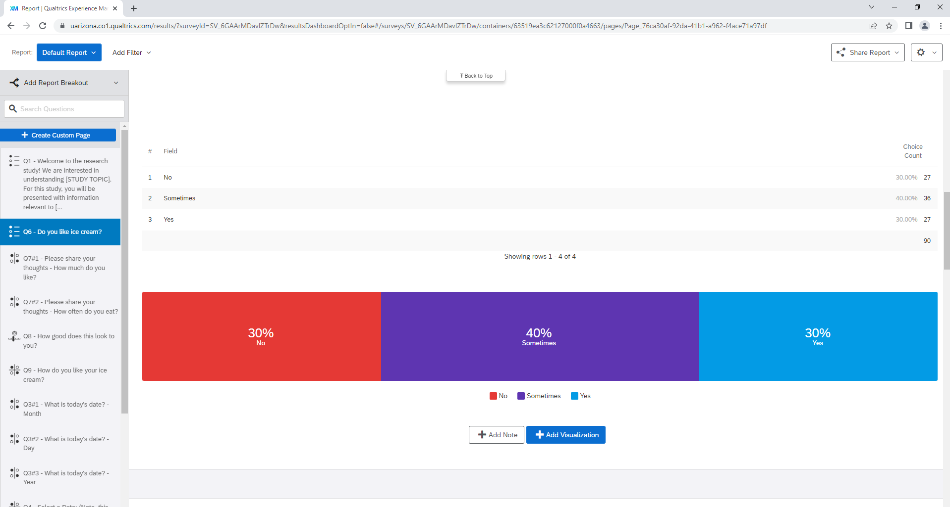
Let’s look at results
Use “Add Visualization” to change graph
Notes:
Select the green Add Visualization tab. Now there is a pull down menu on the right hand side that you can use to add/change visualizations and spruce up your report.
This includes the graph above, pie charts, and so on, with the ability to customize the look of each of these.

Slide 72

Let’s look at results
Use “Page Options” to save as file type
Notes:
Once you have figures the way you want, you can scroll up on right hand side so you can select “Page Options”. You can then export the results directly as a *pdf, word, Power point (each figure will be a slide) or as a spreadsheet.

Slide 73

Data & Analysis
Choices within Data & Analysis:
Data, Text iQ, Stats iQ, Crosstabs iQ, Weighting
Notes:
For more in-depth analyses, we could use the following options. For simplicity, I will focus on the Stats iQ and Crosstabs iQ domains.

Slide 74

Data & Analysis Examples > Crosstabs iQ > Cross tabs
Notes:
Create cross tabs. Banner will be the column and Stub will be the row. Here we are looking at age by sex.

Slide 75

Data & Analysis Examples > Stats iQ > Cross tabs
Notes:
Stats iQ can similarly produce the same cross tabs found in Crosstabs iQ, and would be the primary domain for exploring preliminary bivariate analyses.
When incorporating free response sections into a survey, the Text iQ tab can assist with the qualitative analyses, though this component takes longer to use. But specific qualitative data analysis software like NVivo or MAXQDA would be a better tools to work with for the analysis.

Slide 76
Data & Analysis: Export Data
Select file type
Download all fields
Use numeric values – choice text – can “recode” from survey dashboard
More options – recode, split multi-value fields into columns
Notes:
The most important data analysis element that Qualtrics provides, though, is the export data function. This is how we can bring the data we have collected into statistical software for analysis.

Slide 77

Data & Analysis > Export
Notes:
Click here.

Slide 78

Data & Analysis > Export
Notes:
Again, most statistical programs need data in numeric format. Select number and the file type you want. Also select MORE OPTIONS

Slide 79

Export
Can recode missing values to the option of your choosing. Select “Recode” then select the box and change if you don’t want to use “-99”
Ensure each field is a single variable. Select “Split multi-value fields into columns”.
Notes:
Recommend having a specific code for missing (non-responses) to readily differentiate from “0”.
Also, in cases like “check all that apply” questions – each field a respondent can select should be a single variable. Select the option “Split multi-value fields into columns” to do this for you.

Slide 80
Data & Analysis > Export
Once you have made all your choices, select Download
Notes:
Collaborating with biostats team members would allow us to do this step for you and move on directly to importing the data into statistical software like R, SAS, or STATA and getting started on the more involved analysis steps.

Slide 81
Summary of Survey Steps in Qualtrics
Create Questionnaire
Edit Questionnaire
Apply logic
Preview / send to colleagues
Print (word) - IRB & Data Dictionary
Activate / Post or Send
Results
Download for Analysis

Slide 82

General Considerations
Validated questions – Found in Libraries
Literacy – 6th grade
Force response to key questions only and provide options to skip
Limit questions to info needed
Ensure categories do not overlap
Get feedback, ask a biostatistician

Slide 83


Go forth and survey (with Qualtrics)

