Slide 1
Intermediate Qualtrics
U of A licensed Survey software
Workshop
Janet Foote, PhD

Slide 2
Outline
Survey notes
Thinking ahead – coding
Emailed access to ShareFile survey
Back-end tools
Quick & easy presentations
Downloading results
Questions are welcomed at any time!
Notes:
Brief summary of what we will be covering today. You should have received an email this morning inviting you to collaborate on a survey. Please let me know if you did not receive this email.
The first few minutes of this workshop, I will be reviewing a bit of the set up and tools in the Qualtrics software.
Why Qualtrics? Using Redcap for surveys is similar to buying a bus to transport yourself to work. Yes, it will do the job, but it’s made for a different set of conditions and has features (all those seats) that are not needed and just taking up space. Additionally, Qualtrics software is focused on being a survey resource. As such, it has lots of great features that you will not find in Redcap or more generalized resources.

Slide 3
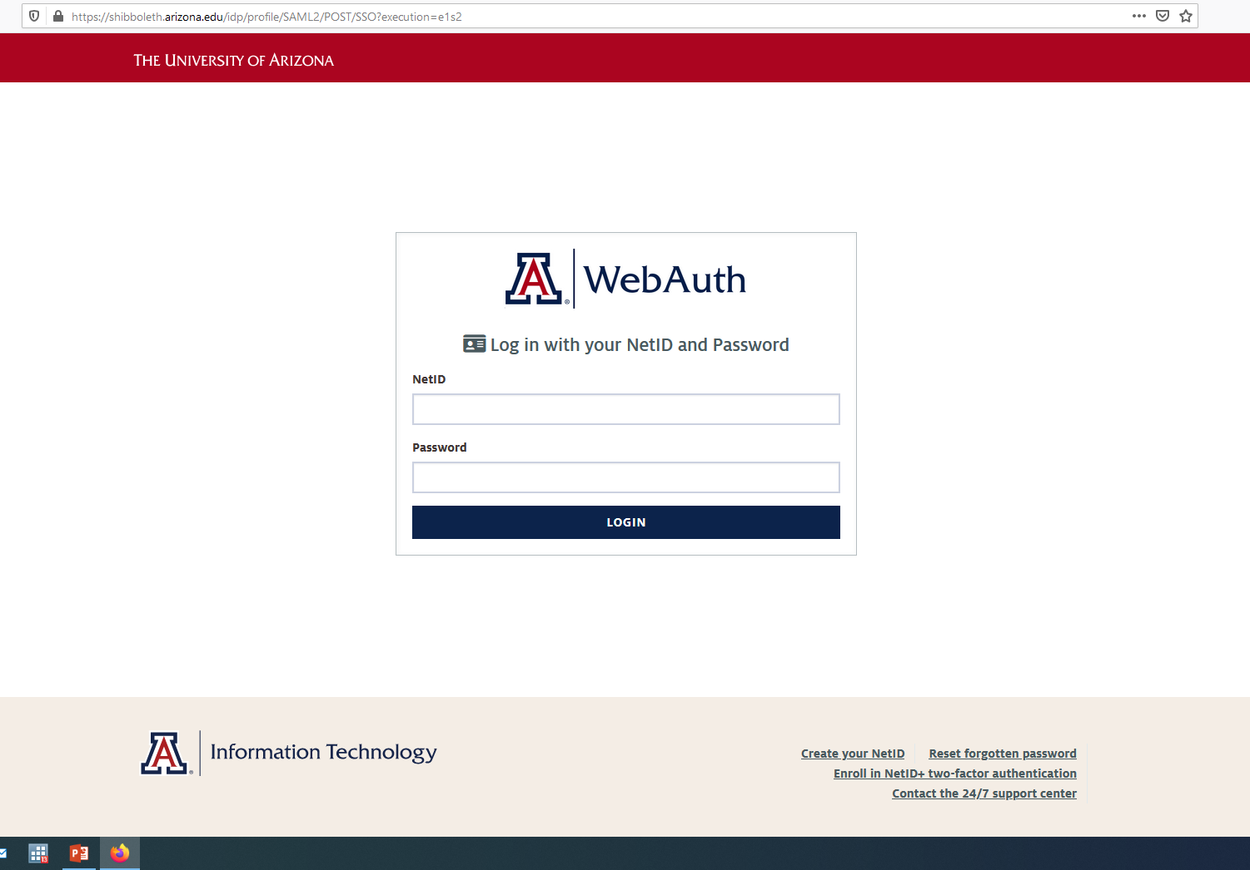
Uarizona.co1.qualtrics.com

Slide 4
PokemonGo2016 Survey was shared with you
Please select Data & Analysis so that the data can be preparing while we continue with our review of Qualtrics basics.

Slide 5
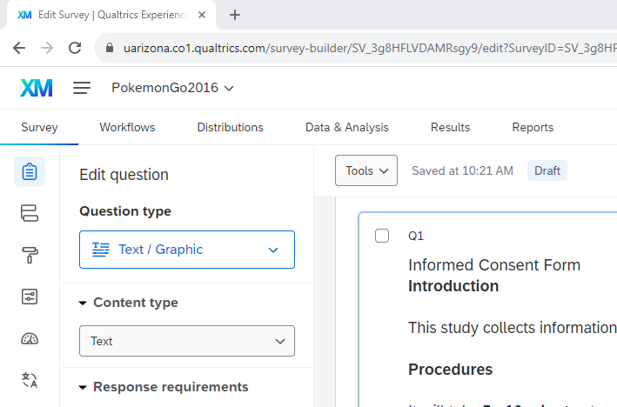
Qualtrics Project Menu
Post - development
Use during creation

Slide 6
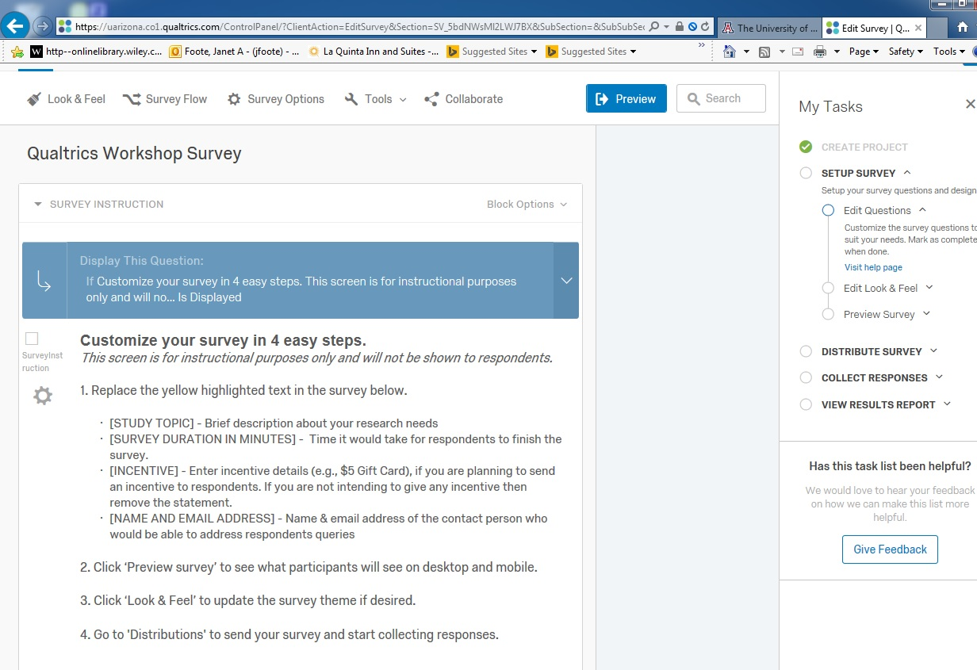
Walking user through steps……
Notes:
As mentioned in the introductory workshop, if you use a Qualtrics template, it will walk you through the survey creation process.

Slide 7
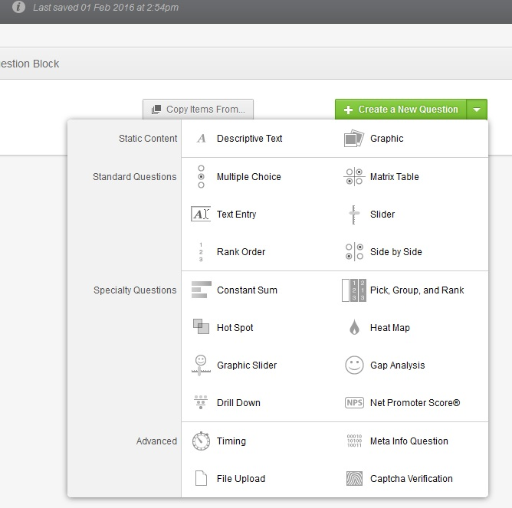
Different question types
Selecting each will give an example
Notes:
There are multiple question types from which to choose and all of these are editable to fit one’s needs.

Slide 8
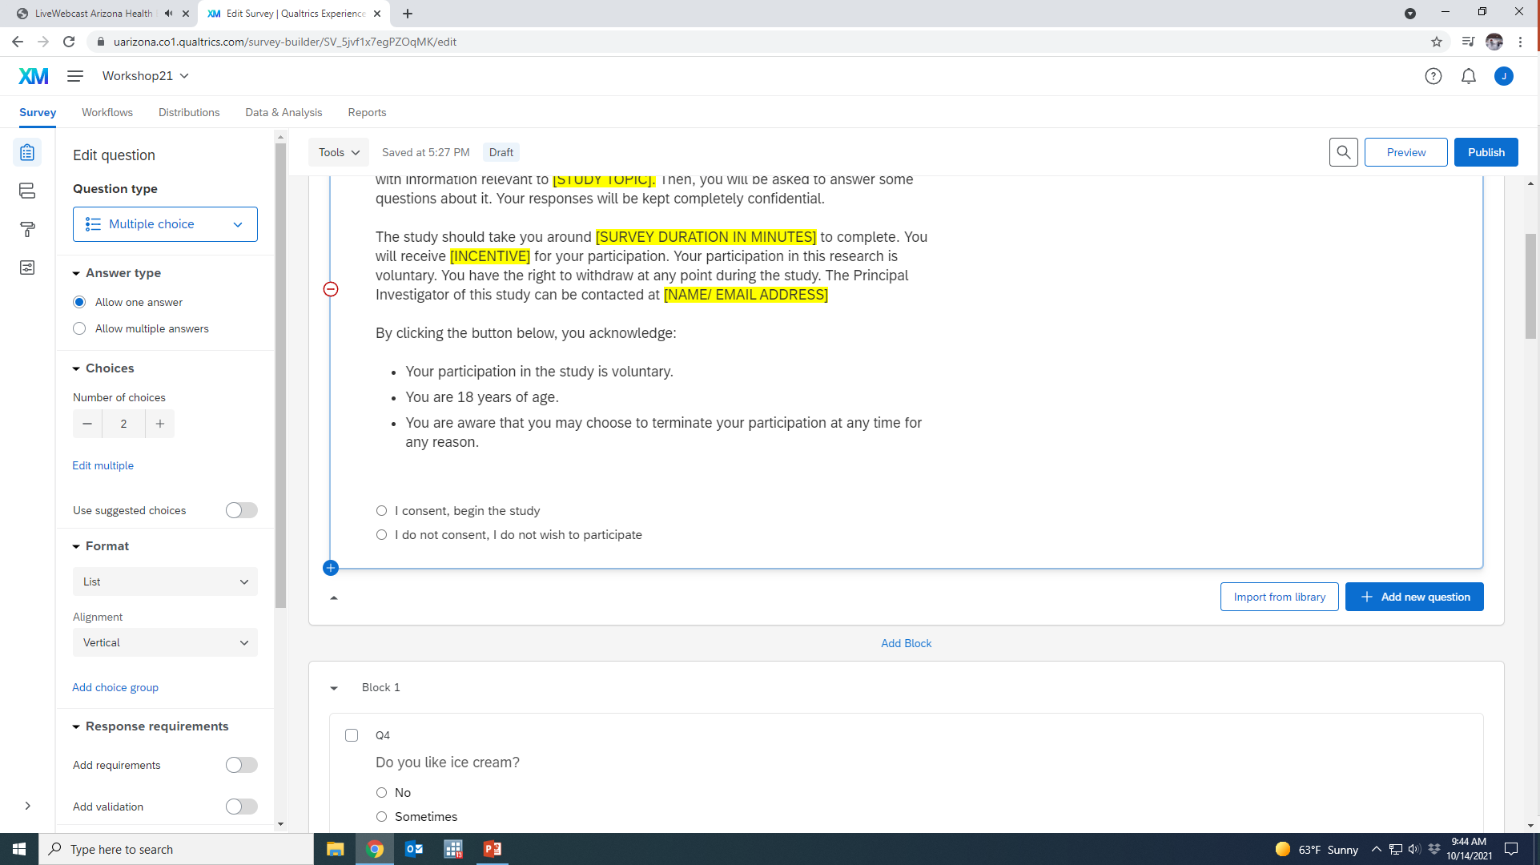
Underneath qx are 3 choices:
Add Block
Add new question
Import from Library
Notes:
After you add a question you have 3 choices of what to do next, add a new question, import a question for the library, or add a new block. Using the import from the library is a great way to find questions that have already been formatted well, a consent form template – or to find questions that are validated instruments such as the Gail breast cancer risk score, depression scales, burnout scales etc..

Slide 9
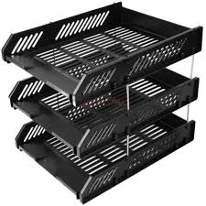
Blocks – build groups of questions within survey
Cannot use logic across separate blocks
Blocks make is easy to readily move groups of questions within your survey

Slide 10
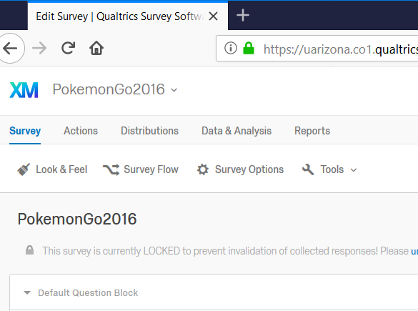
Qualtrics Project Menu
Post - development
Use during creation

Slide 11
Blocks – build groups of questions
within survey
Cannot use logic across separate blocks
Skip Logic – skips questions based on response choice
Display Logic – displays questions based on response choice
Notes:
Two types of logic are skip logic and display logic. Skip logic is typically used when you want to send respondents to a specific section of the survey based on how they answered a question.\
Display logic is typically used to customize the survey to the respondent as in scenarios in which males and females or older compared to younger or rural vs urban participants may receive a different set of questions based on however you are grouping your participants.

Slide 12
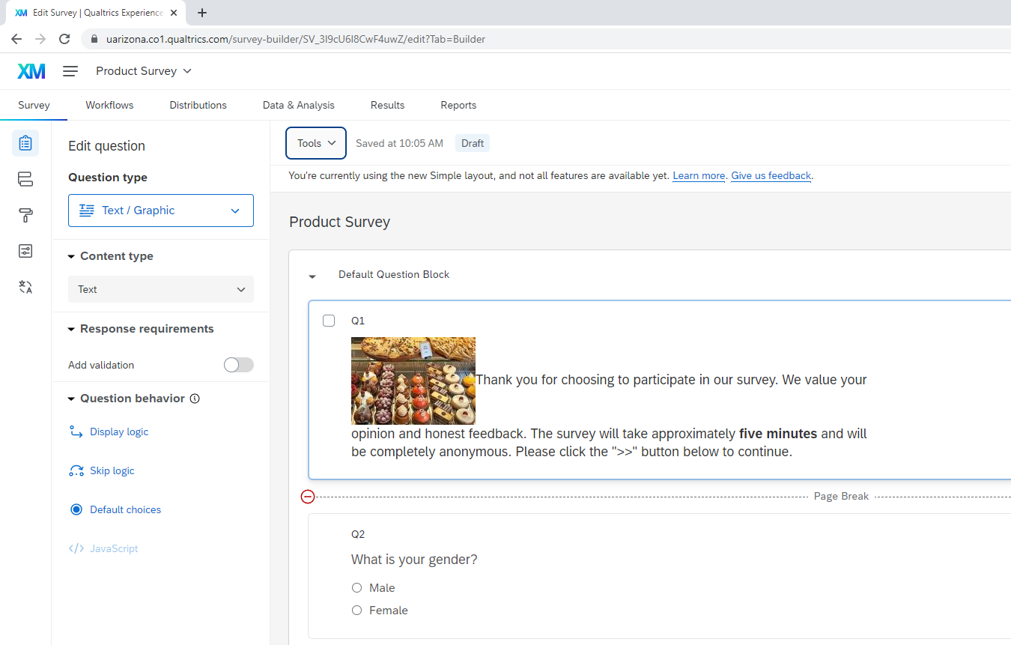
Logic choices can be found under “Question Behavior” near the bottom of the Edit Question tab.

Slide 13
Note that “Content type” and “Add validation” are also found under the edit question tab.
Notes:
The Content type allows you to request specific information types such as phone number, address, email address, zip code, social security number and verifies that the information entered is appropriate. The validation is what you can use to require that participants answer a specific question – or else will give a default message – or a message that you customize – to ask the participant to answer the question. The respondent will not be able to proceed without answering the question.

Slide 14
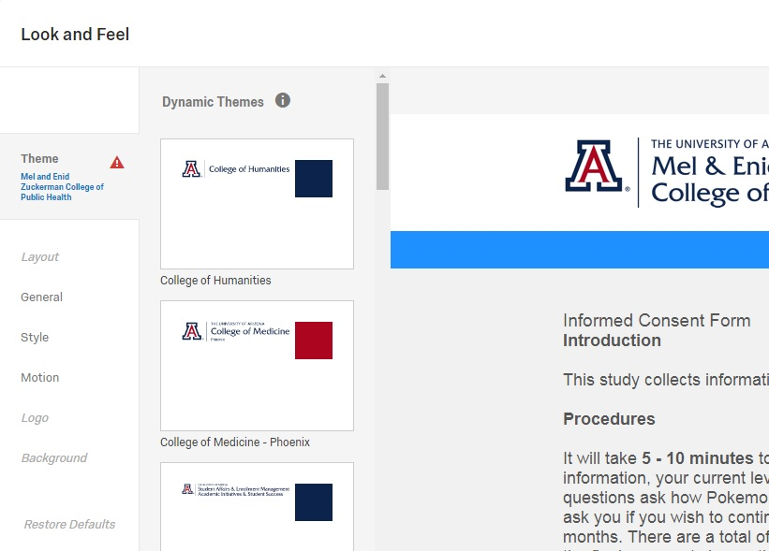
Look and feel (looks like a paint roller)
Most UArizona Colleges have preset themes
Also Presets from Qualtrics
General – adding Progress bar, Next & Back buttons etc.

Slide 15
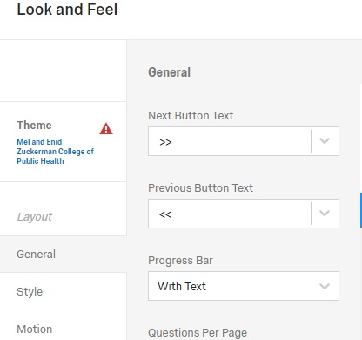
Look Feel – Progress Bar
Add text to be disability friendly

Slide 16
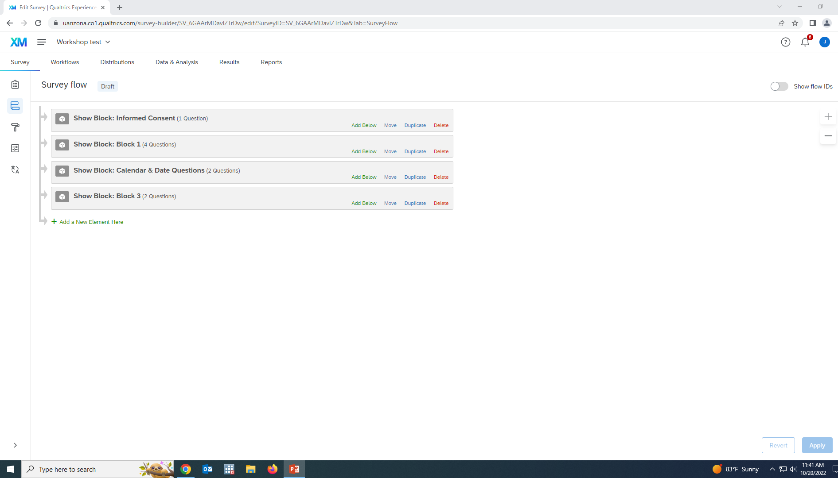
Survey Flow
Most useful for moving around blocks of questions.

Slide 17
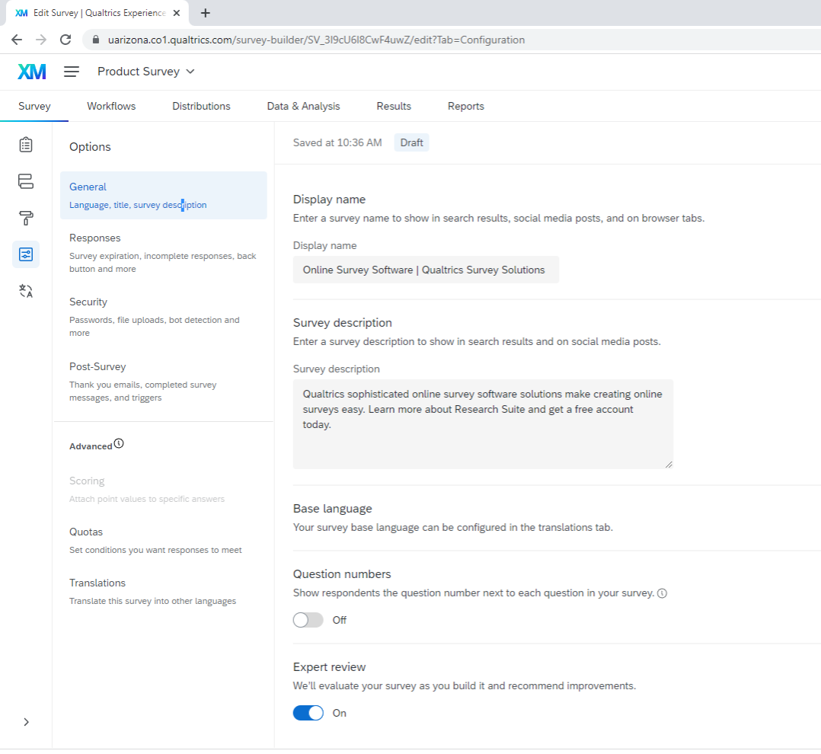
Survey Options
Notes:
Under the General survey options, you can add in a display name, description, have the question numbers shown to respondents or not, and receive the “Expert review” which is feedback while previewing your survey to estimate how user-friendly it may be – including accessibility issues.

Slide 18
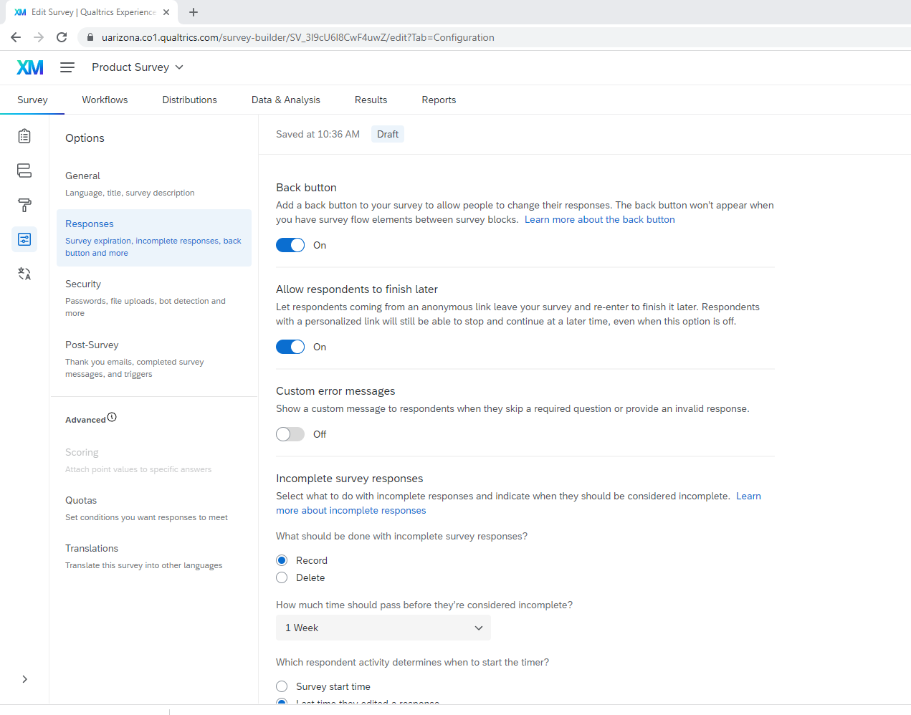
Survey Options
Notes:
Under the Response options, you can allow respondents to go back to the last question, allow them to come back to where they were if they are interrupted in completing the survey rather than start over, decide how you want to handle incomplete surveys, make availability options.

Slide 19
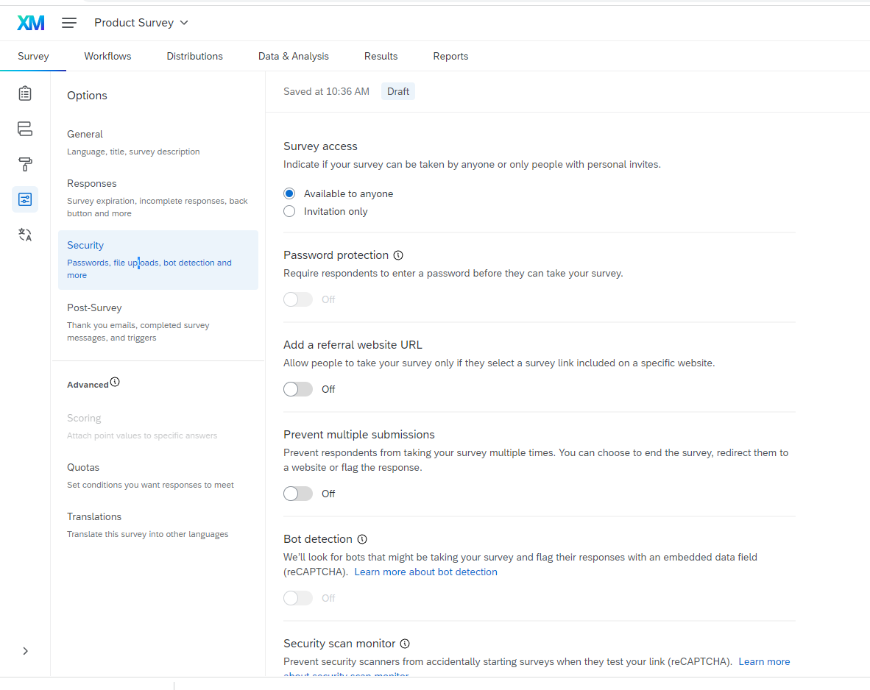
Survey Options
Notes:
Security is important, you can make decisions on the survey availability, prevent multiple submissions, add “bot” (autonomous program) detection, prevent indexing and IMPORTANTLY – Anonymize responses. This Anonymize toggle eliminates recording of the IP address, location data and any contact info that may be drawn from the device on which the survey is being completed. For research, we have typically have told the IRB that we will not collect this information – and the default is not to do so, but one should always verify

Slide 20
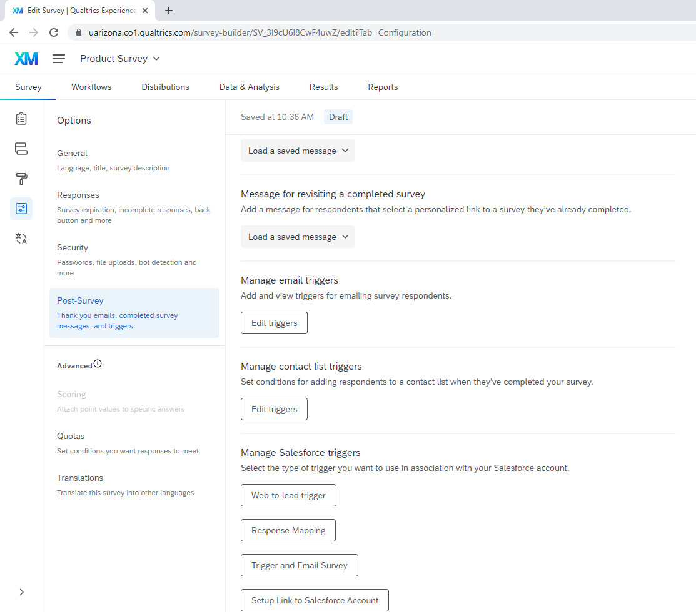
Survey Options
Notes:
Post survey options include sending out thank you emails and updates to yourself, although Qualtrics regularly emails updates about response collection once your survey is published. Note underneath the Post-Survey tab you have options to set quotas, and translate the language of your survey.

Slide 21
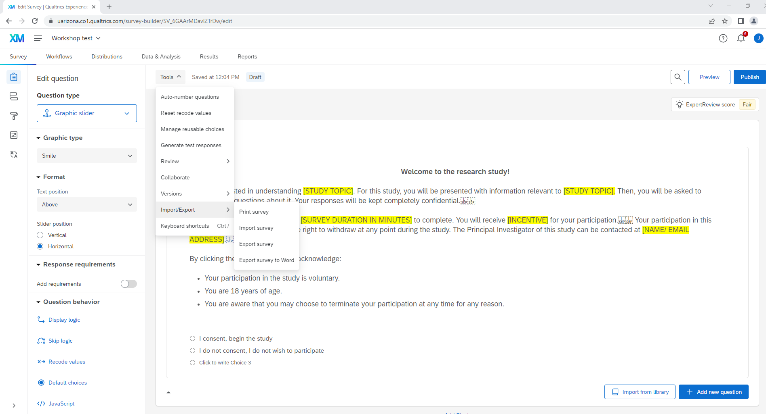
Tools tab
Notes:
Can readily auto-number when you are ready, particularly if you have moved around question or blocks. Reset Recode – from Tools tab would reset the coding on ALL questions in the survey. It is typically better to use the recode values on the individual question. Collaborate – can add other Qualtrics users to collaborate. Review – nice feature – allows “search and replace” if there is word or phrase you need to change throughout, spell check, “Check survey accessibility” please use this before you publish, generate test responses so can see what the data looks like or set up queries/analyses in advance. . Collaborate in where you can share your survey with others on your team and set specific permissions for each team member. Print, import, export are all under the Import/Export tab and you will need these to provide a copy of your survey to the IRB and also a to use as a coding dictionary for analysis.

Slide 22
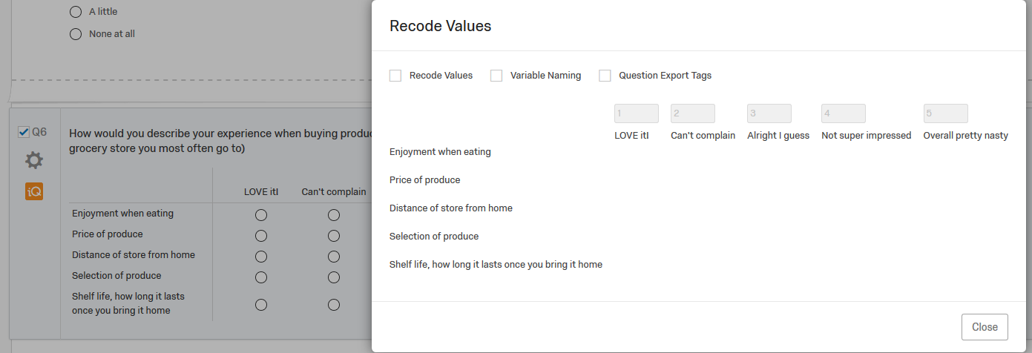
Recode screen:
Change values for easier analyses
So default is the program will just follow across, from 1 to 5. But you can change so your “love it!” is a 5 and the other choices follow appropriately.

Slide 23
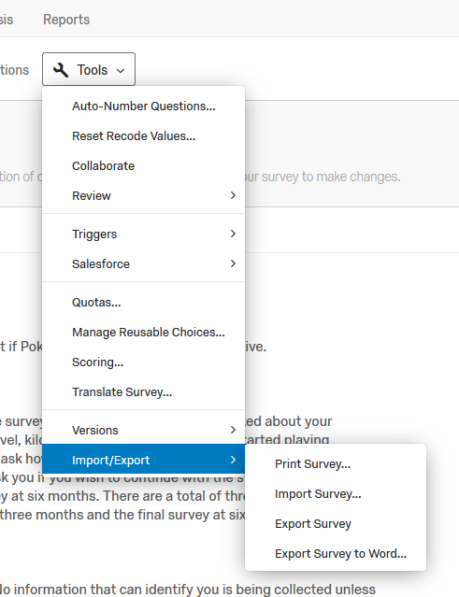
Tools
Copy for IRB
Print – Save as *pdf using Chrome
If export to Word – not in same format as online
Other option: print full color then scan as *pdf

Slide 24
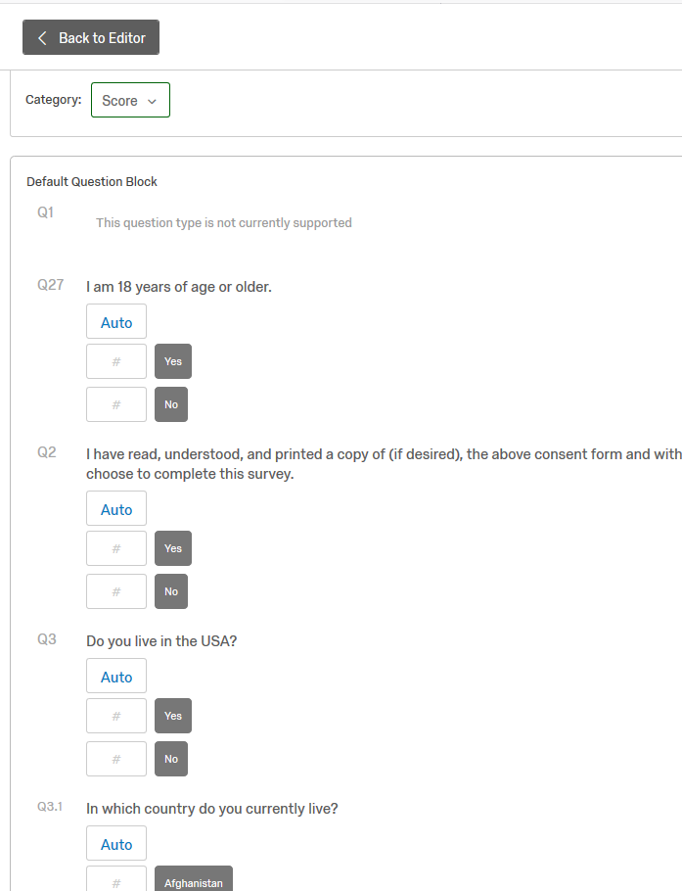
Scoring is under Survey Options*
Scoring option:
Can assign score to each question
Ex: Heart disease risk
Set up contingency based on score
* Some layouts do not allow scoring. If you do not see the option (grayed out) you need to change your layout.

Slide 25
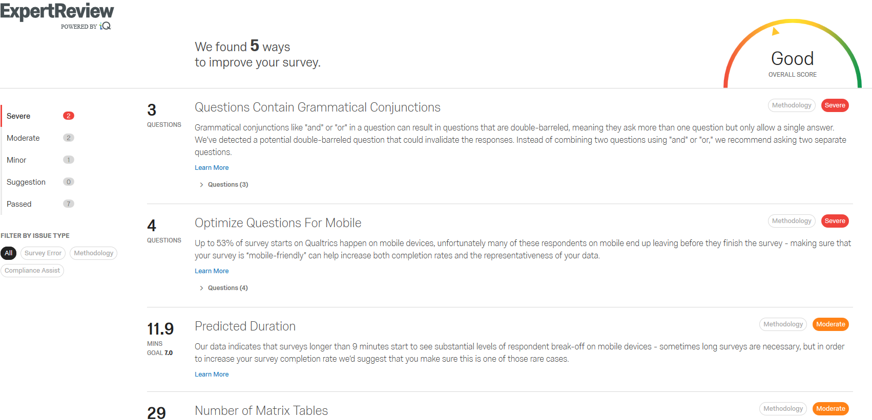
ExpertReview Score
Notes:
This is a new and unique feature of Qualtrics. The “Expert Review” provides some feedback on the questions that may have some issues or be more likely to be left blank. Question types can be optimized for appearance on mobile devices. The review will tell you that words are needed on the progress bars to enhance usability for disabled, and estimate survey response time. So while you may not adopt all of the suggestions, the iQ assessment is definitely worth the few minutes spent.

Slide 26
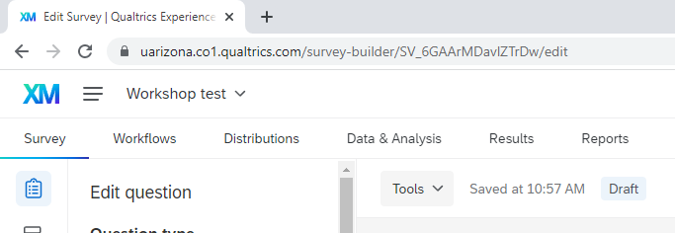
Top Tabs
Post-creation options:
Workflow
Distributions
Data & Analysis
Results
Reports

Slide 27
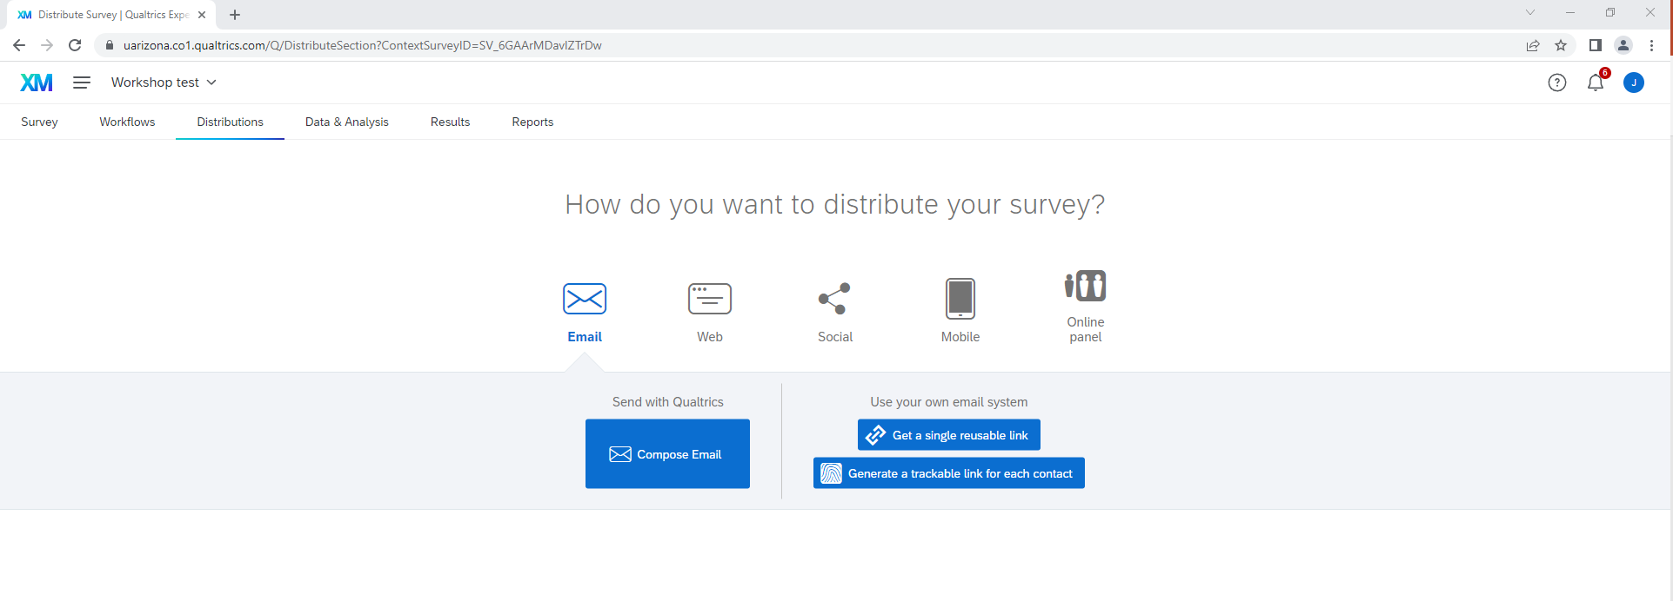
Distributions
Notes:
Distribution has choices of how you can distribute your survey. These are fairly self-explanatory. One you have a survey active, this screen will also provide a summary of responses received over the recent past, and by what source (anonymous link, email sent, QR code, etc.).

Slide 28
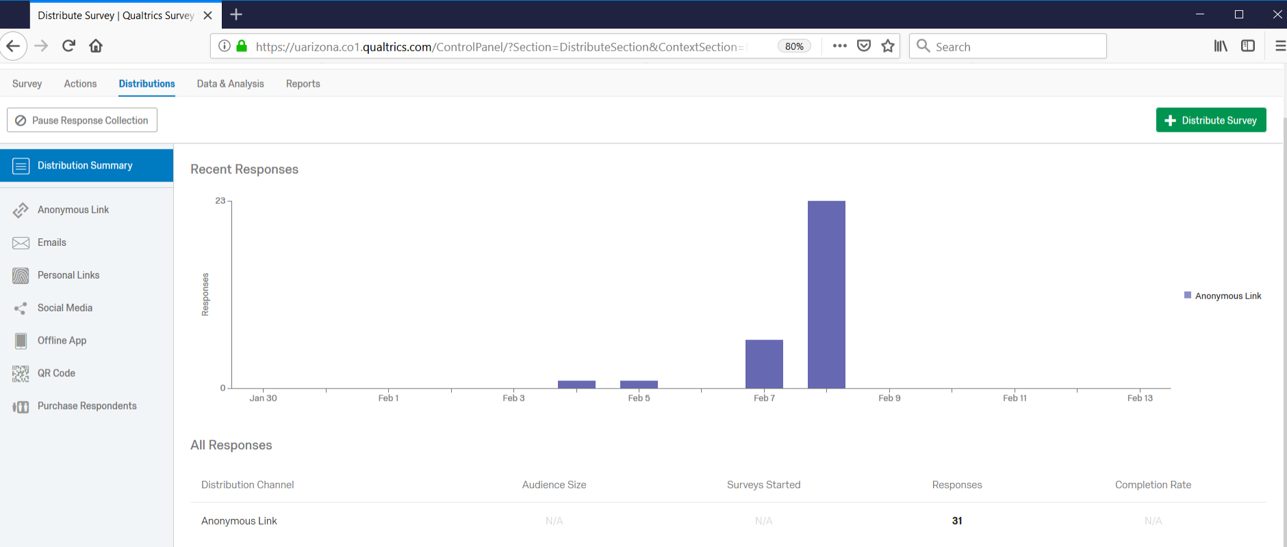
Distribution Tab
Choices – how to distribute
Summary of responses received
Notes:
Distribution has choices of how you can distribute and will also show a summary of responses received over the recent past, and by what source (anonymous link, email sent, QR code, etc.).

Slide 29
Please make sure you are in Qualtrics and select the ShareFile Project.

Slide 30
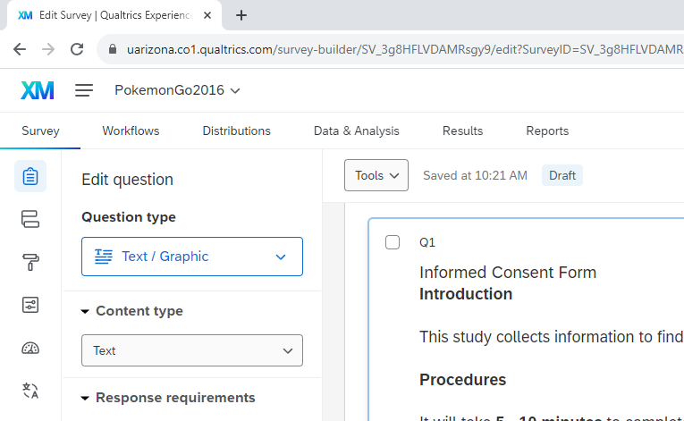
Qualtrics Project Menu

Slide 31
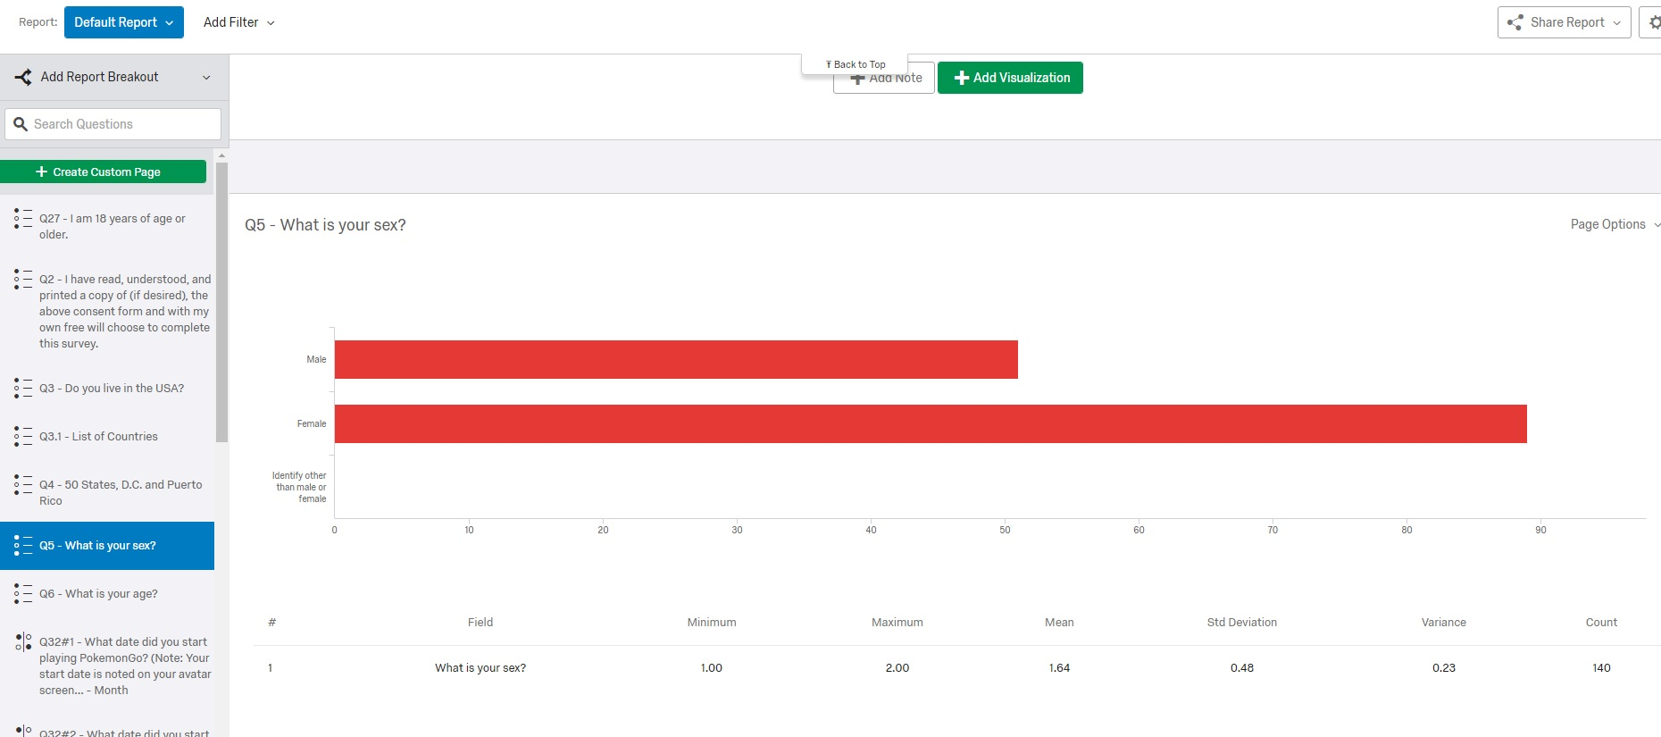
Results
Data received for each question.

Slide 32
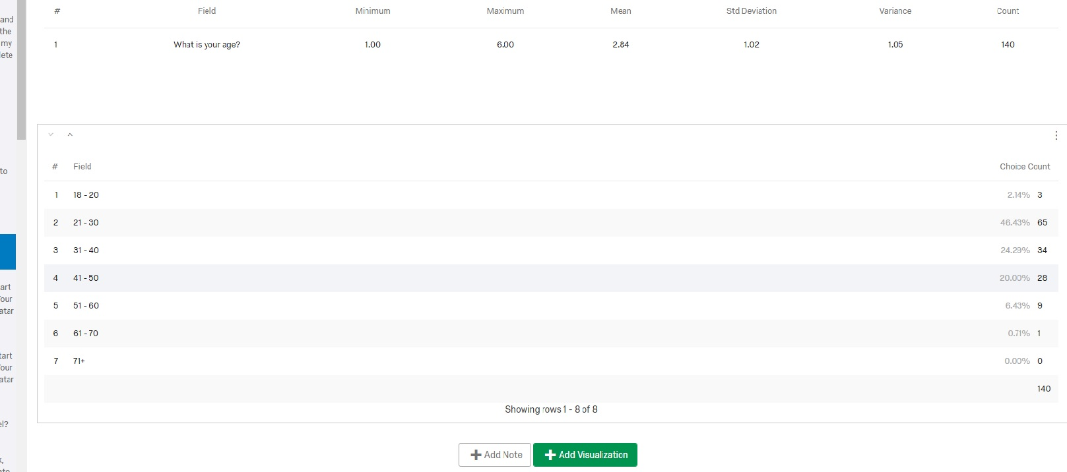
Results
Bottom of page – Add Visualization
Notes:
Select the green Add Visualization tab. Now there is a pull down menu on the right hand side that you can use to “fancy up” your report.
Try moving across the “Visualization” images and see how you figure changes. Note how you can change the pie chart inner radius (so solid pie instead of a donut), only show if certain percentage, change colors, add notes, add labels etc.. Once you get the figure the way you think you want, scroll up on right hand side so you can select “Page Options”. You can export page directly to *pdf, word, Power point (each figure will be a slide) or as a spreadsheet.

Slide 33
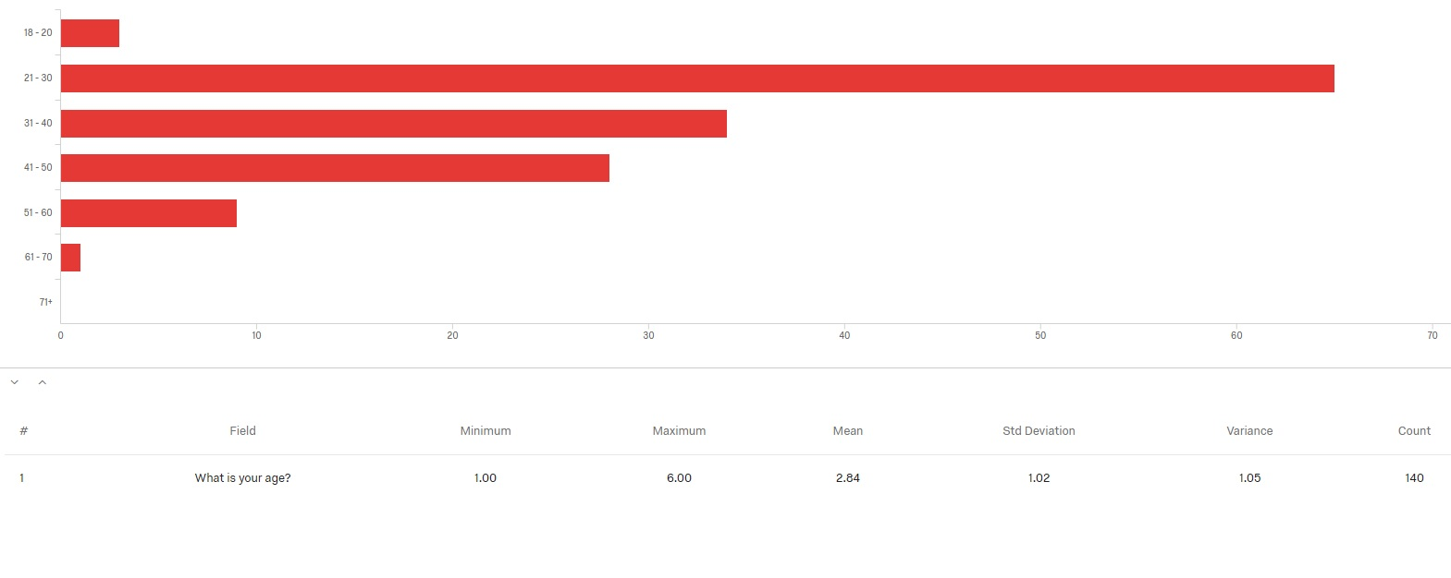
Results
Basic information about your data
Notes:
Select the green Add Visualization tab. Now there is a pull down menu on the right hand side that you can use to “fancy up” your report.
Try moving across the “Visualization” images and see how you figure changes. Note how you can change the pie chart inner radius (so solid pie instead of a donut), only show if certain percentage, change colors, add notes, add labels etc.. Once you get the figure the way you think you want, scroll up on right hand side so you can select “Page Options”. You can export page directly to *pdf, word, Power point (each figure will be a slide) or as a spreadsheet.

Slide 34
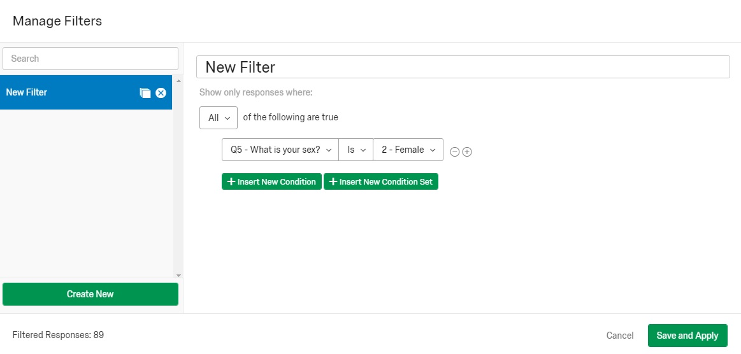
Reports
Can add filters such as only look at responses from females
Notes:
At the top of the page next to “Default Report”, you can “Manage Filters…”. Maybe you only want to report on the female respondents. Once you “Apply” you will only see the responses from the females, unless you cancel.

Slide 35
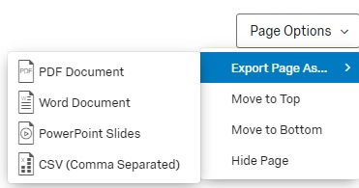
Results
Exporting your reports, under “Share Report”.
Notes:
Once you get the figure the way you think you want, scroll up on right hand side so you can select “Page Options”. You can export page directly to *pdf, word, Power point (each figure will be a slide) or as a spreadsheet.

Slide 36
Example of Report Exported to PowerPoint
Note: It does take a bit of time (depending on survey length) to ready report for download.

Slide 37
Default Report
ShareFile
February 14th 2019, 6:01 am MST

Slide 38
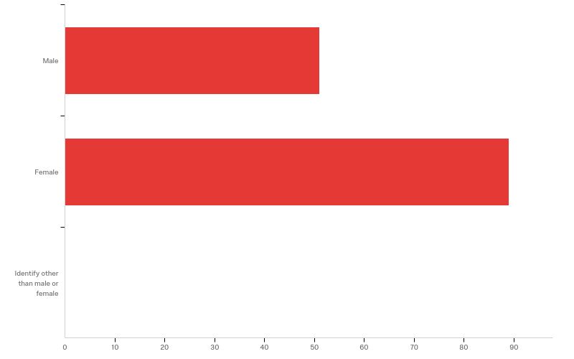
Q5 - What is your sex?

Slide 39
Q5 - What is your sex?
# | Field | Minimum | Maximum | Mean | Std Deviation | Variance | Count
1 | What is your sex? | 1.00 | 2.00 | 1.64 | 0.48 | 0.23 | 140

Slide 40
Q5 - What is your sex?
# | Answer | % | Count
1 | Male | 36.43% | 51
2 | Female | 63.57% | 89
3 | Identify other than male or female | 0.00% | 0
 | Total | 100% | 140

Slide 41
Q5 - What is your sex?

Slide 42
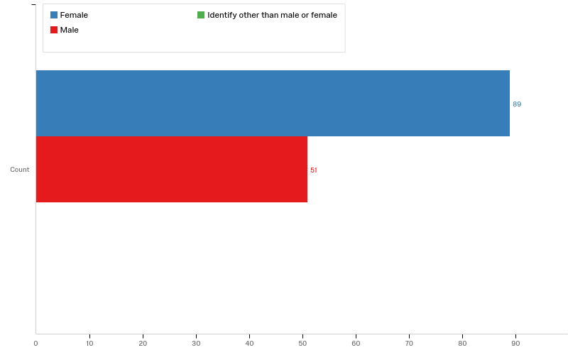
Q5 - What is your sex?

Slide 43
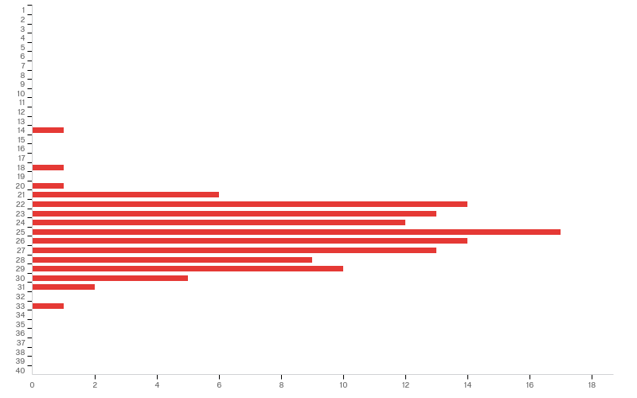
Q8 - What is your current level?

Slide 44
Q8 - What is your current level?
# | Field | Minimum | Maximum | Mean | Std Deviation | Variance | Count
1 | What is your current level? | 14.00 | 33.00 | 25.21 | 2.96 | 8.77 | 119

Slide 45
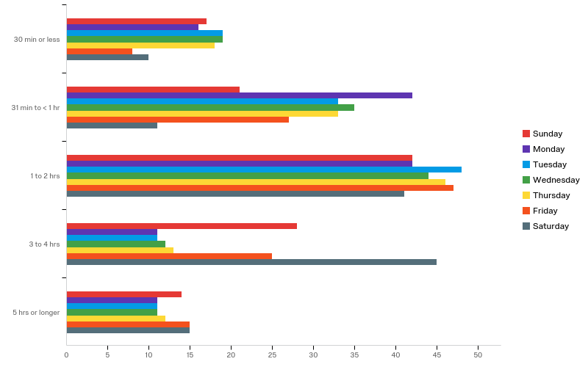
Q9 - For each day of the week, please indicate the approximate time you typically spend engaged in PokemonGo:

Slide 46
Q9 - For each day of the week, please indicate the approximate time you typically spend engaged in PokemonGo:
# | Field | Minimum | Maximum | Mean | Std Deviation | Variance | Count
1 | Sunday | 1.00 | 5.00 | 3.01 | 1.19 | 1.42 | 122
2 | Monday | 1.00 | 5.00 | 2.66 | 1.10 | 1.21 | 122
3 | Tuesday | 1.00 | 5.00 | 2.69 | 1.12 | 1.25 | 122
4 | Wednesday | 1.00 | 5.00 | 2.68 | 1.13 | 1.28 | 121
5 | Thursday | 1.00 | 5.00 | 2.74 | 1.14 | 1.29 | 122
6 | Friday | 1.00 | 5.00 | 3.10 | 1.08 | 1.17 | 122
7 | Saturday | 1.00 | 5.00 | 3.36 | 1.07 | 1.15 | 122

Slide 47
Q9 - For each day of the week, please indicate the approximate time you typically spend engaged in PokemonGo:
# | Question | 30 min or less |  | 31 min to < 1 hr |  | 1 to 2 hrs |  | 3 to 4 hrs |  | 5 hrs or longer |  | Total
1 | Sunday | 13.93% | 17 | 17.21% | 21 | 34.43% | 42 | 22.95% | 28 | 11.48% | 14 | 122
2 | Monday | 13.11% | 16 | 34.43% | 42 | 34.43% | 42 | 9.02% | 11 | 9.02% | 11 | 122
3 | Tuesday | 15.57% | 19 | 27.05% | 33 | 39.34% | 48 | 9.02% | 11 | 9.02% | 11 | 122
4 | Wednesday | 15.70% | 19 | 28.93% | 35 | 36.36% | 44 | 9.92% | 12 | 9.09% | 11 | 121
5 | Thursday | 14.75% | 18 | 27.05% | 33 | 37.70% | 46 | 10.66% | 13 | 9.84% | 12 | 122
6 | Friday | 6.56% | 8 | 22.13% | 27 | 38.52% | 47 | 20.49% | 25 | 12.30% | 15 | 122
7 | Saturday | 8.20% | 10 | 9.02% | 11 | 33.61% | 41 | 36.89% | 45 | 12.30% | 15 | 122

Slide 48
Qualtrics Project Menu

Slide 49
Choices within Data & Analysis
Data, TextIQ (requires 48 hr setup), StatsIQ, Crosstabs, Weighting

Slide 50
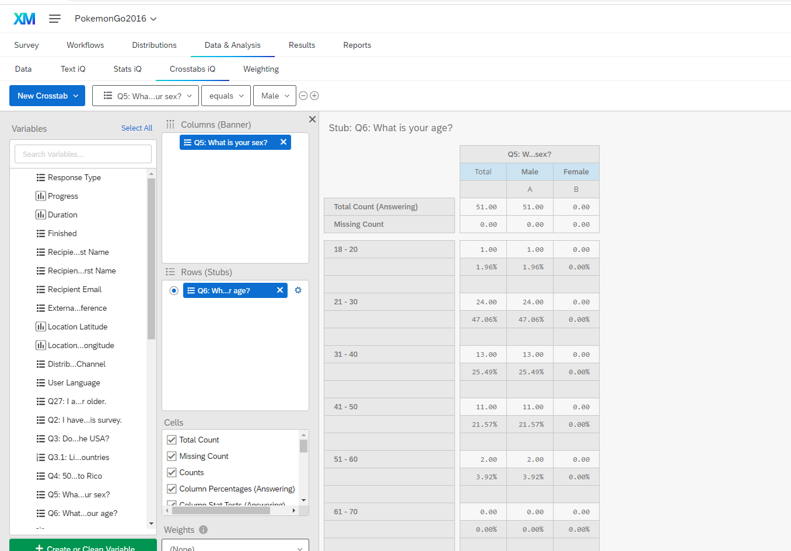
Data & Analysis > Cross Tabs
Notes:
Create cross tabs. Banner will be the column and Stub will be the row. Let’s look at age by sex.

Slide 51
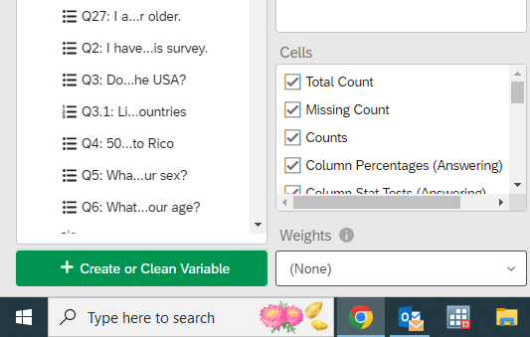
Cross Tab – Data options

Slide 52
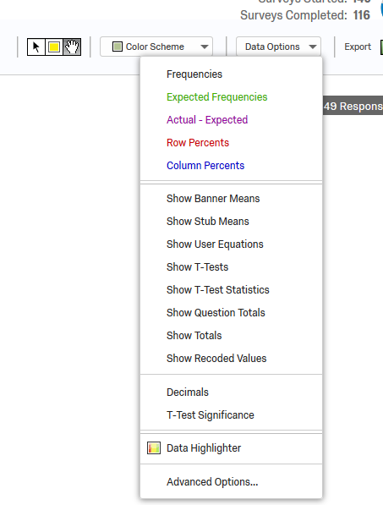
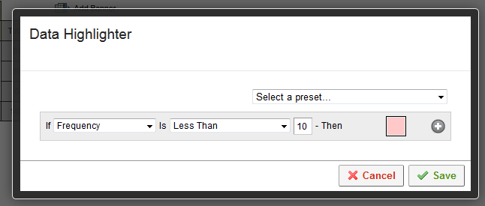
Cross Tab – Data options
Create or Clean Variable

Slide 53
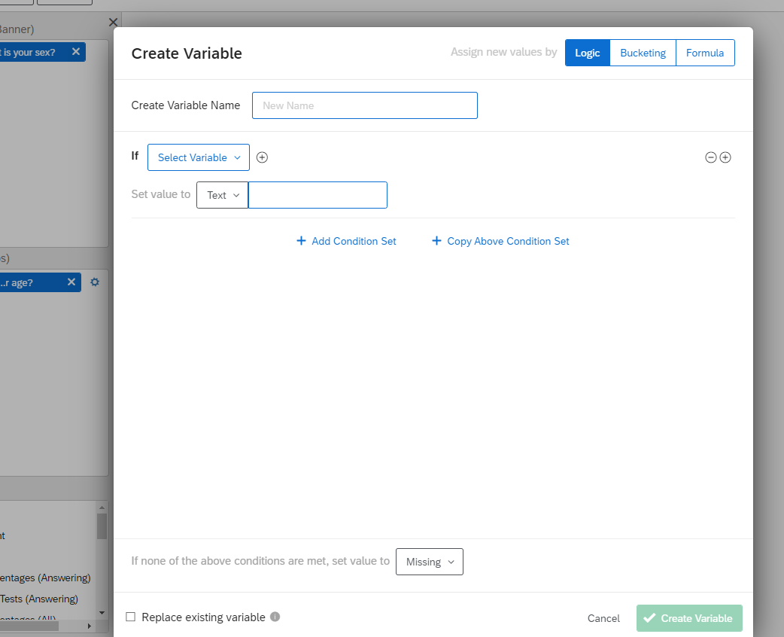
Cross Tab – Data options
Create variable

Slide 54
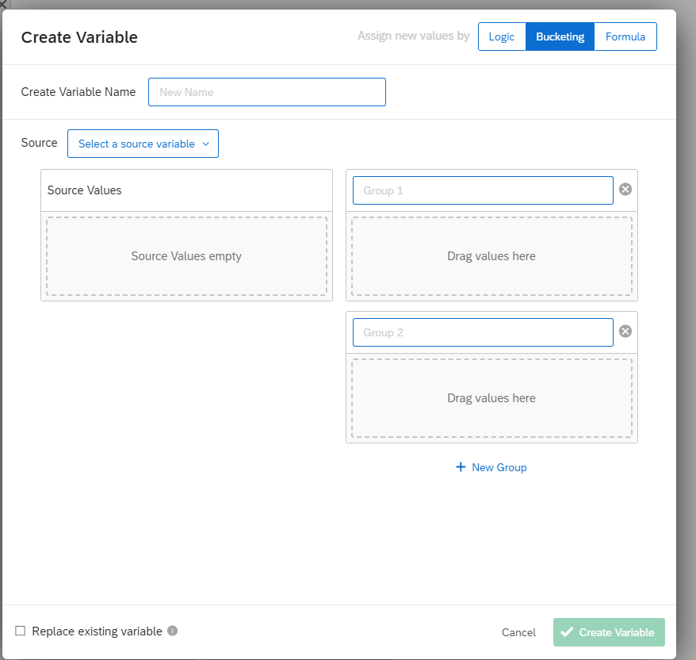
Cross Tab – Data options
Bucketing

Slide 55
Create Variable

Slide 56
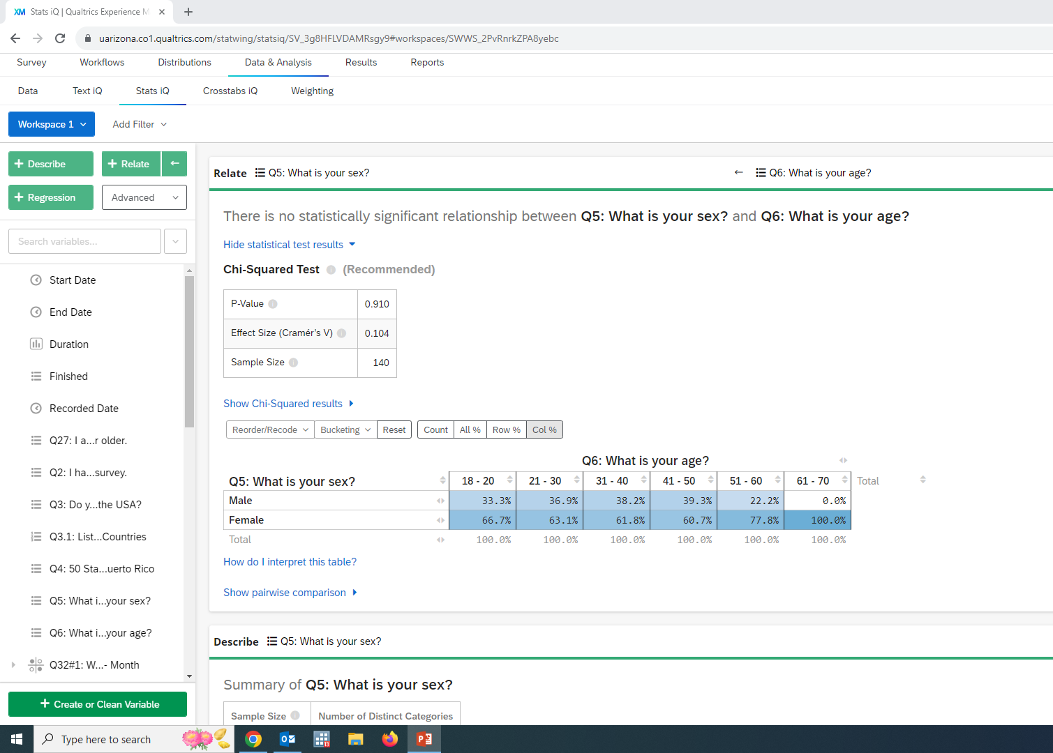
Cross Tab – StatsIQ

Slide 57
Cross Tabs > StatsIQ > Filters
- allows adding a condition
(i.e. only female or > 5
Notes:
Can make choices on how the data is examined (include or not include non-responses). Right hand corner, can export cross tab to Excel or *pdf

Slide 58
Qualtrics Project Menu

Slide 59
Data & Analysis > Export

Slide 60
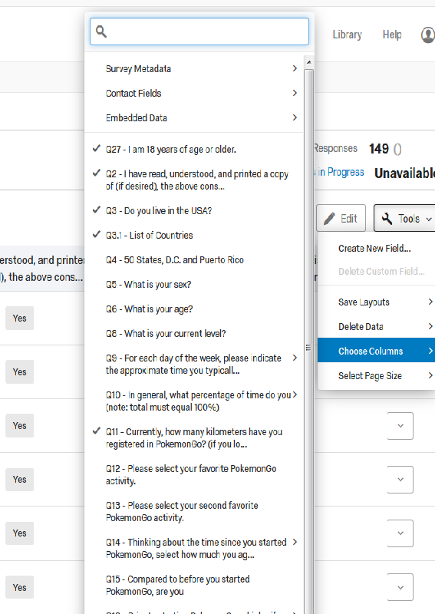
Data & Analysis
Export
Choose Columns

Slide 61
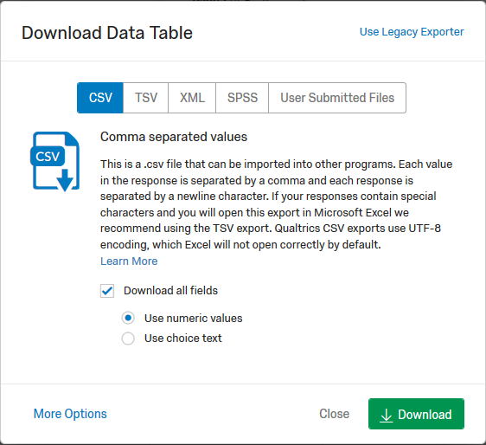
Data & Analysis > Export
Notes:
Again, most statistical programs need data in numeric format. Select number and the file type you want. Also select MORE OPTIONS

Slide 62
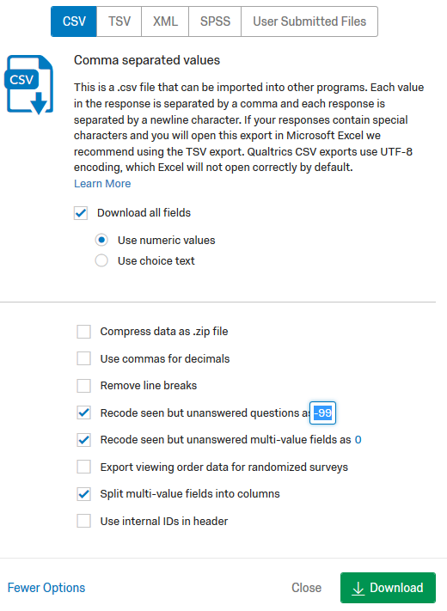
Export
Can recode missing values to the option of your choosing. Select “Recode” then select the box and change if you don’t want to use “-99”
Ensure each field is a single variable. Select “Split multi-value fields into columns”.
Notes:
Recommend having a specific code for missing (non-responses) to readily differentiate from “0”.
Also – each field should be a single variable. Select the option “Split multi-value fields into columns”.

Slide 63
Data & Analysis > Export
Once you have made all your choices, select Download
Notes:
Again, most statistical programs need data in numeric format. Select number and the file type you want. Also select MORE OPTIONS

Slide 64
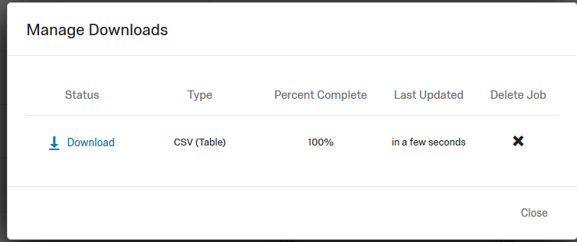
Notes:
If you selected CSV or Excel, you will be asked if you want to Open with Microsoft Excel (assuming you did not alter that default on your computer).
Please note – particularly with Excel – always SAVE your original file and then open a copy to view or manipulate. CSV or Excel can be readily imported into SAS or Stata, can download a SPSS file directly from Qualtrics.

Slide 65
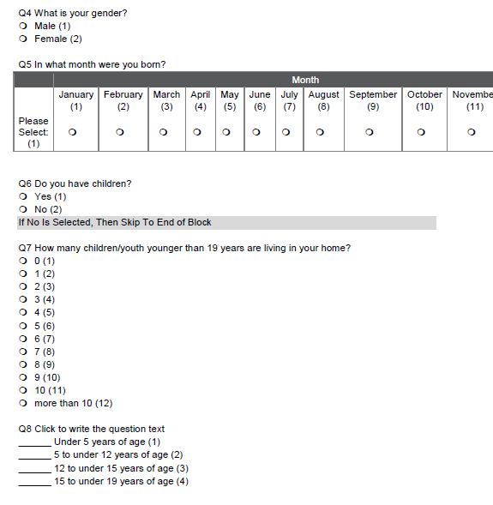
Remember you can go back to Project and download the survey for your Data Dictionary.
Codes
Skip or Display logic

Slide 66
Steps
Plan analyses as plan survey
Print (word) - IRB & Data Dictionary
Reports – summarize results
Download for Analysis

Slide 67
Questions?

